Slide 1



ROUTEVIEWS
Global BGP Collector for Operators and Research
Presented by Greg Shepherd
shep@routeviews.org

Slide 2

ROUTEVIEWS
NSRC
A collaborative router looking glass to share BGP views among network operators and researchers.
RouteViews was founded at the University of Oregon’s Advanced Network Technology Center (ANTC) in 1995. Data archives began in 1997 and amount to 50TBs (compressed) today.
The group is currently led by the Network Startup Resource Center (NSRC) group engineering team at the University of Oregon
  NSRC supports the growth of global Internet infrastructure by providing engineering assistance, collaborative technical workshops, training, and other resources to university, research & education networks worldwide. NSRC is partially funded by the IRNC program of the NSF and Google with other contributions from public and private organizations.
UNIVERSITY OF OREGON
The University of Oregon is a public research institution in Eugene, Oregon, USA founded in 1876. UO is renowned for its research prowess and commitment to teaching. Both NSRC and RouteViews are based at the UO.

Slide 3
Why Routeviews?
It’s YOUR Internet
Originally conceived in 1995 as a tool for Internet operators to look at the BGP table from different backbones and locations around the world to troubleshoot and to asses:
  reachability, hijacks, peer visibility, mass withdrawals, and RPKI status
Operators who find it a valuable tool also peer to contribute to the value
The 26-year data-set of BGP information archived by RouteViews since 1997 has become an invaluable research resource
  RouteViews data has been used in over 1000 research papers.
  http://www.routeviews.org/routeviews/index.php/papers/

Slide 4
RouteViews Impact
Geoff Huston wrote in his report, “BGP in 2022 – the routing table”:
“I should take a moment to mention the Route Views Project. It was originally intended to offer a multi-perspective real-time view of the inter-domain routing system, allowing network operators to examine the current visibility of route objects from various points in the inter-domain topology.
What makes Route Views so unique is that it archives these routing tables every two hours and has done so for more than two decades. It also archives every BGP update message. This vast collection of data is a valuable research data source in its own right, and here we are just taking a tiny slice of this data set to look at longer-term routing growth trends.
The folk at the Route Views Project, with support from the University of Oregon and the US National Science Foundation, should be commended for their efforts here. This is a very unique data set if you are interested in the evolution of the Internet over the years.”

Slide 5
RouteViews Impact
Aftab Siddiqui:
"The MANRS Observatory relies heavily on BGPStream and GRIP for the detection of BGP related incidents such as BGP Leakss and BGP mis-origination. It is also very critical to verify that any incident highlighted by these services can be verified independently and to do that we require raw BGP data which is made available by 2 sources: RIPE RIS and Route Views. Diversity of data sources is once again very important to verify any such incidents. NSRC, which manages the Route Views project, ensures that the routing data they provide is accurate and they have promptly addressed any issues or concerns raised by the MANRS team, whether it is related to changes in the MRT format causing problems in data parsing or helping with BMP data. Actively maintaining Route Views provides community service by NSRC.
MANRS has gained a lot of good reputation in the community due to the support and expertise provided by its partners such as NSRC. NSRC included MANRS Action explanation and implementation guidelines in their training courses for network operators and R&E networks, in their technical video content, and has been promoting various MANRS programs to respective communities specifically in Asia Pacific and Africa where the MANRS participation is low as compared to other regions.”

Slide 6
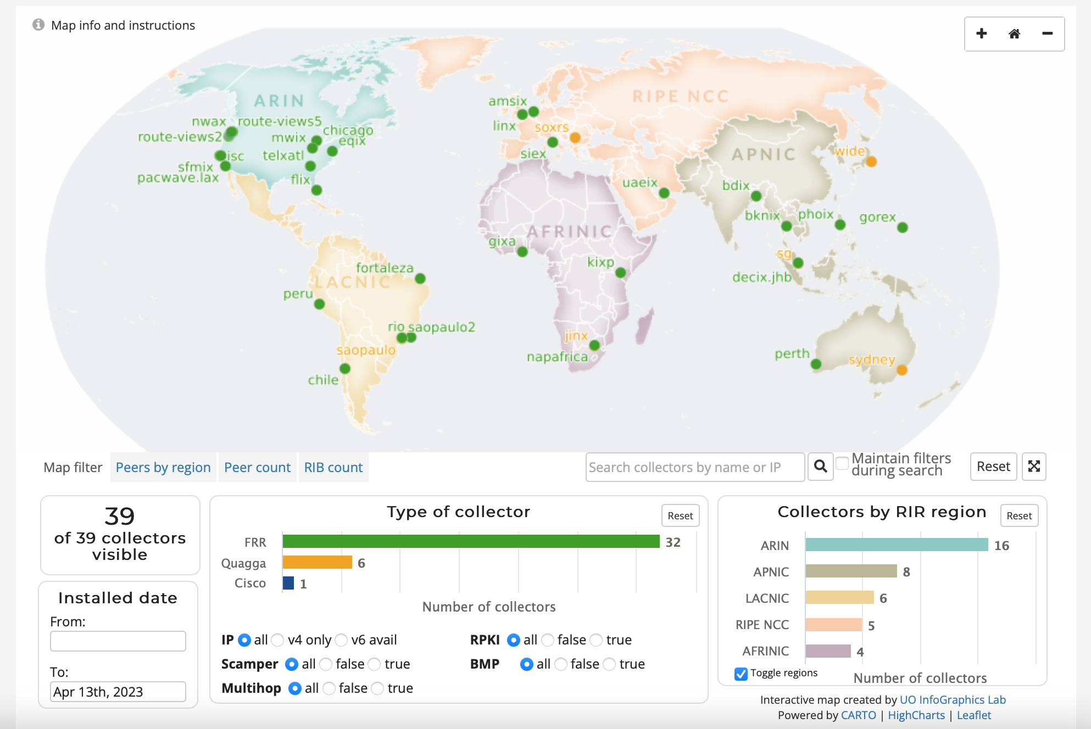
Routeviews Collector Map
http://www.routeviews.org/routeviews/index.php/map/

Slide 7
COLLECTOR DEPLOYMENT
Physical
  Off the shelf hardware.
  Shipped to the IX.
  Least preferred.
  Much quicker deployment time.
  Easier to upgrade.
Virtual

Slide 8
Collectors
Hardware
Software
Commodity
8-16 Cores
32G-64G Ram
400GB-1TB SSD
10 GB eth
OpenSource
Linux/Centos and…
Quagga – bgpd
FRR – bgpd
Gobgpd
OpenBMP
GoBMP

Slide 9
Collector Deployment
Multi-hop
  Pros:
    If you can reach the collector, you can peer.
  Cons:
    Multi-hop peerings are subject to the routing anomalies RouteViews seeks to observe and archive.
IX-Hosted/co-located
  Pros:
    Better positioned to address multi-hop issues.
    Geographic diversity.
    Peering diversity.
    Scalable.
  Cons:
    More infrastructure to manage.

Slide 10
Collector Data
Multi-Threaded Routing Toolkit (MRT)
https://tools.ietf.org/html/rfc6396
MRT provides a standard for parsing or dumping routing information to a binary file.
RouteViews Dumps consist of BGP RIBs and UPDATES
  RIBs are archived every 2 hours
  UPDATEs are archived every 15 minutes
Data Access
MRT files are bzipped and rsynced back to http://archive.routeviews.org/ on above schedule
They can be accessed via, http, ftp and rsync
Map view tool is interactive
Direct BMP Feed
New Model
BMP upstream from collectors, not FROM peers

Slide 11
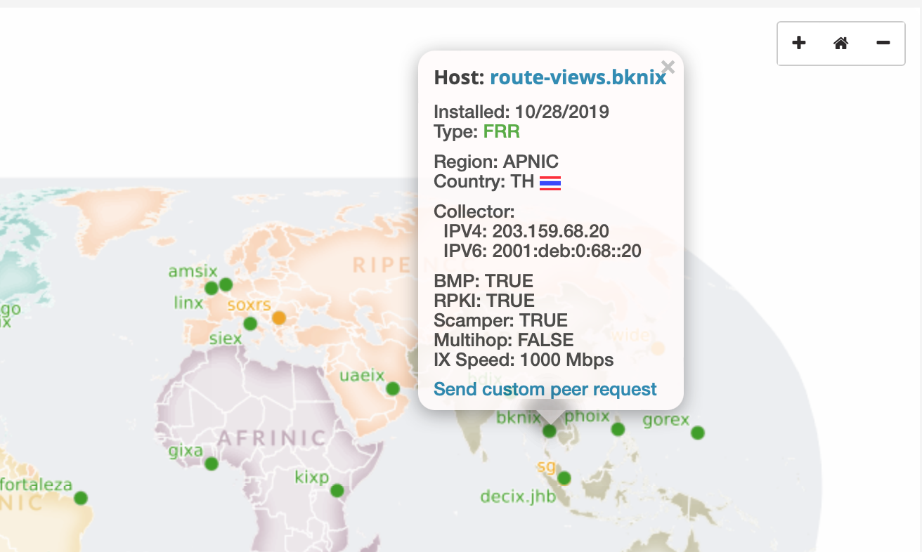
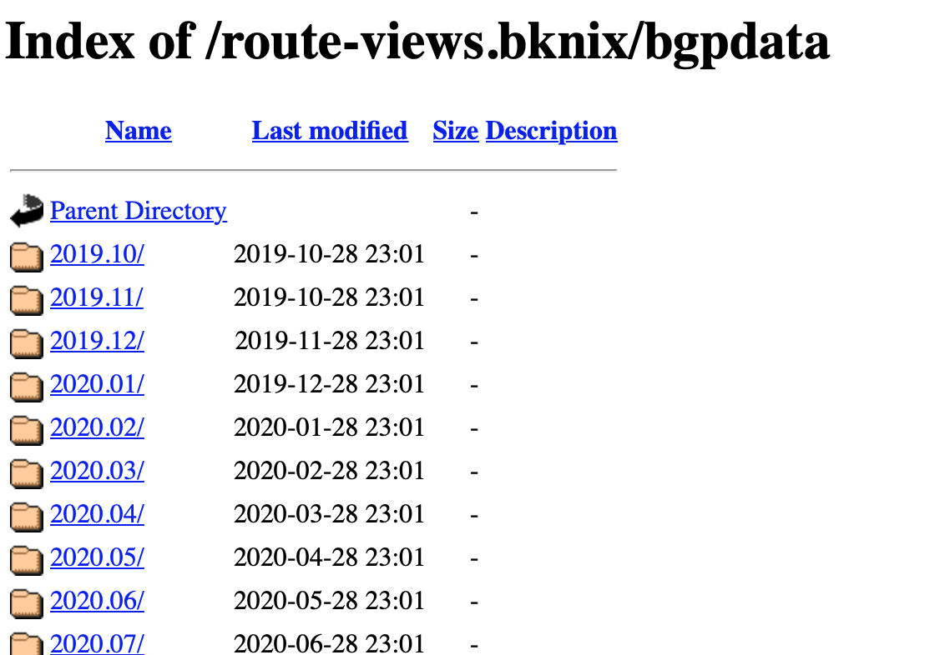
Collector Data
http://archive.routeviews.org/route-views.bknix/bgpdata/

Slide 12
MRT Tools
RIPE libbgpdump, UCLA BGP Parser, NTT bgpdump2, etc.
    https://bitbucket.org/ripencc/bgpdump/wiki/Home
    https://github.com/cawka/bgpparser
    https://github.com/yasuhiro-ohara-ntt/bgpdump2
    https://github.com/t2mune/mrtparse (python)
    https://github.com/rfc1036/zebra-dump-parser (perl)

Slide 13
NEW COLLECTOR FEATURES
BMP
  BMP data will feed tools like BGPStream and ARTEMIS.
  Or write your own Kafka consumer for raw BMP data.
  Limited access at first.
  Wider availability to follow.
  RPKI data will be accessible directly from the collectors.
  We also are establishing an archive of RPKI ROA data.
  Working on back-filling that data set from the RIR/CAs.
RPKI

Slide 14
PEERING HowTo
BGP Configuration
Send full-table if you can
Remove default route
Remove NULL routes
Remove RFC-1918 addresses
We don’t accept ADD-PATH TX/RX
We don’t send any routes back
When peering with multi-hop collectors, set ebgp-multihop

Slide 15
Use Cases
Operations
BGP is the backbone of the Global Routing Infrastructure.
To ensure its stability, it needs to be constantly monitored.
RouteViews provides:
  Command-Line/ Looking Glass
  Prefix Visibility, Verify Convergence, Path Stability
  Comparing Local/Regional/Global Views
  Troubleshooting Reachability
  Access to historical BGP data, ie “When did this happen??”

Slide 16
Use Cases
Accessing a Collector
telnet://route-views*.routeviews.org
No username necessary.
Users are able to run show commands, e.g. show ip bgp x.x.x.x/
Telnet access is rate-limited to prevent automation overuse
PLEASE don’t script. There is an API for that.
Gotchas
Why not SSH?!
  RouteViews data is publicly available. We’ve got nothing to hide.
show ip route x.x.x.x next-hop is incorrect!
  Remember, this is a collector
  There’s no data-plane, thus no true FIB
  Kernel default-route points to transit provider next-hop

Slide 17
Use Cases
Operations
Worldwide CLI access – how to access a collector
telnet://route-views.routeviews.org
  route-views, route-views{2,3,4,6} are all housed at University of Oregon in the United States, and each collector has eBGP Multihop sessions with peers from around the world
Legacy Naming Scheme
  telnet://route-views.bknix.routeviews.org
  Other collector locations accessible via these 3rd level domains (replace “bknix”): saopaulo, saupaulo2, telxatl, jinx, napafrica, perth, soxrs, eqix, nwax, sg, sfmix, flix, amsix, chicago, chile, isc, sydney, mwix, kixp, & wide
New Naming Scheme
  (exchange).(closest airport).routeviews.org
  ie: decix.jhb.routeviews.org - Malaysia IX, JHB airport

Slide 18
USE CASES
OPERATIONS
route-views.bknix.routeviews.org> sh ip bg sum
IPv4 Unicast Summary (VRF default):
BGP router identifier 203.159.68.20, local AS number 6447 vrf-id 0
BGP table version 58060
RIB entries 2141, using 401 KiB of memory
Peers 6, using 4345 KiB of memory
Neighbor V AS MsgRcvd MsgSent TblVer InQ OutQ Up/Down State/PfxRcd PfxSnt Desc
203.159.68.1 4 63528 2 16880 197077 0 0 0 04w3d03h 3 0 BKNIX
203.159.68.2 4 63528 216945 197077 0 0 0 19w3d20h 3 0 BKNIX
203.159.68.5 4 63528 394163 394153 0 0 0 19w3d20h 6 0 BKNIX
203.159.68.122 4 132280 414908 394155 0 0 0 14w5d19h 518 0 Symphony
203.159.68.130 4 16509 441589 394152 0 0 0 19w3d20h 652 0 Amazon.com
203.159.68.131 4 16509 441609 394152 0 0 0 19w3d20h 652 0 Amazon.com
Total number of neighbors 6
route-views.bknix.routeviews.org>
Only 6 peers currently
Not full routes.. :(

Slide 19
USE CASES
ThaiNOG event prefix
OPERATIONS
route-views>sh ip bgp 103.120.115.0/28 short
BGP table version is 15689777, local router ID is 128.223.51.103
Status codes: s suppressed, d damped, h history, * valid, > best, i - internal,
r RIB-failure, S Stale, m multipath, b backup-path, f RT-Filter,
x best-external, a additional-path, c RIB-compressed,
Origin codes: i - IGP, e - EGP, ? - incomplete
RPKI validation codes: V valid, I invalid, N Not found
Network Next Hop Metric LocPrf Weight Path
V* 103.120.112.0/22 206.24.210.80 0 3561 209 3356 9002 9304 135419 i
V* 194.85.40.15 0 0 3267 1299 15412 9304 135419 i
V* 208.74.64.40 0 19214 174 9304 135419 i
V* 217.192.89.50 0 3303 9304 135419 i
V* 212.66.96.126 0 20912 3257 2914 9304 135419 i
V* 202.232.0.2 0 2497 9304 135419 i
V* 162.250.137.254 0 4901 6079 15412 9304 135419 i
V* 144.228.241.130 156 0 1239 9304 135419 i
…
Covered by /22

Slide 20
USE CASES
ThaiNOG IPv6 global reach
OPERATIONS
route-views>sh bgp ipv6 uni 2403:56c0:0522::/30 long
BGP table version is 8597067, local router ID is 128.223.51.103
Status codes: s suppressed, d damped, h history, * valid, > best, i - internal,
r RIB-failure, S Stale, m multipath, b backup-path, f RT-Filter,
x best-external, a additional-path, c RIB-compressed,
Origin codes: i - IGP, e - EGP, ? - incomplete
RPKI validation codes: V valid, I invalid, N Not found
Network Next Hop Metric LocPrf Weight Path
V* 2403:56C0::/32 2001:1860::223 0 101 6939 10089 135419 i
V* 2600:803::15 0 701 5511 45629 135419 i
V* 2001:1890:111D:1::63 0 7018 1299 10089 135419 i
V* 2A00:A7C0:E20A::17 0 57866 9002 45629 135419 i
V* 2A02:898:0:300::3 0 8283 1299 10089 135419 i
V* 2A02:D140:1::60 0 49788 12552 6939 10089 135419 i

Slide 21
USE CASES
OPERATIONS
77 peers, multi-hop
route-views2.routeviews.org> sh ip bg sum
IPv4 Unicast Summary (VRF default):
BGP router identifier 128.223.51.102, local AS number 6447 vrf-id 0
BGP table version 14375055
RIB entries 1786807, using 327 MiB of memory
Peers 77, using 54 MiB of memory
Neighbor V AS MsgRcvd MsgSent TblVer InQ OutQ Up/Down State/PfxRcd PfxSnt Desc
4.68.4.46 4 3356 0 7241 0 0 0 never Active 0 Level3
5.101.110.2 4 14061 0 0 0 0 0 never Connect 0 DIGITALOCEAN
12.0.1.63 4 7018 3986207 14643 0 0 0 01w3d04h 907452 0 ATT
37.139.139.17 4 57866 3740071 29283 0 0 0 01w3d04h 910247 0 Fusix
43.226.4.1 4 63927 0 0 0 0 0 never Connect 0 Rise
45.61.0.85 4 22652 3583124 29285 0 0 0 2d07h01m 911510 0 FIBRENOIRE
62.115.128.137 4 1299 9158678 14643 0 0 0 01w3d04h 883318 0 Telia
64.71.137.241 4 6939 3389354 14642 0 0 0 01w3d04h 933920 0 Hurricane Electric
64.71.255.61 4 812 0 0 0 0 0 never Connect 0 Sprint
66.185.128.1 4 1668 0 0 0 0 0 never Connect 0 AOL
67.219.192.18 4 19653 0 0 0 0 0 never Active 0 CTSTelecom
68.67.63.245 4 22652 0 0 0 0 0 never Active 0 FIBRENOIRE
80.241.176.31 4 20771 0 0 0 0 0 never Connect 0 CAUCASUS
85.114.0.217 4 8492 5173073 29285 0 0 0 4d09h09m 940862 0 OBITRU
87.121.64.4 4 57463 1247665 14641 0 0 0 01w3d03h 417683 0 NETIXLTD
89.149.178.10 4 3257 3545660 14643 0 0 0 01w3d04h 907675 0 Tiscali
91.209.102.1 4 39756 0 0 0 0 0 never Connect 0 HOSTWAY-RO
91.218.184.60 4 49788 5731466 14642 0 0 0 01w3d04h 913404 0 NEXTHOPNO
…
Total number of neighbors 77
Not all peers are up..
Lots of full tables

Slide 22
USE CASES
OPERATIONS
route-views2.routeviews.org> sh ip bgp 130.105.44.0/22
BGP routing table entry for 130.105.44.0/22, version 13607198
Paths: (29 available, best #25, table default)
Not advertised to any peer
22652 6453 23944
45.61.0.85 from 45.61.0.85 (184.95.245.30)
Origin IGP, valid, external, rpki validation-state: valid
Community: 6453:50 6453:3000 6453:3400 6453:3409
Last update: Mon May 8 01:08:57 2023
3130 1239 6453 23944
147.28.7.1 from 147.28.7.1 (147.28.7.1)
Origin IGP, valid, external, rpki validation-state: valid
Community: 1239:321 1239:1000 1239:1010
Last update: Mon May 8 01:56:35 2023
8492 31133 23944
…
37.139.139.17 from 37.139.139.17 (37.139.139.17)
Origin IGP, metric 0, valid, external, rpki validation-state: valid
Community: 6453:50 6453:3000 6453:3400 6453:3409 57866:100 65100:6453 65103:1 65104:31
Large Community: 57866:100:6453 57866:101:100 57866:103:1 57866:104:31
Last update: Mon May 8 01:57:01 2023
37100 23944
Communities set by peers
RPKI Validation State
Large Communities

Slide 23
USE CASES
OPERATIONS
route-views2.routeviews.org> sh ip bgp 45.235.208.0/22
BGP routing table entry for 45.235.208.0/22, version 1474520
Paths: (30 available, best #25, table default)
Not advertised to any peer
11686 52320 22381 22381 22381 22381 11432 11432 11432 11432 11432 11432 11432 11432 11432 11432 11432 11432 11432 11432 11432 11432 11432 11432 11432 11432 11432 11432 11432 268214
96.4.0.55 from 96.4.0.55 (96.4.0.55)
Origin IGP, valid, external, rpki validation-state: not found
Community: 11686:294
Last update: Tue May 9 04:34:01 2023
22652 4230 11432 268214
45.61.0.85 from 45.61.0.85 (184.95.245.30)
Origin IGP, valid, external, rpki validation-state: not found
Community: 4230:11 4230:30 4230:511 4230:5101
Last update: Sat May 6 08:05:45 2023
8492 31133 3356 268214 268214
85.114.0.217 from 85.114.0.217 (85.114.0.104)
Origin IGP, valid, external, rpki validation-state: not found
Community: 8492:1104 8492:1601
Last update: Thu May 4 05:57:42 2023
…
What is ASN:11432 trying to achieve by prepending 23 times??

Slide 24
USE CASES
OPERATIONS
ASn: 203905 ??
route-views2.routeviews.org> sh ip bgp rpki invalid
….
I* 212.193.8.0/24 168.209.255.56 0 3741 5511 6453 8551 203905 i
I* 194.153.0.253 0 5413 8551 203905 i
I* 45.61.0.85 0 22652 6453 8551 203905 i
I* 91.218.184.60 0 49788 12552 8551 203905 i
I* 198.129.33.85 710 0 293 6453 8551 203905 i
I* 212.66.96.126 0 20912 49367 6762 61135 61135 60446 204843 204843 204843 i
I* 202.232.0.3 0 2497 6453 8551 203905 i
I*> 85.114.0.217 0 8492 8551 203905 i
I* 203.189.128.233 0 23673 23764 8551 203905 i
I* 94.156.252.18 0 0 34224 6453 8551 203905 i
ASn: 204843 ??
Two ASN: of origin ??

Slide 25
USE CASES
OPERATIONS
WHOIS Lookup ( 212.193.8.0 )
inetnum: 212.193.8.0 - 212.193.8.255
netname: AjyalFiCompanyLLC
country: PS
admin-c: KB5060-RIPE
tech-c: KB5060-RIPE
status: ASSIGNED PA
abuse-c: AR68281-RIPE
mnt-by: lir-ae-rcstechnologies-1-MNT
mnt-by: interlir-mnt
created: 2023-01-12T18:31:35Z
last-modified: 2023-01-12T18:31:35Z
source: RIPE
Palestine

Slide 26
USE CASES
operations
WHOIS Lookup ( AS204843 )
…
organisation: ORG-SVMY1-RIPE
org-name: STERLY VERI MERKEZI YAZILIM VE SIBER GUVENLIK HIZMETLERI A.S.
country: TR
org-type: OTHER
address: KONAK MAH. BARIS(120) SK. OFIS ARTI BLOK NO:3 IC KAPI NO:10 NILUFER/BURSA
abuse-c: ACRO48320-RIPE
mnt-ref: ulasatakan
mnt-ref: bggroupittelecom-mnt
mnt-by: lir-tr-teknosos-1-MNT
mnt-by: Teknosos-TR
created: 2022-05-27T09:14:49Z
last-modified: 2022-12-01T17:27:16Z
source: RIPE # Filtered
From Turkey ??

Slide 27
USE CASES
operations
WHOIS Lookup ( AS203905 )
…
as-block: AS196608 - AS207419
…
admin-c: KB5060-RIPE
tech-c: KB5060-RIPE
status: ASSIGNED
mnt-by: RIPE-NCC-END-MNT
mnt-by: DigiComm-MNT
created: 2015-10-06T13:35:54Z
last-modified: 2023-02-04T17:55:17Z
source: RIPE # Filtered
organisation: ORG-DCL18-RIPE
org-name: Digital Communication Company for Telecommunications and Information Technology LTD
country: PS
org-type: LIR
address: Omar Al-Mokhtar st., Khaduir Building Floor #2
address: 9990300
address: Gaza Al-Remal
address: PALESTINE, STATE OF
From Palestine

Slide 28
USE CASES
OPERATIONS
ASN: 203905
route-views2.routeviews.org> sh ip bgp rpki invalid
….
I* 212.193.8.0/24 168.209.255.56 0 3741 5511 6453 8551 203905 i
I* 194.153.0.253 0 5413 8551 203905 i
I* 45.61.0.85 0 22652 6453 8551 203905 i
I* 91.218.184.60 0 49788 12552 8551 203905 i
I* 198.129.33.85 710 0 293 6453 8551 203905 i
I* 212.66.96.126 0 20912 49367 6762 61135 61135 60446 204843 204843 204843 i
I* 202.232.0.3 0 2497 6453 8551 203905 i
I*> 85.114.0.217 0 8492 8551 203905 i
I* 203.189.128.233 0 23673 23764 8551 203905 i
I* 94.156.252.18 0 0 34224 6453 8551 203905 i
ASn: 204843 Not valid origin ?
Miss-configuration? prefix Hijack??

Slide 29
OTHER BITS..
RouteViews email list
  https://lists.nsrc.org/listinfo/routeviews-users
  Also available on the Contact page at routeviews.org
  A place to ask question and receive updates on RouteViews activities.
  Hosted by the wonderful folks at NSRC.

Slide 30
Route Views
The Internet works because a lot of people cooperate to do things together.
Jon Postel

Slide 31
THANK YOU
Questions?

