Slide 1
The RouteViews Project: Update
Philip Paeps
TWNOG 2026
Last updated 15 May 2026

Slide 2
Background
RouteViews was first started in 1995
Now a growing network of 40+ collectors positioned strategically at Internet Exchange Points around the world
RouteViews collaborates with the Center for Applied Internet Data Analysis (CAIDA) working with NSF grants that support Designing a Global Measurement Infrastructure to Improve Internet Security, GMI3S (OAC-2131987), and an Integrated Library for Advancing Network Data Science, ILANDS (CNS-2120399).
RouteViews is supported with financial and in-kind donations by multiple organizations
RouteViews is based at the University of Oregon and operated by NSRC
NSRC supports the growth of global Internet infrastructure by providing engineering assistance, collaborative technical workshops, training, and other resources to university, research & education networks worldwide.
NSRC is partially funded by the IRNC program of the NSF (OAC-2029309) and Google with other contributions from public and private organizations.
The University of Oregon is a public research institution in Eugene, Oregon, USA founded in 1876.

Slide 3
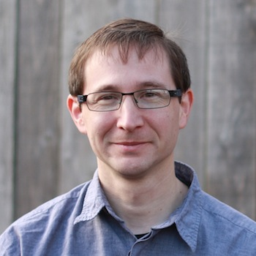

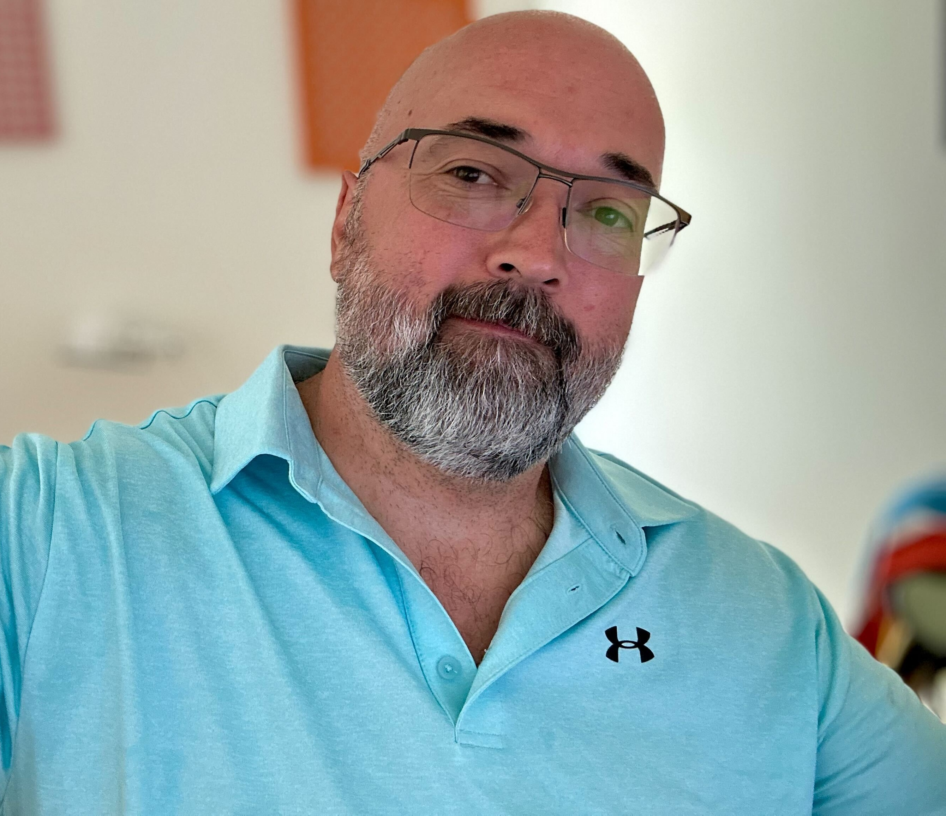


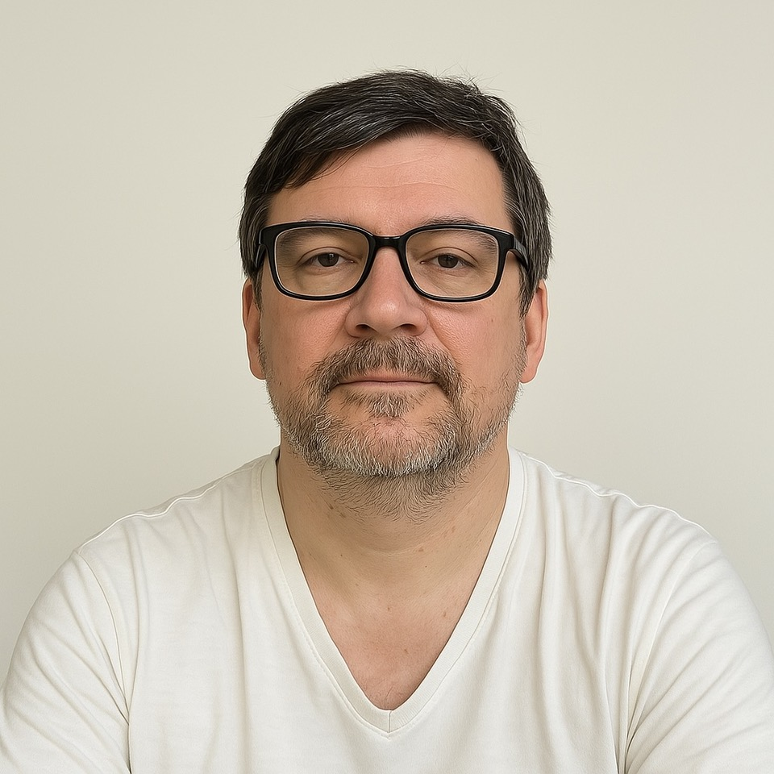
RouteViews Team Members
Hans Kuhn
Nina Bargisen
Owen Conway
Philip Smith
Philip Paeps
Anton Berezin

Slide 4
What is RouteViews
A tool that allows Internet network operators to look at the BGP table from different backbones and locations around the world to troubleshoot and to assess:
  Reachability, hijacks, bugs, peer visibility, mass withdrawals, RPKI status,…
Operators who find it a valuable tool also peer to contribute to the value
RouteViews operates collectors strategically positioned at IXPs around the world.
  It also hosts a few multi-hop collectors at UO for those operators who are not present at IXPs.

Slide 5
What is RouteViews
Many free and commercial tools used by network engineers every day include data from RouteViews
  CAIDA ASRANK
  CAIDA BGP Reader
  HE BGP Tools
  Kentik Market Intelligence
  Kentik BGP monitoring
  Catchpoint
  BGPMon
  And many more

Slide 6
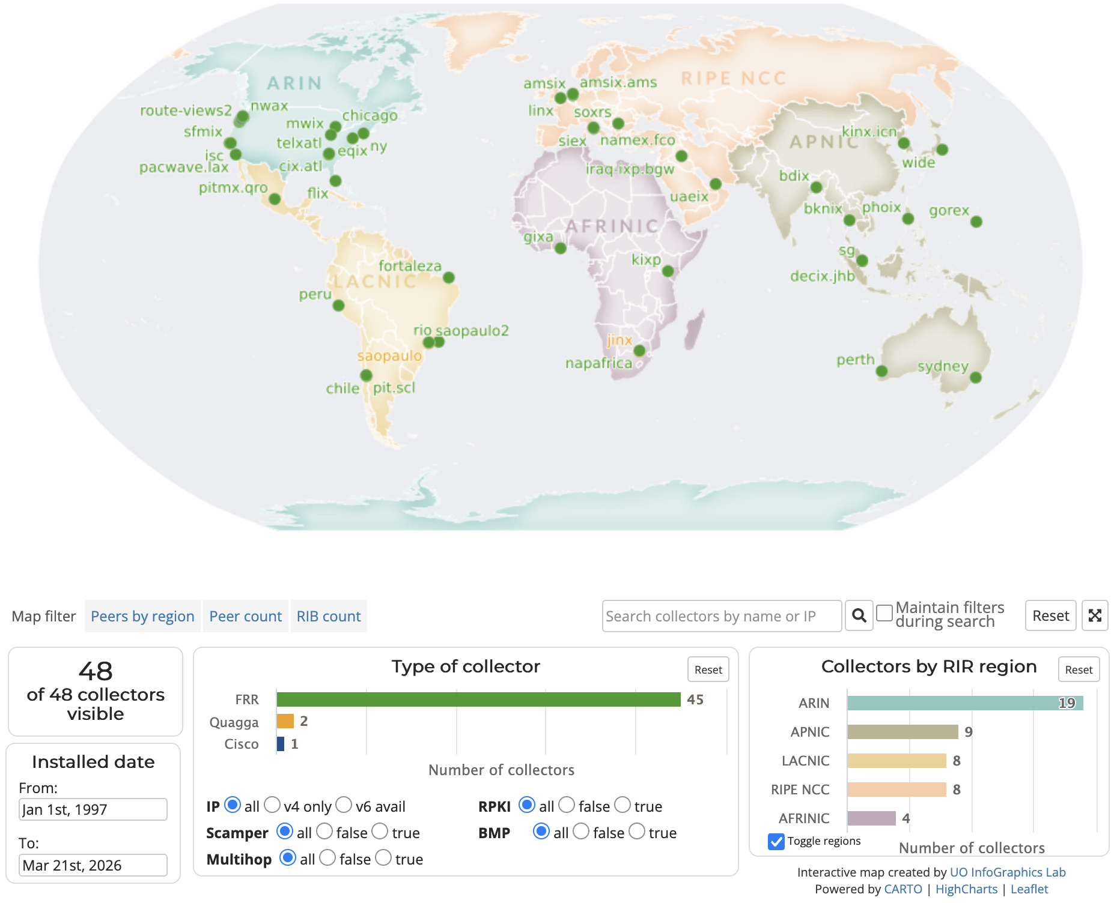
RouteViews Collector Map
https://www.routeviews.org/routeviews/map/
Note: Outdated map – modernised version will be released soon
Currently 55 collectors
Map doesn’t show locix.fra, crix.sjo, decix.fra, getafix.mnl, netnod.mmx, interlan.otp, hkix.hkg, iix.cgk, ixpn.los

Slide 7
Routeviews news
What’s happening at RouteViews

Slide 8
RouteViews News
Collectors:
  All software collectors use FRR¹ (version 10.5.1 where possible)
  One Cisco ASR1004 (as a tribute to the original!)
  Moving collectors from metal to VMs (easier deployment & management)
Location update:
  Most recent additions include Jakarta (IIX), San Jose (CRIX), Lagos (IXPN), Hong Kong (HKIX) and Frankfurt (DE-CIX & LOCIX)
¹FRRouting Project: https://frrouting.org/

Slide 9
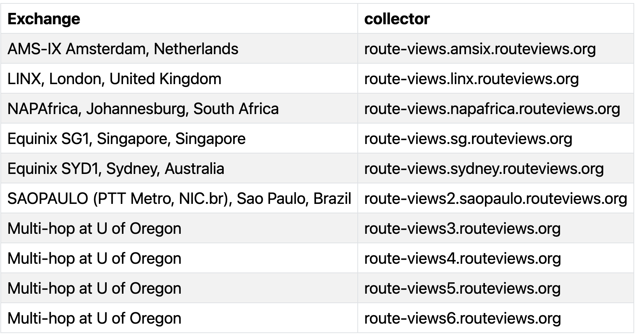
RouteViews Development Projects: API
API allows programmatic access to live RouteViews data
  (our collectors currently allow telnet access, which 1000s of automated scripts hammer daily)
Two access levels:
  Unauthenticated for casual (infrequent queries)
  Authenticated access (using verified PeeringDB users) for more serious research
API currently supports ten collectors
  More will be added as resources become available
Please consult the docs on how to use the API
  https://api.routeviews.org/docs/

Slide 10
RouteViews Development Projects: LG
telnet access is unsustainable
  Gives open access to the collector command line interface to run “show” commands
Looking Glass will soon become the default access for each collector
  Permits the most commonly used BGP diagnostic commands
  telnet remains available on route-views.routeviews.org (the Cisco ASR1004) for legacy access
Looking Glass can be found on https://lg.routeviews.org/lg/
  telnet access will be removed after due notice to the community

Slide 11
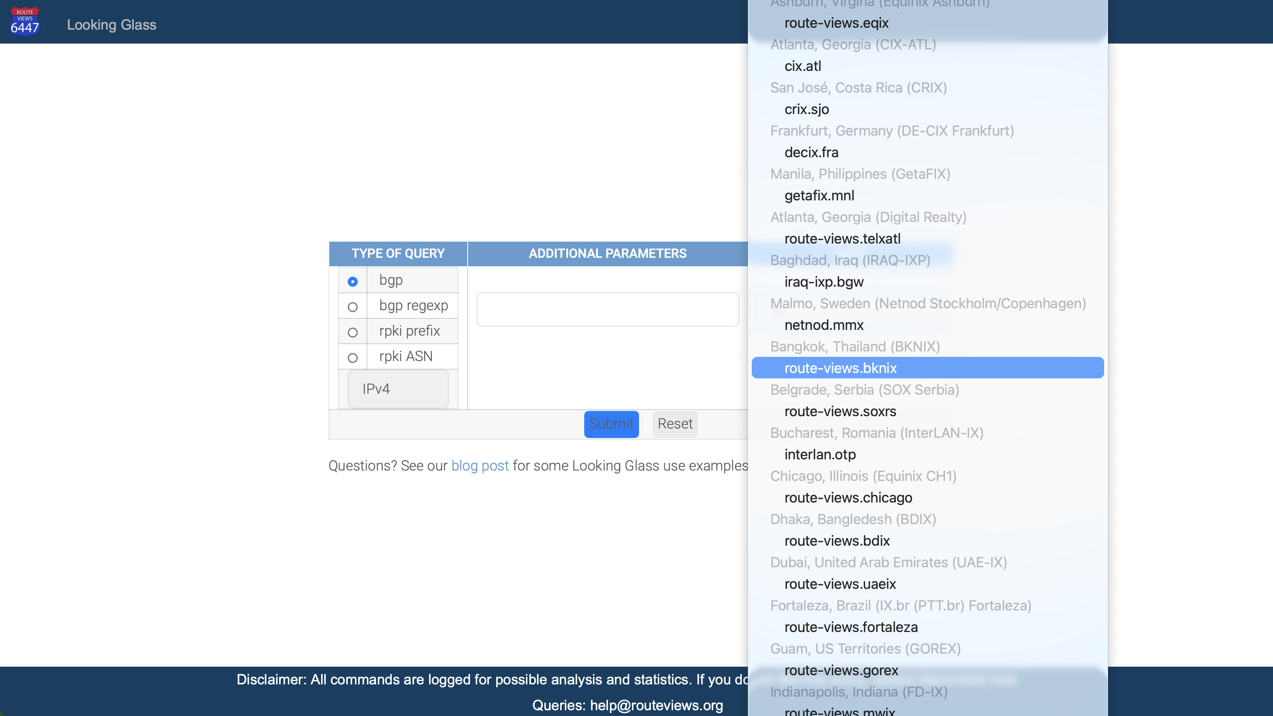
DEMO

Slide 12
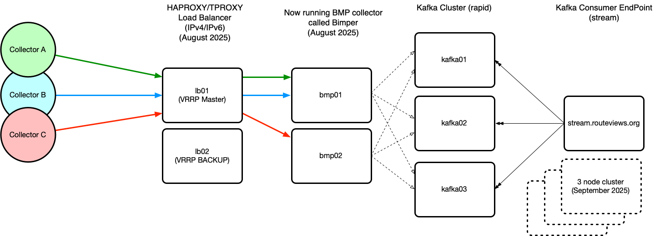
RouteViews Development Projects: BMP
Live feed from collectors for BGP data consumers
Challenge is to make this scale and provide the infrastructure resources to support
stream being replaced by kafka cluster for better resilience

Slide 13
RouteViews Behind the Scenes Projects
Upgrading archive infrastructure and storage
  RouteViews stores BGP data from 1997 – around 50 TBytes (compressed)
    https://archive.routeviews.org/ and https://archive2.routeviews.org/
Tooling
  Automation tools for managing the whole infrastructure and deploying new peers
Collector OS (from CentOS to Ubuntu)
  CentOS end-of-life – a few collectors still running CentOS
FRR performance
  Tuning Linux TCP parameters to improve BGP peer performance
    https://fasterdata.es.net/host-tuning/linux/
  “Badly behaving peers” (aka slow and/or noisy peers)

Slide 14
RouteViews Future Planning
Collectors & hosts in new locations outside North America
  Large IXPs with dense interconnection
  Unique or specialist environments (e.g. R&E exchanges)
Scalable and diverse archiving
RouteViews Peering Portal
Improved community support
  Running this infrastructure costs money!
  We hugely appreciate our generous supporters
    https://www.routeviews.org/routeviews/index.php/supporters/
Your recommendations are welcome! 🙏

Slide 15
Using routeviews
For network operators & researchers

Slide 16
Using RouteViews
Network Operators use the live data to analyse how their routes appear on the Global Routing System
Researchers use the 29-year-old data archive to study trends, route hijacks, and changes such as:
  Origin change
  Next-hop change
  New prefix / more specifics
  New neighbours
  Operator ASN appearing in a new transit path
  Bogons

Slide 17
RouteViews Use Cases: Peering Negotiation
Understanding your prospects connectivity can be key to a good negotiation
  Who are the upstreams?
  Who are the peers?
  Who are the customers?

Slide 18
Peering with routeviews
For Peering Coordinators

Slide 19
Peering with RouteViews
RouteViews has a Selective peering policy
  PeeringDB: https://www.peeringdb.com/asn/6447
We require all peers to have a PeeringDB entry
  Our tools build peering options (for IXP based collectors) and configurations from PeeringDB
Peering:
  Over IPv4 (for IPv4 prefixes) and IPv6 (for IPv6 prefixes)
  We want to receive the entire BGP table (if operationally possible)
  We do not send you any prefixes (please don’t ask)

Slide 20
Peering with RouteViews: General Requirements
Peer must operate stable equipment
  RouteViews will shutdown BGP sessions that impact the stability of the RouteViews platform
Peer must have a public routable ASN
Peer must not be a hobby network
Peer’s full view of the global routing table is preferred
Routes should be aggregated as much as possible
  (no longer than /24 for IPv4 and /48 for IPv6)
Peer must have up-to-date information in PeeringDB, including the NOC email address
Peer must filter RFC6890 space and must not send default routes
RouteViews does not accept addpath-RX or TX

Slide 21
Peering with RouteViews: IXP & Multihop
IXP Peering
We happily accept everyone's routes from the route servers.
We will set up bilateral sessions with anyone who meets the general requirements and will send us their full table.
We will peer at all mutual exchanges if requested.
Multihop Peering
We will accept multihop peers who are not on any mutual IXPs.
Peers must provide their full view of the Internet as they see it.
We accept two sessions for redundancy; more than two sessions can be set up if the feeds are sufficiently different.

Slide 22
Why a Selective Peering policy?
Balancing operational overhead, scale and information from the data
Hobby Networks
Full View of the Internet
What makes a peering interesting?
  Networks in regions where we have limited visibility
  Networks demonstrating new interconnection patterns
  Networks using innovative routing practices
  Networks that help us understand emerging market dynamics
  Or maybe something we haven’t thought about yet

Slide 23
R&E Routes
Dedicated R&E collector hosted by NSRC to support REN BGP statistics (managed by Philip Smith)
Daily or weekly REN routing table reports
See https://bgp.nsrc.org/REN/
Please send us your R&E routes!

Slide 24
SUPPORTING routeviews
How you can help

Slide 25
Supporting RouteViews
The project was started in 1995 because network operators wished to see what their BGP announcements looked like from an external viewpoint
  Thousands of network operators & researchers all around the world now rely on RouteViews
  Many everyday tools we all rely on use RouteViews data
  Many commercial products and services rely on RouteViews data

Slide 26
Supporting RouteViews
Please consider supporting RouteViews:
By peering with one of our collectors
By publicly acknowledging the value of the information we have collected
  For citations, our DOI is 10.7264/1y7v-2d90
If your product or service is commercially successful, we look forward to receiving your support to keep your product or service that way!
In any other way that helps keep this community service going

Slide 27
Consumers of RouteViews data
If you use RouteViews data for your products or services:
Please acknowledge the source!
  Your product or service likely would not work without our data!
Please do NOT send your customers of your products or services to us for technical support:
  We simply collect what is seen in the global routing table
  We cannot fix mistakes made by network operators
  We cannot fix bugs in BGP implementations
  We cannot remove BGP announcements we receive
  We cannot change what is seen in the global routing table

Slide 28
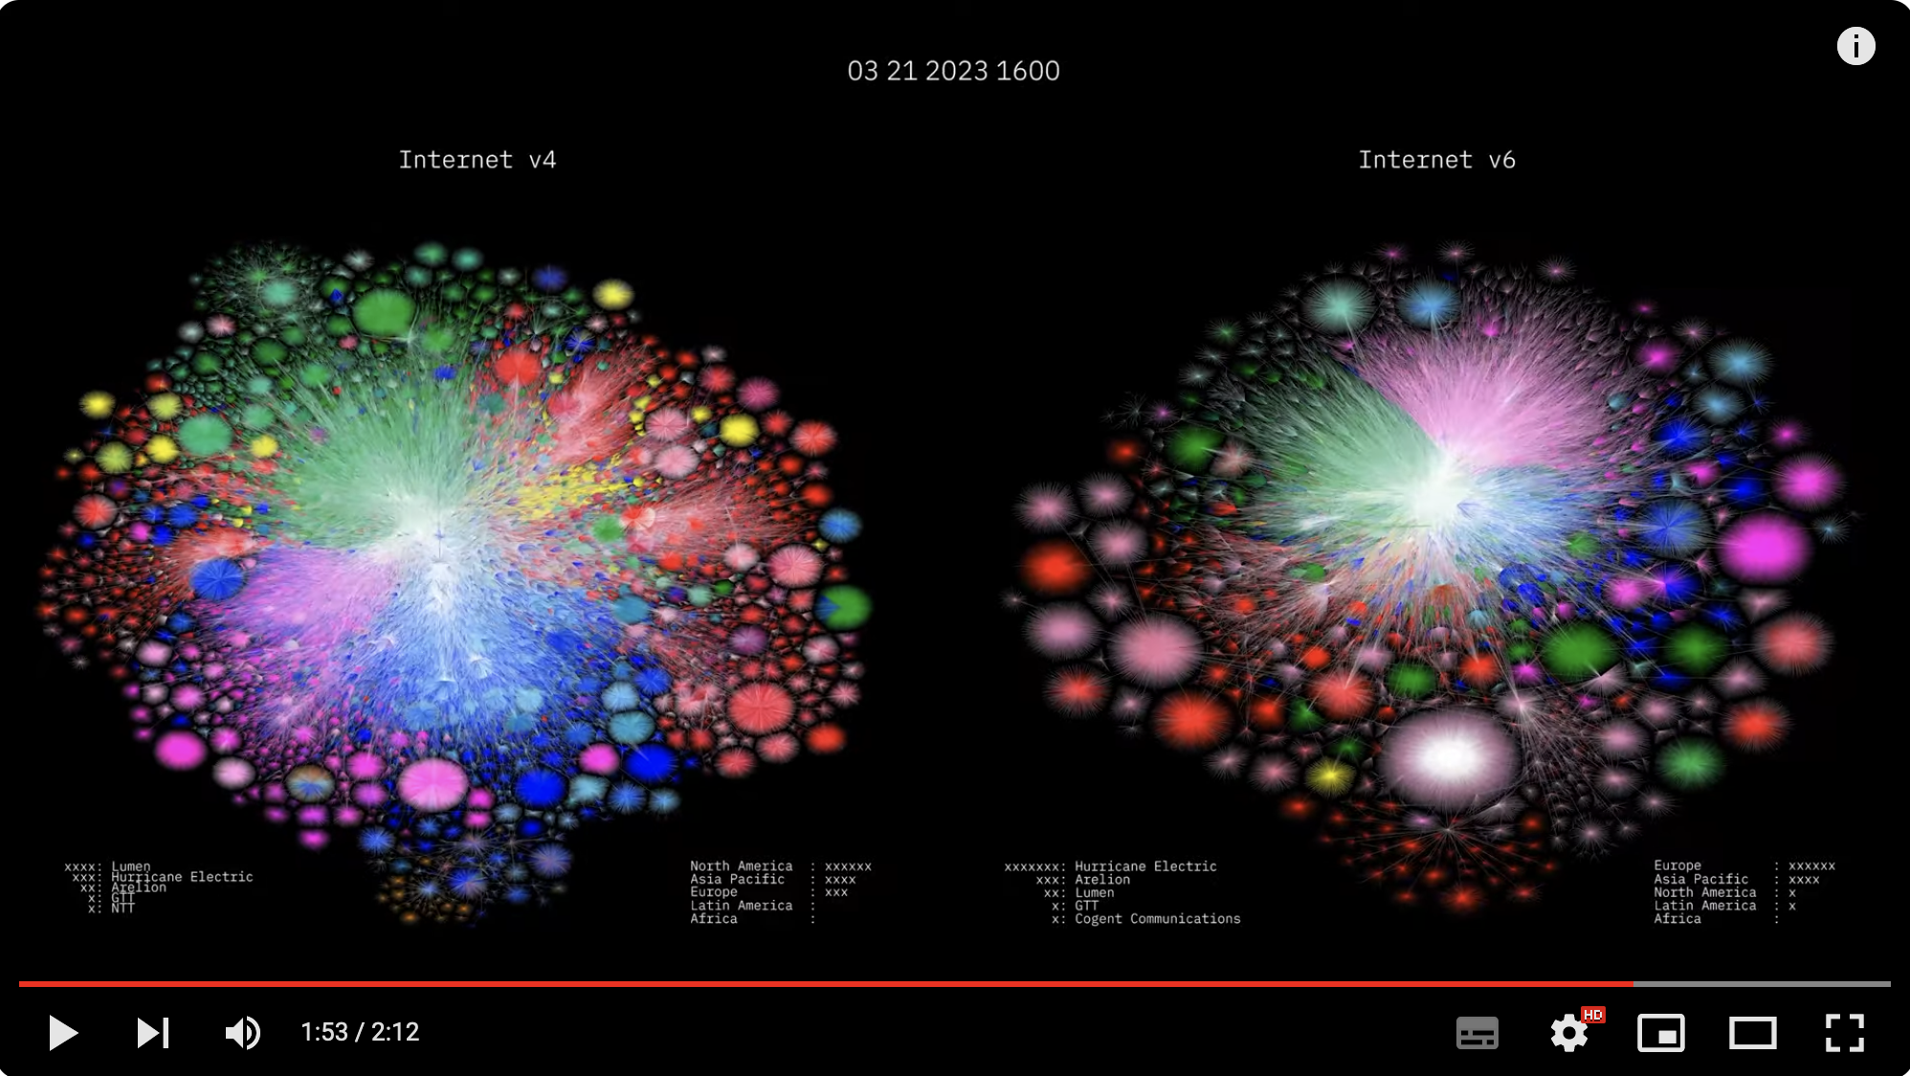
RouteViews Impact
Barrett Lyon: https://www.youtube.com/watch?v=vo5glK9czIE

Slide 29
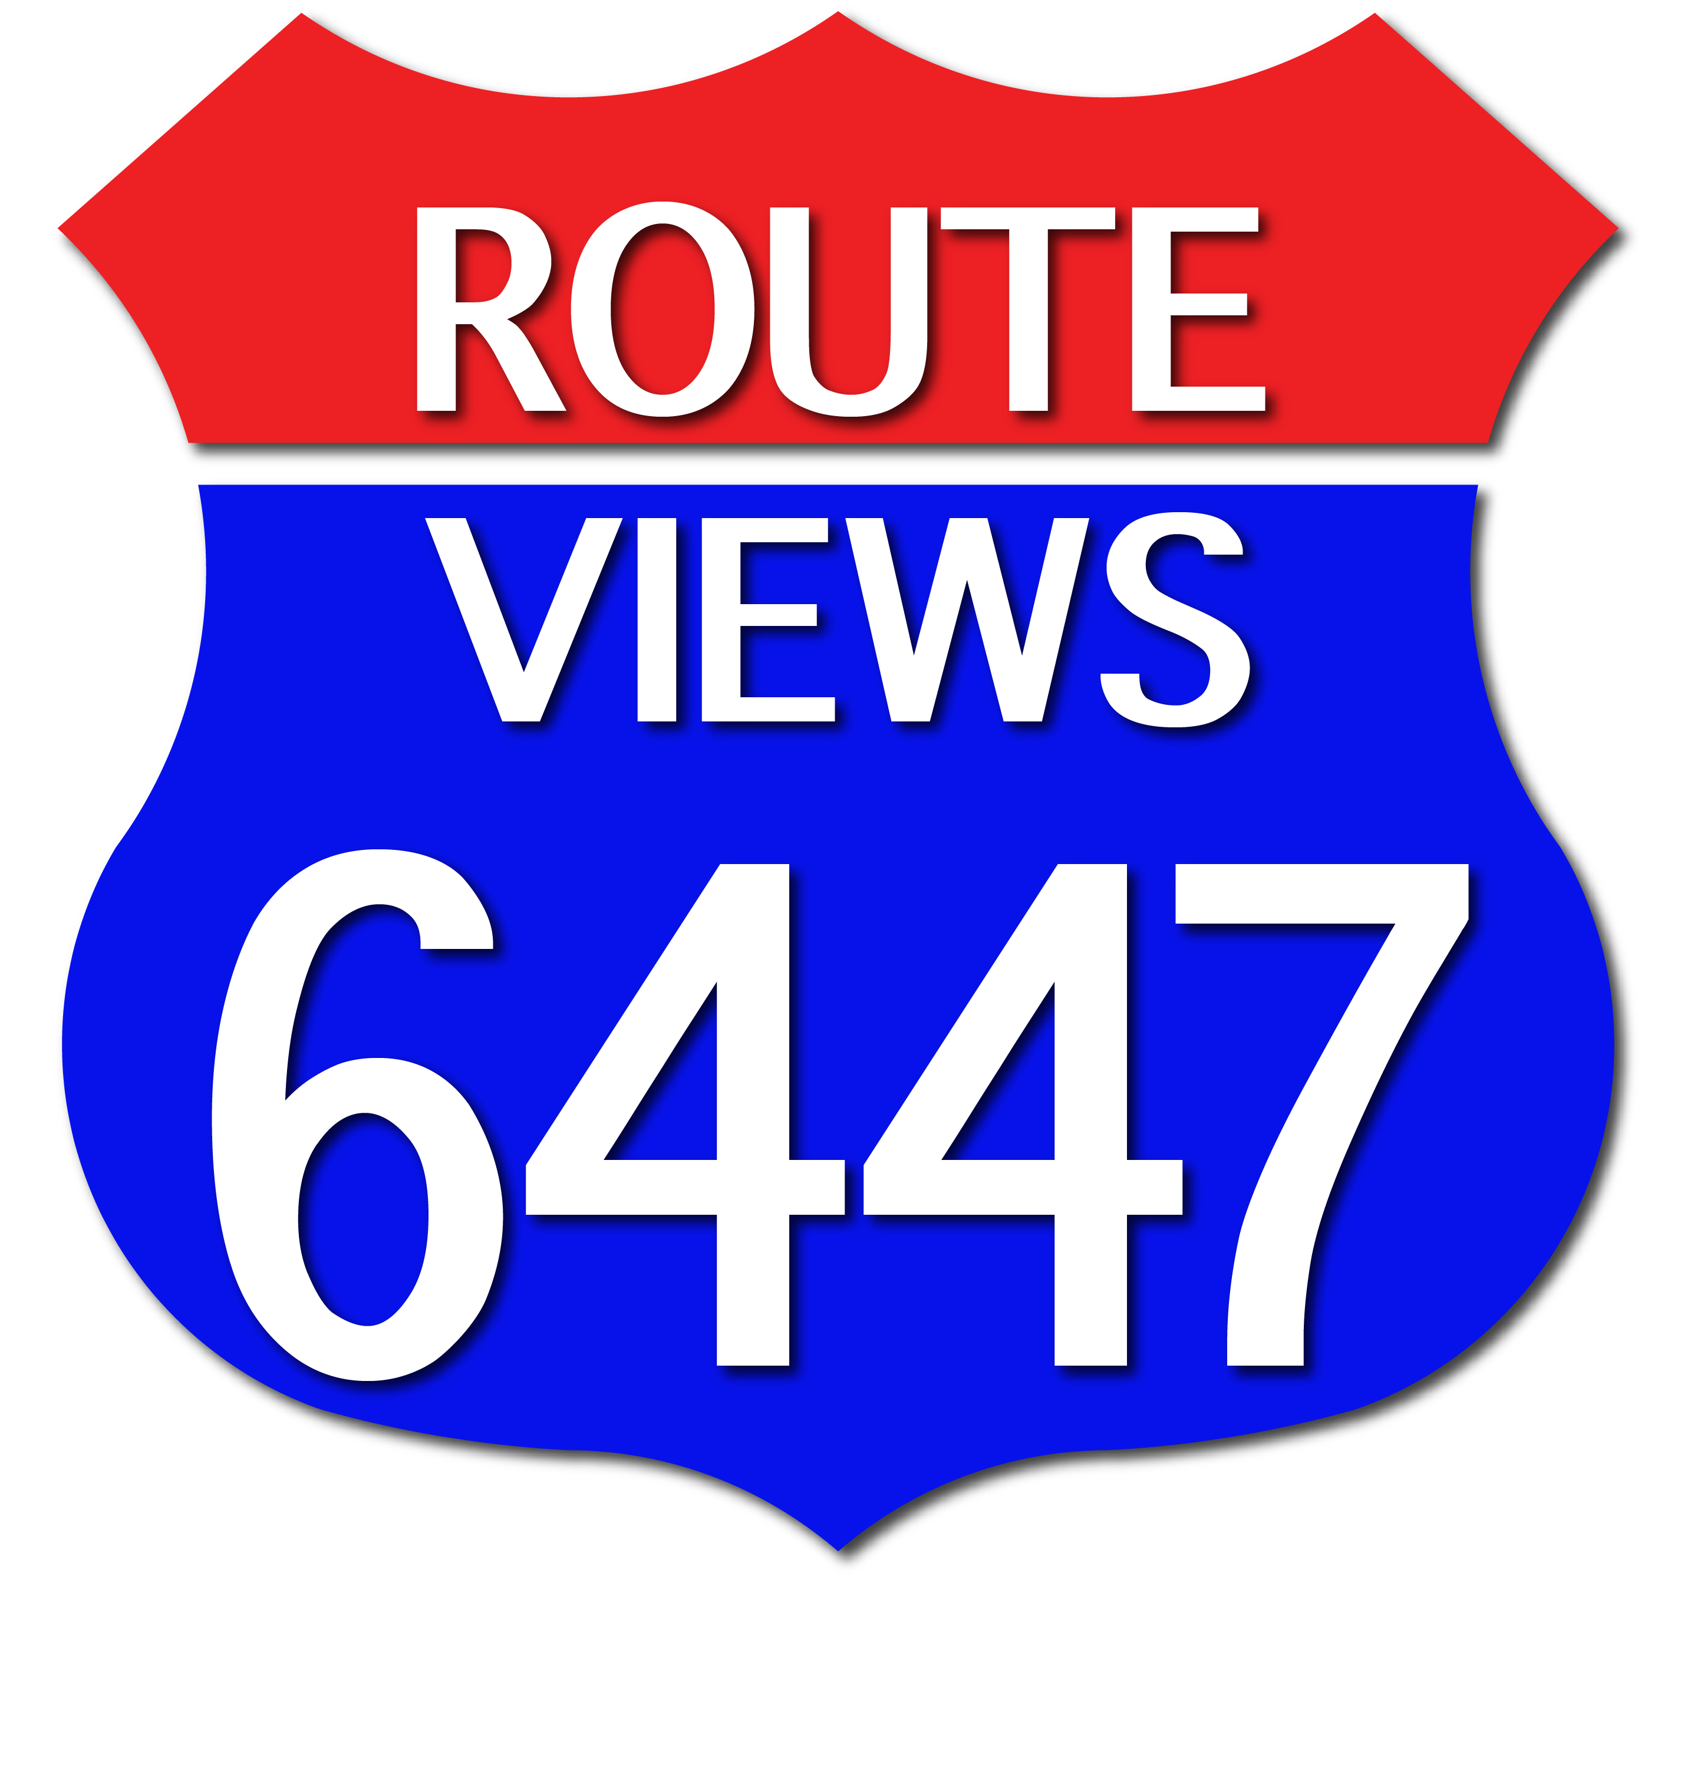
Thank you!

