Slide 1
The RouteViews Project: Update
Philip Paeps
philip@routeviews.org
TWNOG 6, Taipei
18 April 2025

Slide 2
Note to TWNOG PC
The data slides and ‘RouteViews News’ slides are from November 2024. They will be updated with the most recent information available before the presentation.
This can fit in 20–25 minutes. I can make this shorter though.

Slide 3
Background
RouteViews was first started in 1995
Now a growing network of 40+ collectors positioned strategically at Internet Exchange Points around the world
RouteViews collaborates with the Center for Applied Internet Data Analysis (CAIDA) working with NSF grants that support Designing a Global Measurement Infrastructure to Improve Internet Security, GMI3S (OAC-2131987), and an Integrated Library for Advancing Network Data Science, ILANDS (CNS-2120399).
RouteViews is supported with financial and in-kind donations by multiple organizations
RouteViews is based at the University of Oregon and operated by NSRC
NSRC supports the growth of global Internet infrastructure by providing engineering assistance, collaborative technical workshops, training, and other resources to university, research & education networks worldwide.
NSRC is partially funded by the IRNC program of the NSF (OAC-2029309) and Google with other contributions from public and private organizations.
The University of Oregon is a public research institution in Eugene, Oregon, USA founded in 1876.

Slide 4




RouteViews Team Members
Hans Kuhn
Nina Bargisen
Owen Conway
Philip Smith

Slide 5
What is RouteViews
A tool that allows Internet network operators to look at the BGP table from different backbones and locations around the world to troubleshoot and to assess:
  Reachability, hijacks, bugs, peer visibility, mass withdrawals, RPKI status,…
Operators who find it a valuable tool also peer to contribute to the value
RouteViews operates collectors strategically positioned at IXPs around the world.
  It also hosts a few multi-hop collectors at UO for those operators who are not present at IXPs.

Slide 6
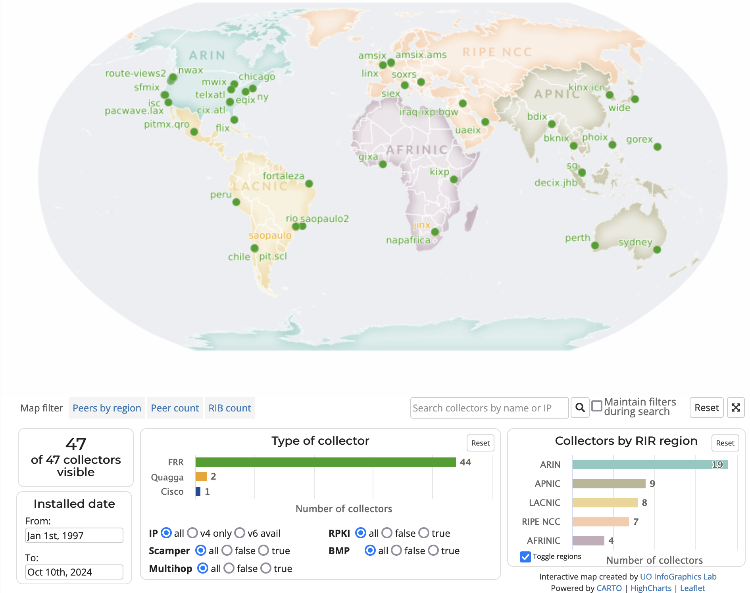
RouteViews Collector Map
http://www.routeviews.org/routeviews/index.php/map/

Slide 7
Routeviews news
What’s happening at RouteViews

Slide 8
RouteViews News
Collectors:
  The majority use FRR¹ (either version 9.1 or 10)
  One Cisco ASR1004 (as a tribute to the original!)
  Moving collectors from metal to VMs (easier deployment & management)
Location update:
  Recent additions include KINX, CIX-ATL, PacWave LAX, Iraq IX, PIT Mexico & Santiago, DE-CIX Johor Bahru
  Several new locations offered; resources required to fulfil those offers
¹FRRouting Project: https://frrouting.org/

Slide 9
RouteViews Development Projects
API
  Allow programmatic access to live RouteViews data
  (our collectors currently allow telnet access, which 1000s of automated scripts hammer on a daily basis)
LookingGlass
  telnet access is unsustainable
  Aim to making LookingGlass default access for each collector
    telnet available on one collector for legacy
BMP
  Live feed from collectors for BGP data consumers

Slide 10
RouteViews Behind the Scenes Projects
Months of ongoing effort:
Upgrading archive infrastructure and storage
  RouteViews stores BGP data from 1997 – around 50 TBytes (compressed)
Tooling
  Automation tools for managing the whole infrastructure and deploying new peers
Collector OS (from CentOS to Ubuntu)
  CentOS end-of-life – half the collectors still running CentOS
FRR performance
  Standardising on two latest releases, upgrading from old releases
  “Badly behaving peers” (aka slow peers)

Slide 11
RouteViews Future Planning
Collectors & hosts in new locations outside North America
  Large IXPs with dense interconnection
  Unique or specialist environments (e.g. R&E exchanges)
Scalable and diverse archiving
Improved community support
  Running this infrastructure costs money!
  We hugely appreciate our generous supporters
    https://www.routeviews.org/routeviews/index.php/supporters/
Your suggestions are very welcome! 🙏

Slide 12
Using routeviews
For network operators & researchers

Slide 13
Using RouteViews
Network Operators use the live data to analyse how their routes appear on the Global Routing System
Researchers use the 27-year-old data archive to study trends, route hijacks, and changes such as:
  Origin change
  Next-hop change
  New prefix / more specifics
  New neighbours
  Operator ASN appearing in a new transit path
  Bogons

Slide 14
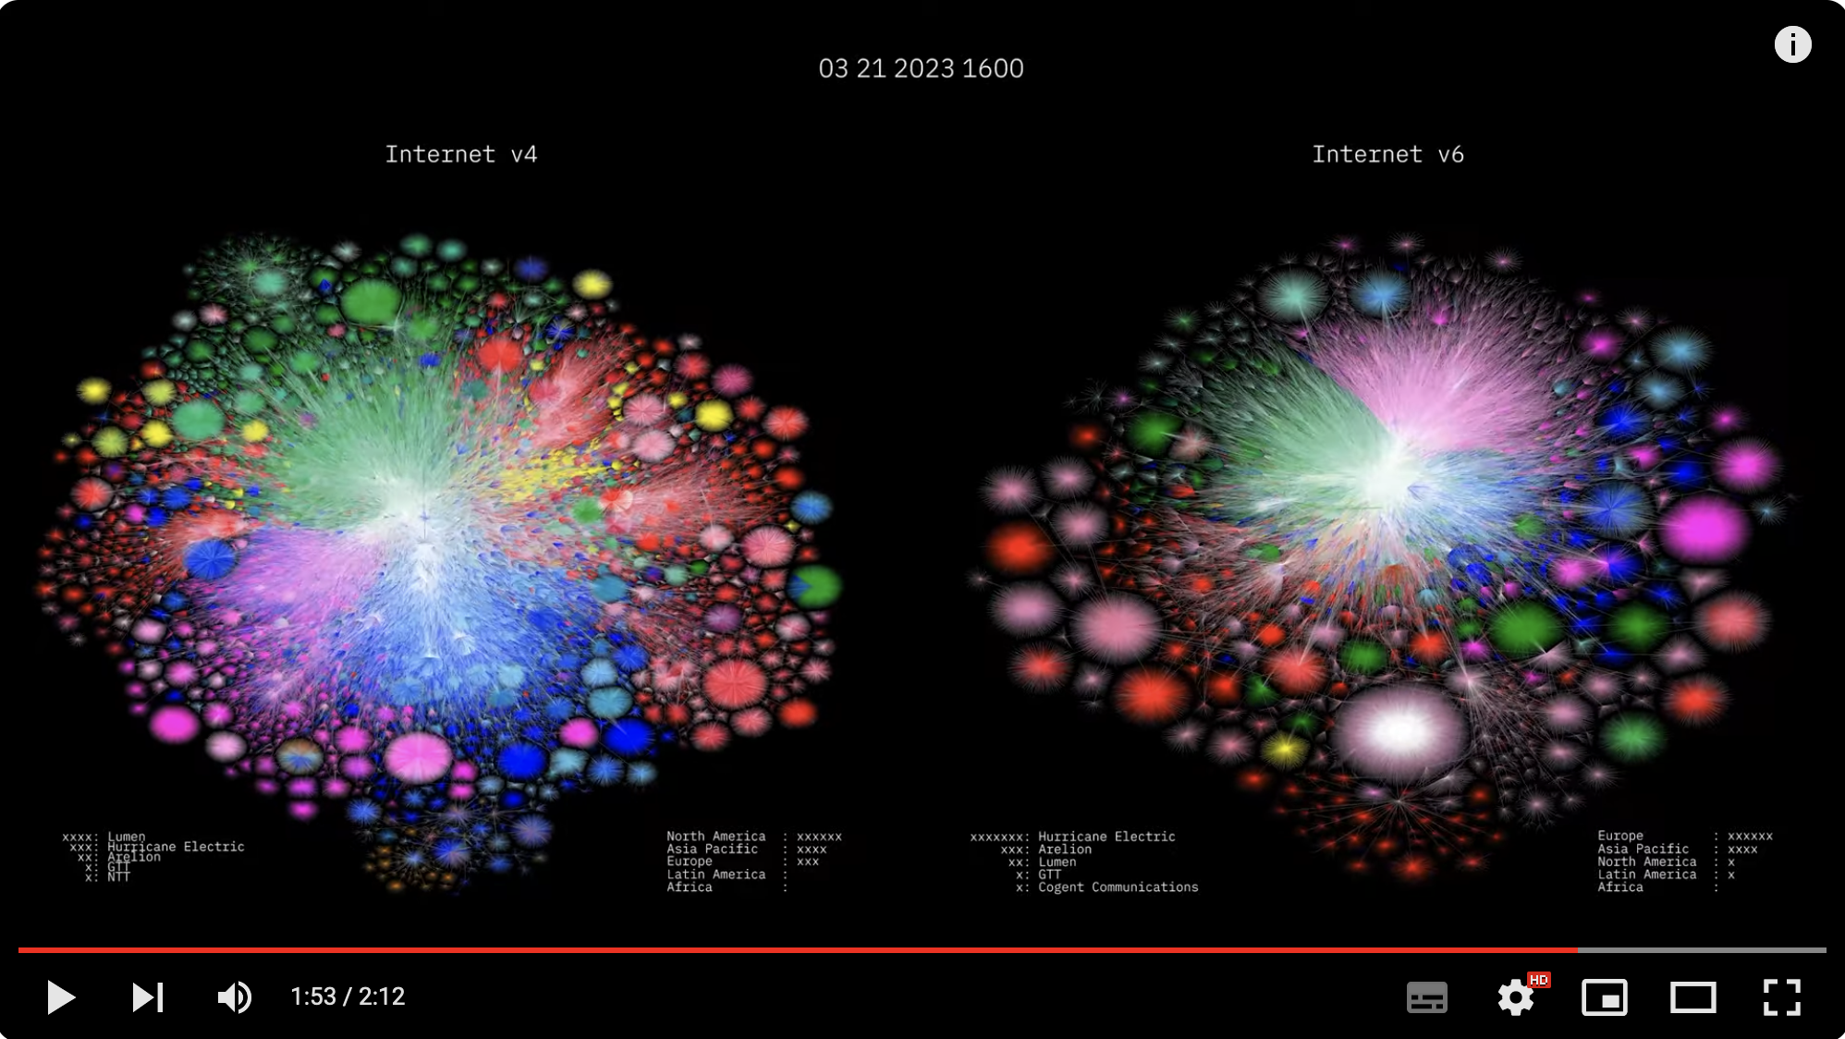
RouteViews Impact
Barrett Lyon: https://www.youtube.com/watch?v=vo5glK9czIE

Slide 15
Use Cases – Multihop Collector
32 peers, multi-hop
route-views2.routeviews.org> sh bgp sum
IPv4 Unicast Summary (VRF default):
BGP router identifier 128.223.51.102, local AS number 6447 vrf-id 0
BGP table version 2376140
RIB entries 1842070, using 169 MiB of memory
Peers 32, using 644 KiB of memory
Neighbor V AS MsgRcvd MsgSent TblVer InQ OutQ Up/Down State/PfxRcd PfxSnt Desc
12.0.1.63 4 7018 278377 377 2376140 0 0 06:14:18 938553 0 ATT
37.139.139.17 4 57866 281167 751 2376140 0 0 06:14:18 941733 0 Fusix
45.61.0.85 4 22652 430462 754 2376140 0 0 05:30:45 943602 0 FIBRENOIRE
62.115.128.137 4 1299 1145666 377 2376140 0 0 06:14:18 919817 0 Telia
64.71.137.241 4 6939 222621 376 2376140 0 0 06:14:18 961672 0 Hurricane Electric
77.39.192.30 4 20912 199676 2247 2376140 0 0 06:14:18 942334 0 PANSERVICE
87.121.64.4 4 57463 124693 375 2376140 0 0 06:13:35 483102 0 NETIXLTD
89.149.178.10 4 3257 301777 377 2376140 0 0 06:14:18 939075 0 Tiscali
91.218.184.60 4 49788 280255 376 2376140 0 0 06:14:18 943183 0 NEXTHOPNO
94.156.252.18 4 34224 365615 376 2376140 0 0 06:14:17 965856 0 NETERRA
105.16.0.247 4 37100 304500 746 2376140 0 0 06:11:16 942394 0 SEACOM
129.250.1.71 4 2914 267752 751 2376140 0 0 06:14:18 939523 0 NTT-A
137.164.16.84 4 2152 219827 376 2376140 0 0 06:14:18 941035 0 CENIC
140.192.8.16 4 20130 247609 751 2376140 0 0 06:14:18 964417 0 DEPAULEDU
144.228.241.130 4 1239 4442 377 2376140 0 0 06:14:17 45863 0 Sprint
147.28.7.1 4 3130 421 376 2376140 0 0 06:14:18 14 0 RGnet, LLC
Lots of full tables

Slide 16
Use Cases – Weird Announcements
route-views7.routeviews.org> sh ip bgp 45.181.4.0/24
BGP routing table entry for 45.181.4.0/24, version 54948963
Paths: (8 available, best #2, table default)
Not advertised to any peer
...
924 835 16735 53062 262698 269289
185.121.168.42 from 185.121.168.42 (10.20.30.40)
Origin IGP, valid, external, best (Older Path), rpki validation-state: not found
Community: 835:11103 924:90 924:601 924:690 16735:111 16735:7000 16735:7203 16735:53062 24115:16735 24115:24115 24115:65023
53062:10020 53062:10021 53062:30004 53062:30007 53062:30009 53062:30011 53062:30013 53062:30045 53062:30049 53062:30058
53062:30091 53062:30092 53062:30105 53062:30114 53062:30115 53062:30117 53062:30122 53062:30130 53062:30136 53062:30152
53062:30156 53062:30161 53062:30168 53062:30182 53062:30183 53062:30184 53062:30185 53062:30186 53062:30187 53062:30188
53062:30191 53062:30198 53062:30200 53062:30203 53062:30208 53062:30217 53062:30222 53062:30228 53062:30232 53062:30235
53062:30239 53062:30244 53062:30250 53062:30255 53062:30263 53062:30274 53062:30278 53062:30287 53062:30291 53062:30296
53062:30301 53062:30305 53062:30317 53062:30328 53062:30344 53062:30355 53062:30357 53062:30369
Large Community: 924:1:90 924:600:90 924:601:101 24115:1000:2 24115:1001:1 24115:1002:1 24115:1003:26 24115:1004:16735
53062:11:3692 53062:12:81 53062:13:48
Last update: Thu Jun 20 04:03:53 2024
37989 18106 263444 262316 269289 269289 269289 269289 269289 269289 269289 269289 269289 269289 269289 269289 269289 269289 269289
269289 269289 269289 269289 269289 269289 269289 269289 269289 269289 269289 269289 269289 269289 269289 269289 269289 269289
269289 269289 269289 269289 269289 269289 269289 269289 269289 269289 269289 269289 269289 269289 269289 269289 269289 269289
269289 269289 269289 269289 269289 269289 269289 269289 269289 269289 269289 269289 269289 269289 269289 269289 269289 269289
269289 269289 269289 269289 269289 269289 269289 269289 269289 269289 269289 269289 269289 269289 269289 269289 269289 269289
269289 269289 269289 269289 269289 269289 269289 269289 269289 269289 269289 269289 269289 269289
203.123.48.6 from 203.123.48.6 (203.123.48.6)
Origin IGP, valid, external, rpki validation-state: not found
Community: 13538:2000
Last update: Sun Jun 16 10:17:30 2024
What is AS53062 trying to achieve with all these communities??
What is AS269289 trying to achieve by prepending 101 times??

Slide 17
Use Cases – Invalid ROAs
route-views.phoix.routeviews.org> sh ip bgp rpki invalid
BGP table version is 14686437, local router ID is 198.32.172.137, vrf id 0
Default local pref 100, local AS 6447
Status codes: s suppressed, d damped, h history, * valid, > best, = multipath,
i internal, r RIB-failure, S Stale, R Removed
Nexthop codes: @NNN nexthop's vrf id, < announce-nh-self
Origin codes: i - IGP, e - EGP, ? - incomplete
RPKI validation codes: V valid, I invalid, N Not found
Network Next Hop Metric LocPrf Weight Path
I*> 1.6.168.0/24 198.32.172.156 0 0 142271 9304 6453 4755 9583 ?
I*> 1.6.169.0/24 198.32.172.156 0 0 142271 9304 6453 4755 9583 i
I*> 1.6.183.0/24 198.32.172.156 0 0 142271 9304 6453 4755 9583 i
I*> 1.6.219.0/24 198.32.172.156 0 0 142271 9304 6453 4755 9583 137130 i
I*> 1.6.247.0/24 198.32.172.156 0 0 142271 9304 6453 4755 9583 i
I*> 1.7.178.0/24 198.32.172.156 0 0 142271 9304 6453 4755 9583 137130 i
I*> 1.7.191.0/24 198.32.172.156 0 0 142271 9304 6453 4755 9583 137130 i
I*> 1.7.205.0/24 198.32.172.156 0 0 142271 9304 6453 4755 9583 140202 i
I*> 1.7.228.0/24 198.32.172.156 0 0 142271 9304 6453 4755 9583 137130 i
I*> 1.44.160.0/23 198.32.172.156 0 0 142271 9304 7473 7474 ?
...

Slide 18
Use Cases – Valid ROAs
route-views.phoix.routeviews.org> sh ip bgp rpki valid
BGP table version is 14686899, local router ID is 198.32.172.137, vrf id 0
Default local pref 100, local AS 6447
Status codes: s suppressed, d damped, h history, * valid, > best, = multipath,
i internal, r RIB-failure, S Stale, R Removed
Nexthop codes: @NNN nexthop's vrf id, < announce-nh-self
Origin codes: i - IGP, e - EGP, ? - incomplete
RPKI validation codes: V valid, I invalid, N Not found
Network Next Hop Metric LocPrf Weight Path
V*> 1.0.0.0/24 198.32.172.170 0 150000 150000 150000 150000 150000 18233 135607 13335 i
V* 1.0.4.0/22 198.32.172.170 0 150000 150000 150000 150000 150000 18233 135607 7545 2764 38803 i
V*> 198.32.172.156 0 0 142271 135607 7545 2764 38803 i
V* 1.0.5.0/24 198.32.172.170 0 150000 150000 150000 150000 150000 18233 135607 7545 2764 38803 i
V*> 198.32.172.156 0 0 142271 135607 7545 2764 38803 i
V* 1.0.64.0/18 198.32.172.170 0 150000 150000 150000 150000 150000 18233 135607 174 2497 7670 18144 i
V*> 198.32.172.156 0 0 142271 174 2519 7670 18144 i
V*> 1.1.1.0/24 198.32.172.170 0 150000 150000 150000 150000 150000 18233 135607 13335 i
V* 1.6.0.0/22 198.32.172.170 0 150000 150000 150000 150000 150000 18233 135607 9583 i
V*> 198.32.172.156 0 0 142271 135607 9583 i
V* 1.6.1.0/24 198.32.172.170 0 150000 150000 150000 150000 150000 18233 135607 9583 i
V*> 198.32.172.156 0 0 142271 135607 9583 i
V* 1.6.2.0/24 198.32.172.170 0 150000 150000 150000 150000 150000 18233 135607 9583 i
V*> 198.32.172.156 0 0 142271 135607 9583 i
...

Slide 19
Consumers of RouteViews data
If you use RouteViews data for your products or services:
Please acknowledge the source!
  Your product or service likely would not work without our data!
Please do NOT send your customers of your products or services to us for technical support:
  We simply collect what is seen in the global routing table
  We cannot fix mistakes made by network operators
  We cannot fix bugs in BGP implementations
  We cannot remove BGP announcements we receive
  We cannot change what is seen in the global routing table

Slide 20
Peering with routeviews
For Peering Coordinators

Slide 21
Peering with RouteViews
RouteViews has an Open peering policy
  PeeringDB: https://www.peeringdb.com/asn/6447
We require all peers to have a PeeringDB entry
  Our tools build peering options (for IXP based collectors) and configurations from PeeringDB
Peering:
  Over IPv4 (for IPv4 prefixes) and IPv6 (for IPv6 prefixes)
  We want to receive the entire BGP table (if operationally possible)
  Please do not use “add-path” or send us bogon routes
  We do not send you any prefixes (please don’t ask)

Slide 22
Peering with RouteViews
Presence in multiple IXP locations?
  It can be interesting to peer; we will assess based on available capacity
Will we peer with everyone?
  If you peer with IXP Route Servers, you will be peering with AS6447
  We are more selective about bi-lateral and multi-hop peerings (we would like to receive your view of the Global Routing Table)
  We are interested in new, interesting, diverse peers all around the world

Slide 23
Hosting routeviews
For potential hosts of collectors

Slide 24
Hosting RouteViews
RouteViews is interested in new locations
  Especially in regions or economies we have no collector
  Where there are IXPs with large numbers of peers (>100)
Hosting a RouteViews collector
  Hosts can be IXPs themselves
  Hosts can be members of IXPs
  Hosts sponsor the IXP port and the (~10Mbps) transit required
  Hosts sponsor the VM needed for the collector
    Physical hardware is less preferred due to being harder to manage
    VMs sometimes may not be possible due to operational requirements

Slide 25
Collector Specifications
Virtual Machine:
  16GB RAM min (prefer 32GB)
  100GB disk
  4 vCPUs
  1 transit interface (management and public CLI access, low traffic)
  1 peering interface on the IX
Physical Hardware:
  32GB – 64GB RAM
  400GB – 1TB SSD
  4+ CPUs
  Ethernet port for transit interface (1Gbps is enough)
  Ethernet port for IX peering (10Gbps is the standard now)

Slide 26
Collector Software
Ubuntu 24.04 is RouteViews standard OS
  We require a minimal Ubuntu Server install
  Our deployment scripts do the rest
Routing daemon we install is FRR
  MRT¹ used for BGP RIBs (archived every 2 hours) and BGP updates (archived every 15 minutes)
¹ Multi-Threaded Routing Toolkit: https://datatracker.ietf.org/doc/html/rfc6396

Slide 27
Collector Host
Acknowledged on RouteViews website as a sponsor
Contact details kept up to date with RouteViews team
  An up-to-date PeeringDB entry helps 😀

Slide 28
SUPPORTING routeviews
How you can help

Slide 29
Supporting RouteViews
The project was started in 1995 because network operators wished to see what their BGP announcements looked like from an external viewpoint
  Thousands of network operators & researchers all around the world now rely on RouteViews
  Many everyday tools we all rely on use RouteViews data
  Many commercial products and services rely on RouteViews data

Slide 30
Supporting RouteViews
Please consider supporting RouteViews:
By peering with one of our collectors
By publicly acknowledging the value of the information we have collected
If your product or service is commercially successful, we look forward to receiving your support to keep your product or service that way!
In any other way that helps keep this community service going

Slide 31

Thank you!

