Slide 1

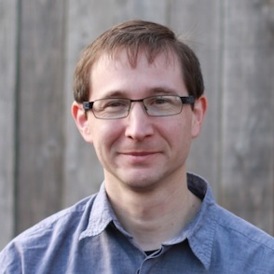
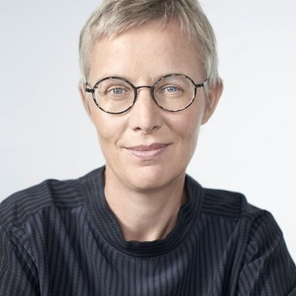
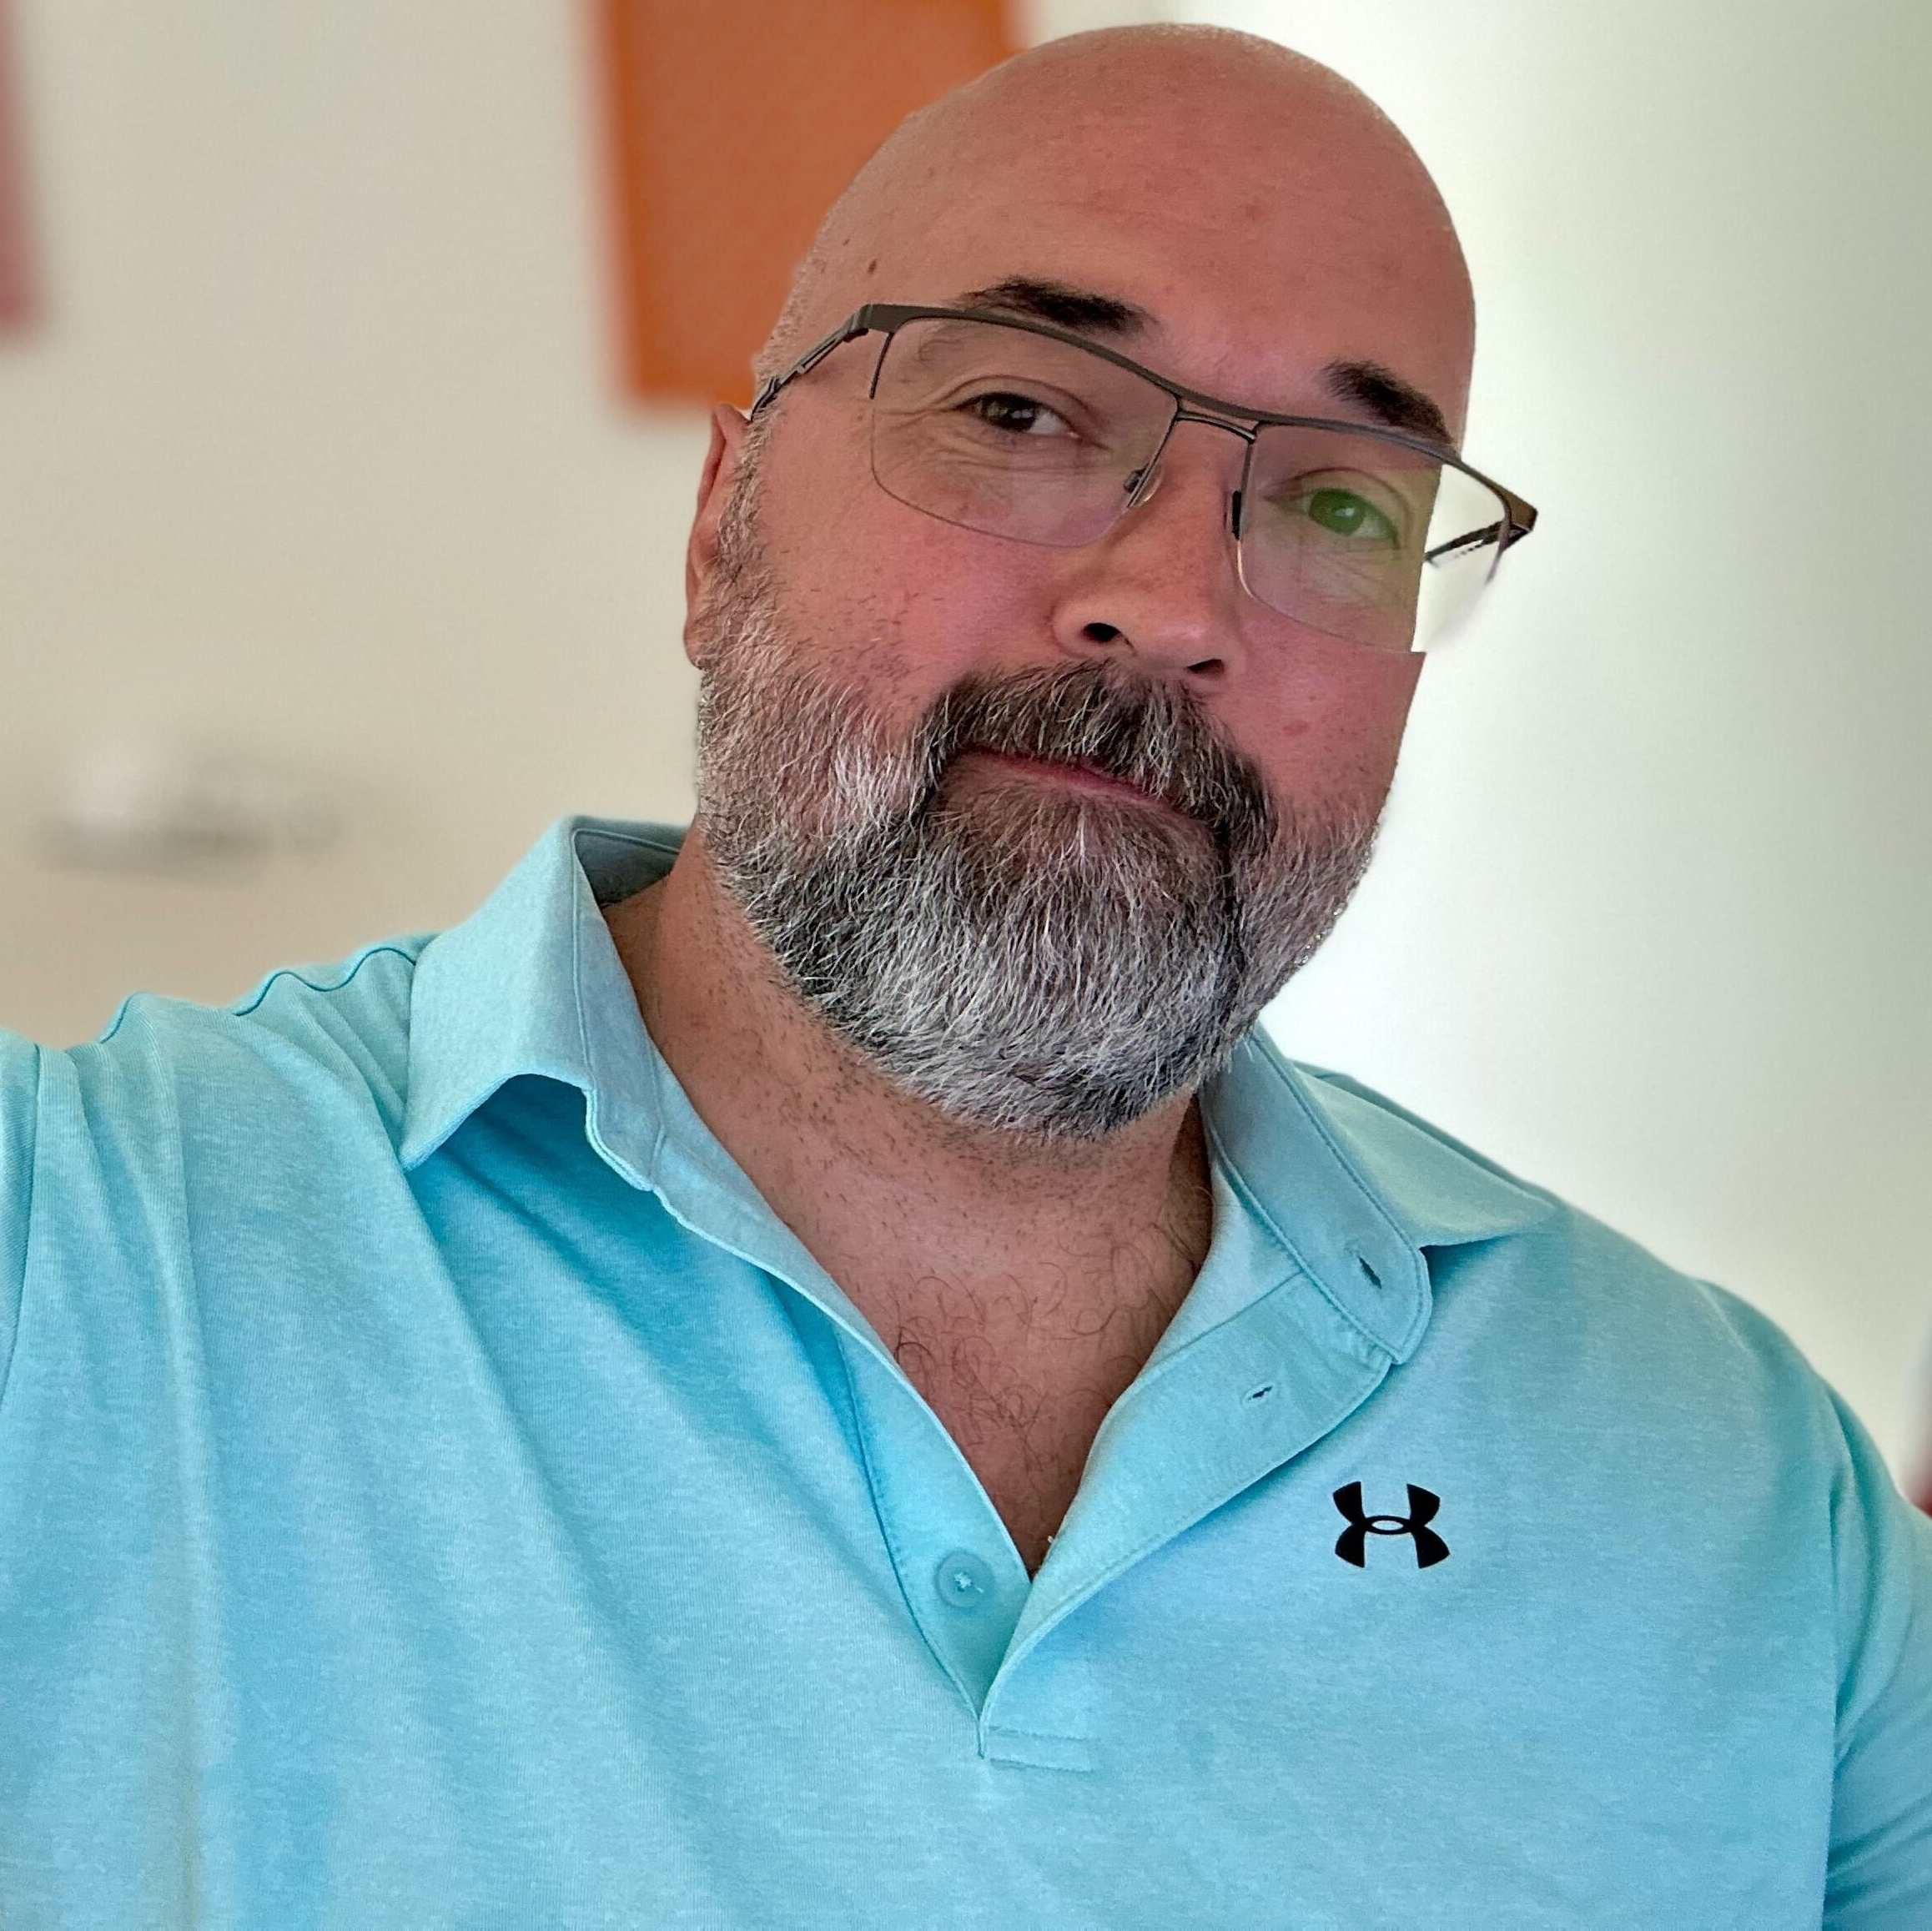
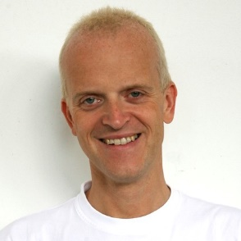
RESEARCH
RouteViews
ASN | 6447
Traffic Profile | Educational/Research
Traffic Volume | Under 100Mbps
Peering Policy | Selective ( and give us full routes please)
Peering Locations | ~50+ IXes around the world (more planned in 2026)
PeeringDB Entry | https://as6447.peeringdb.com
Contact Information | Nina Bargisen, Philip Smith, Owen Conway, Hans Kuhn <help@routeviews.org>
Recent Updates: Collector at IIX Jakarta
Hans
Nina
Owen
Philip

