Slide 1

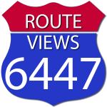


RouteViews
BGP Global Monitoring Infrastructure and Services

Slide 2
RouteViews
NSRC
A collaborative router looking glass to share BGP views among network operators and researchers.
RouteViews was founded at the University of Oregon’s Advanced Network Technology Center (ANTC) in 1995. Data archives began in 1997 and amount to 50TBs (compressed) today.
The group is currently led by the Network Startup Resource Center (NSRC) group engineering team at the University of Oregon.
RouteViews collaborates with the Center for Applied Internet Data Analysis (CAIDA) working with NSF grants that support Designing a Global Measurement Infrastructure to Improve Internet Security, GMI3S (OAC-2131987), and an Integrated Library for Advancing Network Data Science, ILANDS (CNS-2120399).
RouteViews is supported with financial and in-kind donations by multiple additional organizations:
https://www.routeviews.org/routeviews/index.php/supporters/
NSRC supports the growth of global Internet infrastructure by providing engineering assistance, collaborative technical workshops, training, and other resources to university, research & education networks worldwide. NSRC is partially funded by the IRNC program of the NSF (OAC-2029309) and Google with other contributions from public and private organizations.
The University of Oregon is a public research institution in Eugene, Oregon, USA founded in 1876. UO is renowned for its research prowess and commitment to teaching. Both NSRC and RouteViews are based at the UO.
UNIVERSITY OF OREGON

Slide 3
Why RouteViews?
It’s YOUR Internet
Originally conceived in 1995 as a tool for Internet operators to look at the BGP table from different backbones and locations around the world to troubleshoot and to assess:
Reachability, hijacks, peer visibility, mass withdrawals, and RPKI status
Operators who find it a valuable tool also peer to contribute to the value
The 26-year data-set of BGP information archived by RouteViews since 1997 has become an invaluable research resource
RouteViews data has been used in over 1000 research papers.
http://www.routeviews.org/routeviews/index.php/papers/

Slide 4
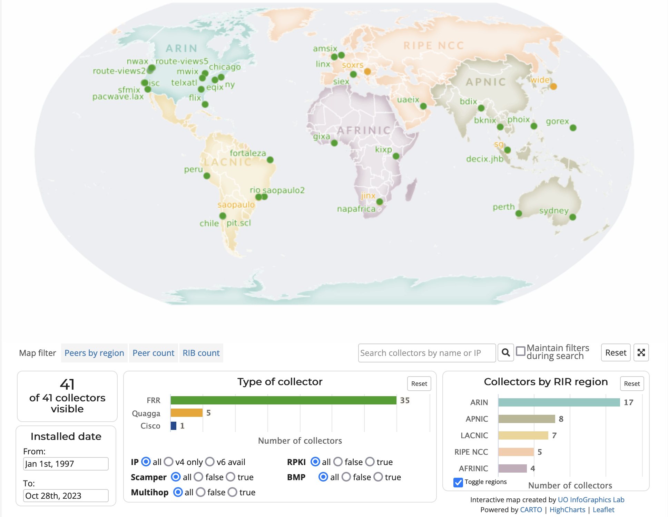
RouteViews Collector Map
http://www.routeviews.org/routeviews/index.php/map/

Slide 5
Collector Deployment
Locations
Collector
At Internet Exchange Points
Or DataCentres hosting major interconnections
Goal is to maximise opportunities for Autonomous Networks to peer with the RouteViews collector
There are also multi-hop collectors hosted at the University of Oregon
One interface on the IXP peering LAN
Peering with operators who wish to supply a BGP feed to the RouteViews collector
One interface for management and backhaul
Managing the collector
Sending the collected BGP table & BGP updates for archival at the University of Oregon

Slide 6
Collectors
Hardware
Hosted
Software
Commodity
1RU
8-16 Cores
32GB RAM
400GB-1TB SSD
2x 10 GB ethernet
Shipped to the IX
Last resort only
Virtual Machine
4 vCPU
32GB RAM
200GB Storage
Peering Interface
Transit Interface
Preferred option
Quicker to deploy
Easier to maintain
Easier to update
OpenSource
Ubuntu LTS with FRR
Legacy: CentOS with Quagga

Slide 7
Collector Deployment
Multi-hop
Advantages
If you can reach the collector, you can peer.
Disadvantages
Multi-hop peerings are subject to the routing anomalies RouteViews seeks to observe and archive.
Advantages
Better positioned to address multi-hop issues.
Geographic diversity.
Peering diversity.
Scalable.
Disadvantages
More infrastructure to manage.
IX hosted/collocated

Slide 8
Collector Data
Multi-Threaded Routing Toolkit (MRT)
https://tools.ietf.org/html/rfc6396
MRT provides a standard for parsing or dumping routing information to a binary file.
RouteViews Dumps consist of BGP RIBs and UPDATES
RIBs are archived every 2 hours
UPDATEs are archived every 15 minutes
MRT files are bzipped and rsynced back to http://archive.routeviews.org/ on above schedule
They can be accessed via http, ftp and rsync
Map view tool is interactive
New Model, in testing right now
BMP upstream from collectors, not FROM peers
Data Access
Direct BGP Monitoring Protocol Feed (BMP)

Slide 9
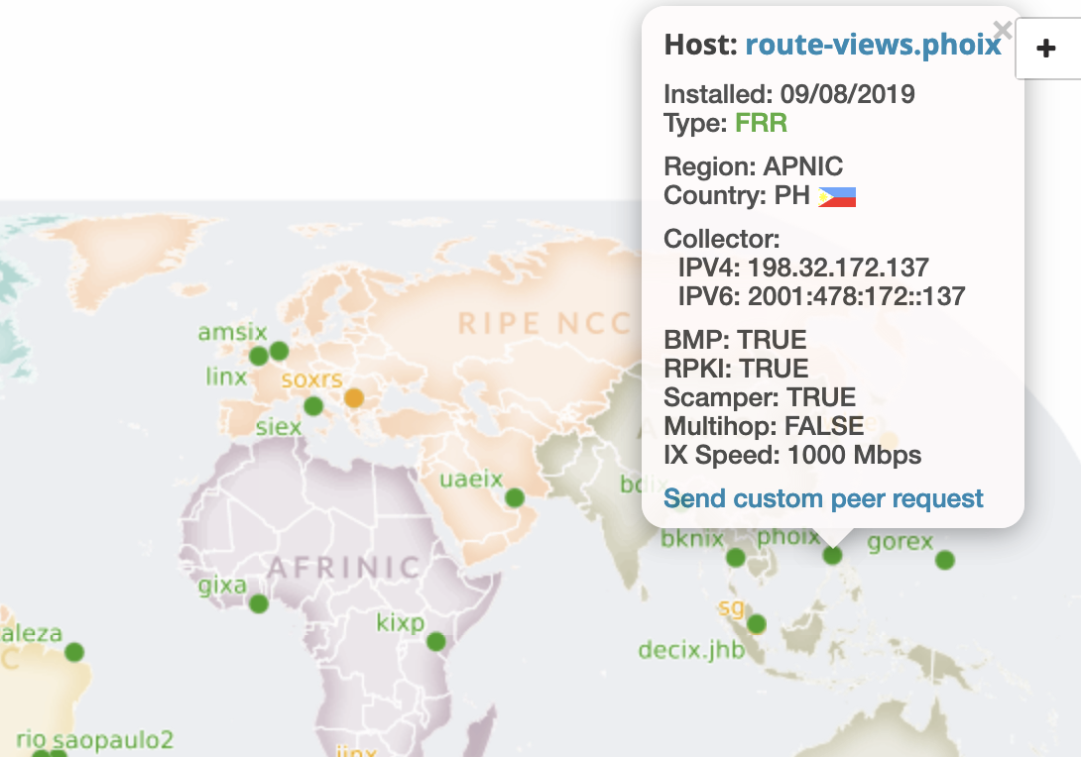
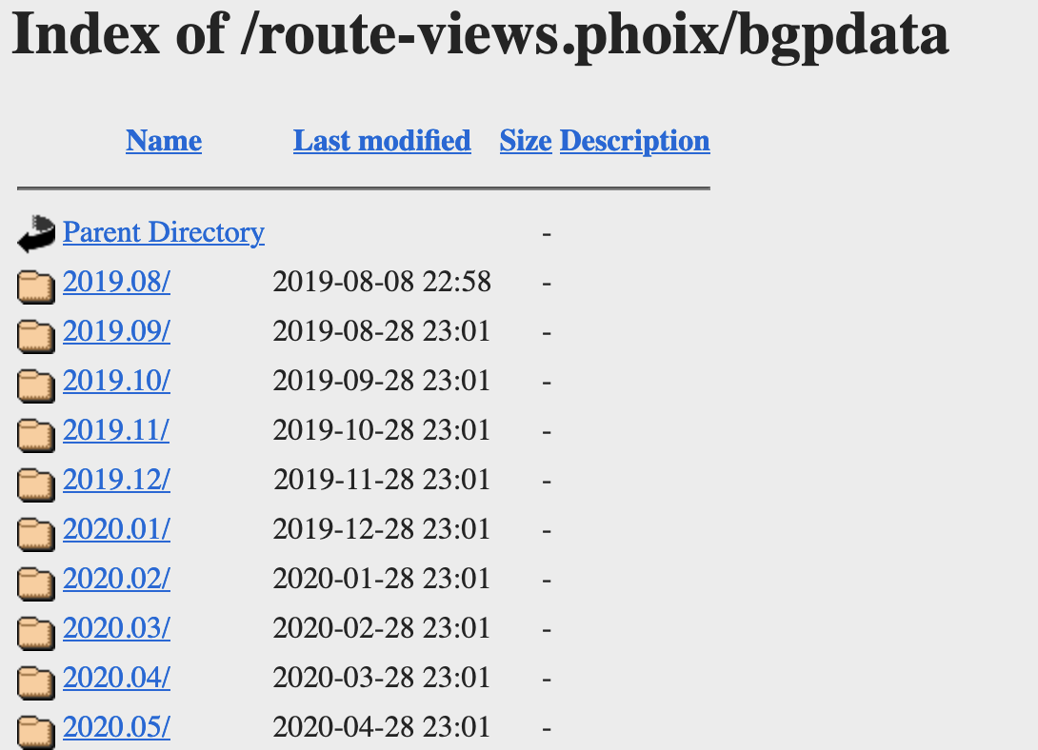
Collector Data
http://archive.routeviews.org/route-views.phoix/bgpdata/

Slide 10
Peering HowTo
BGP Configuration
Please send full-table if you are able to
Please do not send:
Default route
Private address space
We do not accept/want ADD-PATH TX/RX
We do not send any routes to you
When peering with multi-hop collectors, remember to set ebgp-multihop

Slide 11
MRT Tools
BGPKIT, RIPE LIBBGPDUMP, NTT BGPDUMP2, etc
https://bgpkit.com/ (BGP toolkit written in Rust)
https://bgpkit.com/parser
https://github.com/bgpkit
https://github.com/bgpkit/bgpkit-parser
https://github.com/bgpkit/peer-stats
https://github.com/bgpkit/pybgpkit
https://github.com/RIPE-NCC/bgpdump (Last updated 2020)
https://github.com/cawka/bgpparser (Last updated 2015 ☹️)
https://github.com/yasuhiro-ohara-ntt/bgpdump2
https://github.com/t2mune/mrtparse (python)
https://github.com/rfc1036/zebra-dump-parser (perl) (Last updated 2014 ☹️)

Slide 12
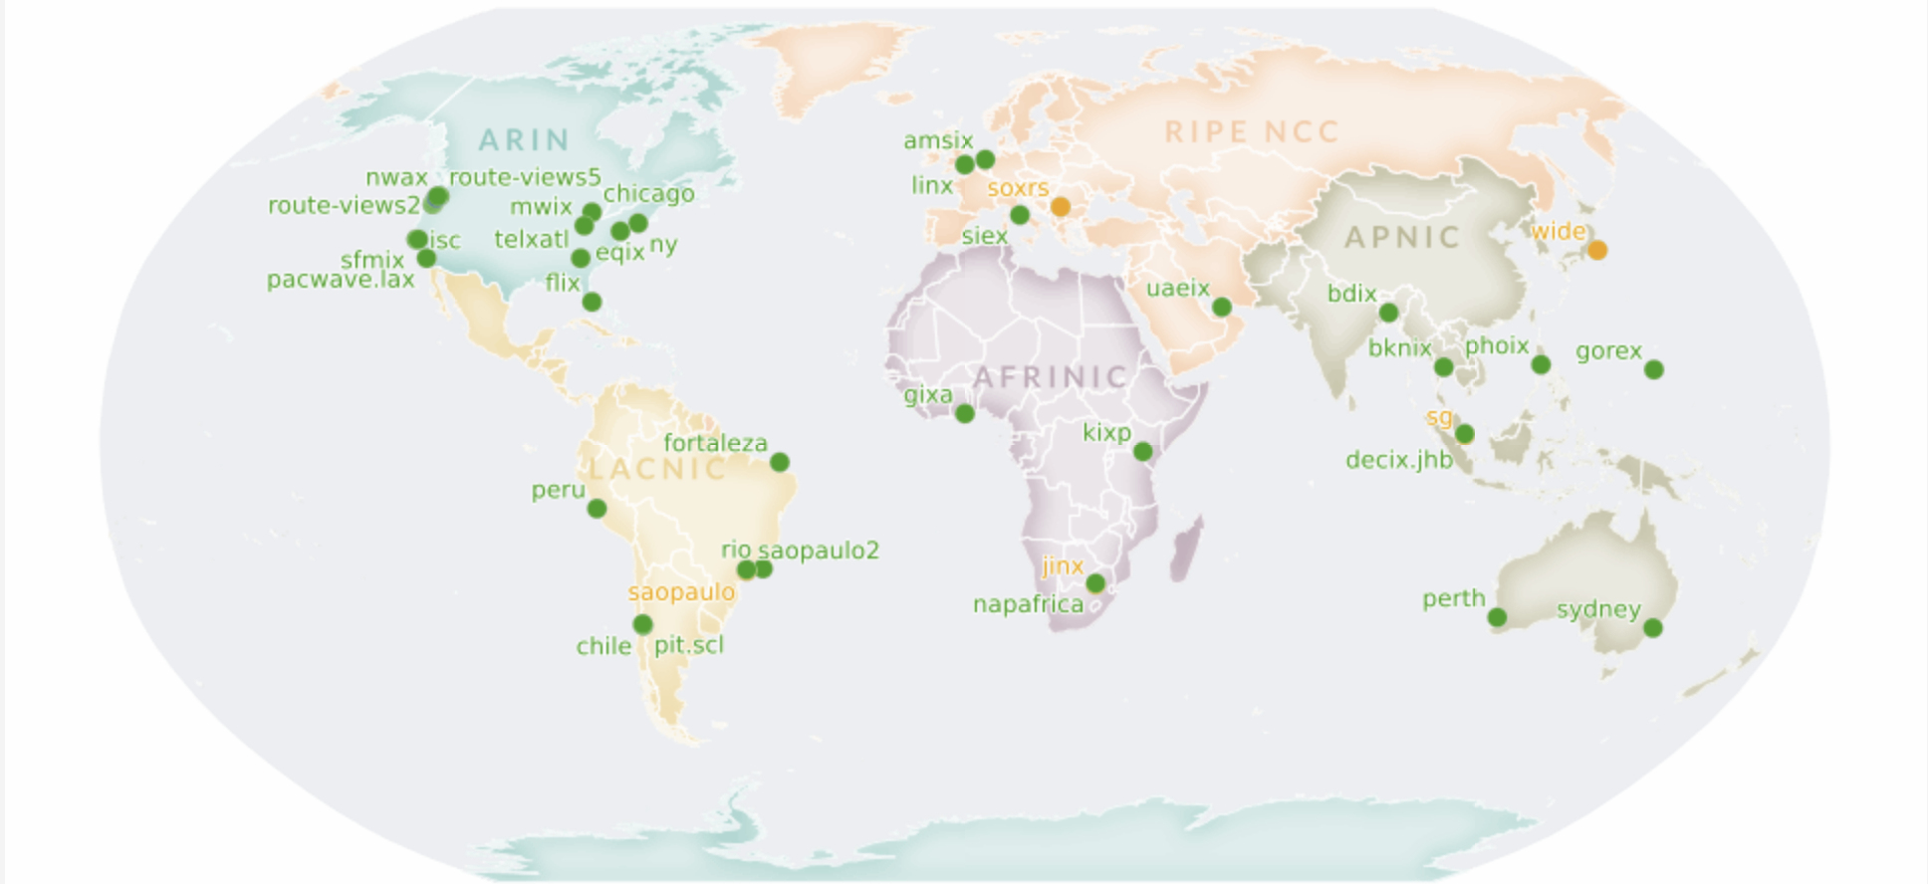
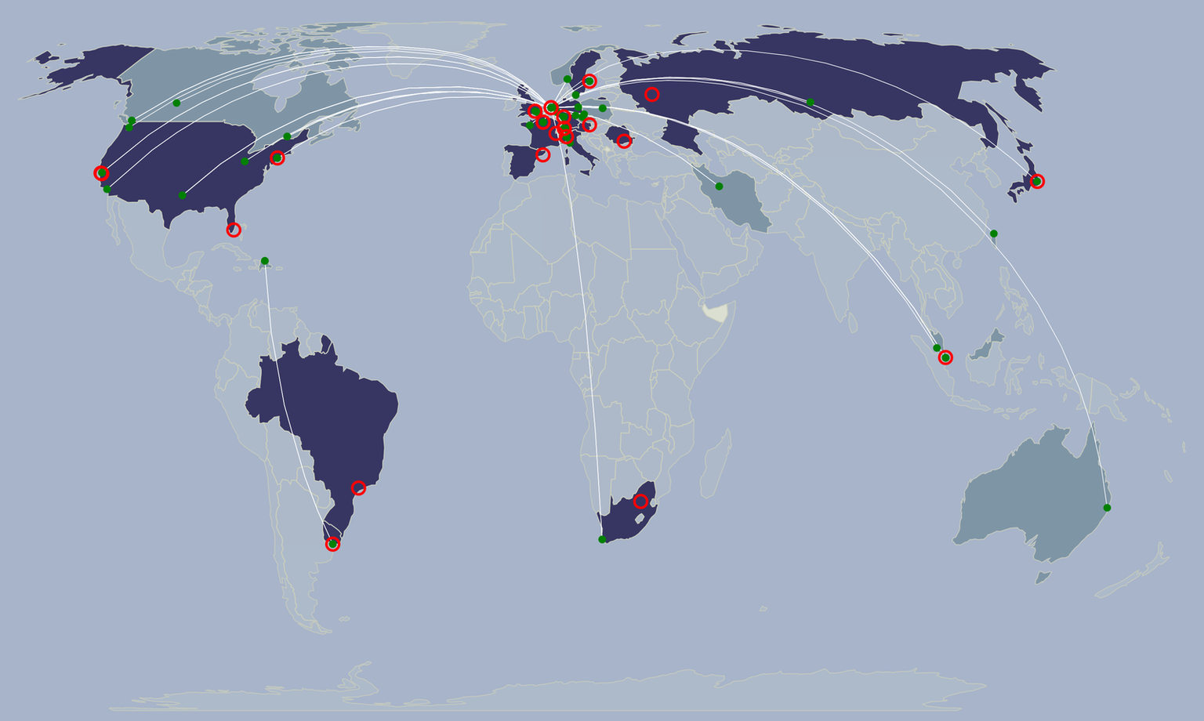
Route Collection: Global Community Cooperation
RIS Collector Map
RouteViews Collector Map
Extends coverage
Provides Redundancy
Complimentary Services
Common files/tools

Slide 13
Operations
Access
BGP is the backbone of the Global Routing Infrastructure.
To ensure its stability, it needs to be constantly monitored.
RouteViews provides:
Command-Line/Looking Glass
Prefix Visibility, Verify Convergence, Path Stability
Comparing Local/Regional/Global Views
Troubleshooting Reachability
Access to historical BGP data, i.e. “When did this happen??”

Slide 14
Operations
Accessing a Collector
telnet://route-views*.routeviews.org
No username necessary.
Users are able to run show commands, e.g. show ip bgp x.x.x.x
Telnet access is rate-limited to prevent automation overuse
PLEASE don’t script. There is an API for that (http://api.routeviews.org).
Why not SSH?!
RouteViews data are publicly available. We’ve got nothing to hide.
show ip route x.x.x.x next-hop is incorrect!
Remember, this is a collector
There’s no data-plane, thus no true FIB
Kernel default-route points to transit provider next-hop
Gotchas

Slide 15
Operations
CLI Access
Worldwide CLI access – how to access a collector
telnet://route-views.routeviews.org
route-views, route-views{2,3,4,6} are all housed at University of Oregon in the United States, and each collector has eBGP Multihop sessions with peers from around the world
Legacy Naming Scheme
telnet://route-views.phoix.routeviews.org
Other collector locations accessible via these 3rd level domains (replace “phoix”): amsix, eqix, telxatl, bknix, soxrs, chicago, bdix, uaeix, fortaleza, gixa, gorex, mwix, jinx, jhb, napafrica, peru, linx, flix, kixp, ny, isc, perth, nwax, rio, siex, sfmix, chile, saopaulo, sg, sydney & wide
New Naming Scheme
(exchange).(closest airport).routeviews.org
ie: decix.jhb.routeviews.org – DE-CIX Asia, Johor Bahru

Slide 16
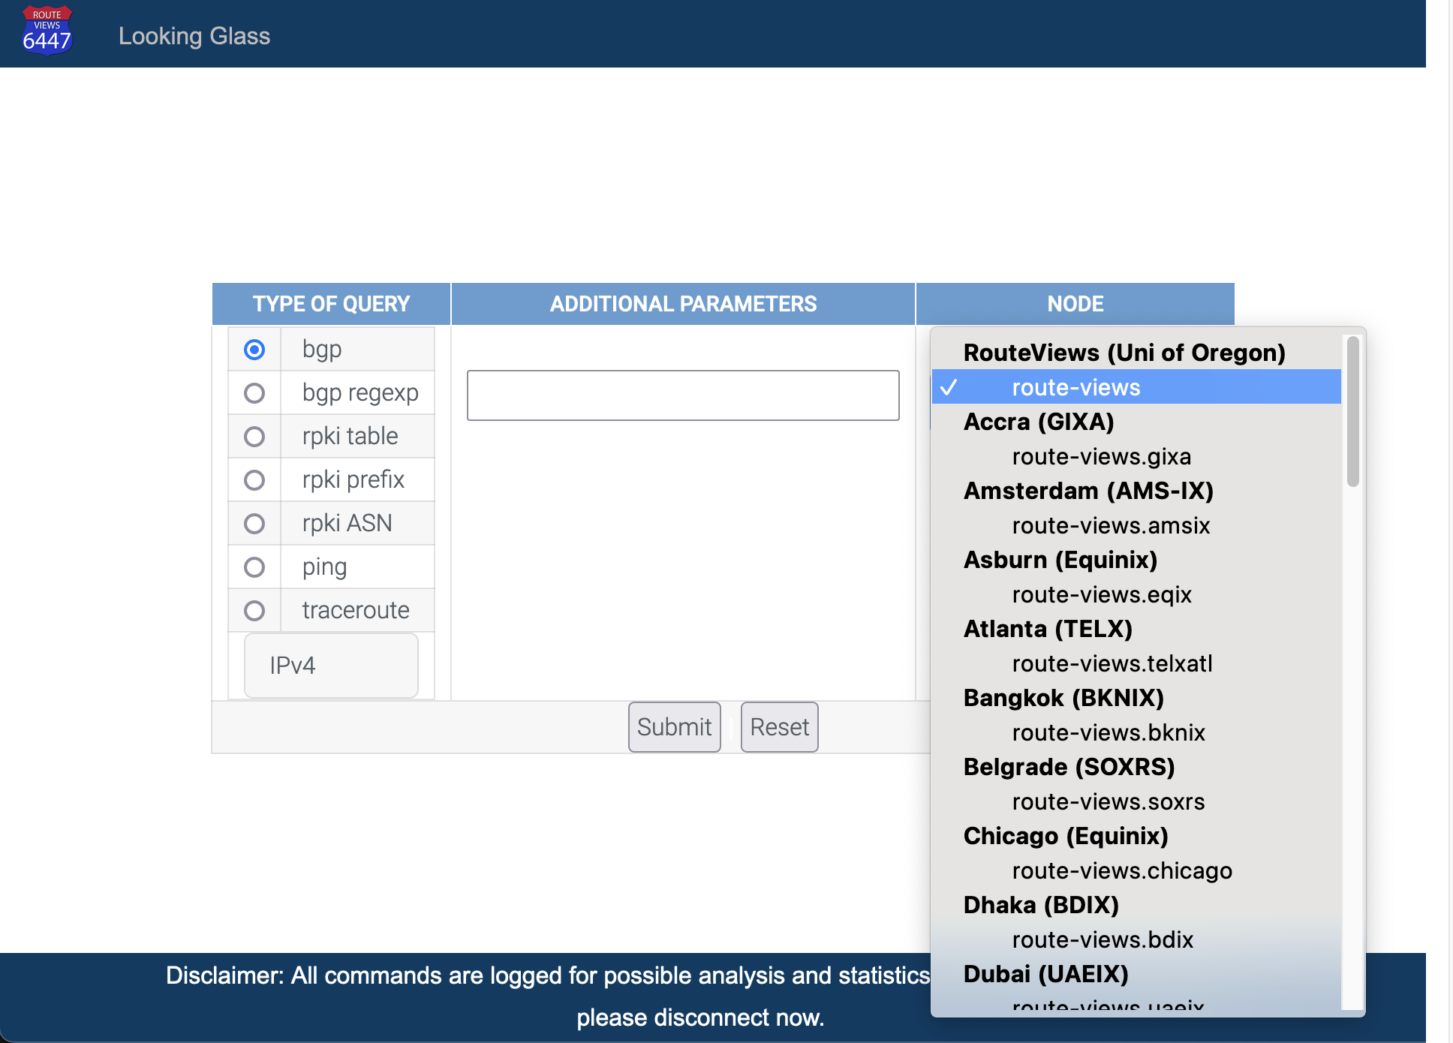
Operations
Looking Glass
Looking Glass front-end as an alternative access is being tested
This will likely replace the telnet access in the near future

Slide 17
Use Cases
New(er) Collector Features
BMP data will feed tools like BGPStream and ARTEMIS.
Or write your own Kafka consumer for raw BMP data.
Limited access during trial period.
Wider availability to follow on completion of trials.
RPKI data is accessible directly from the collectors.
We also are establishing an archive of RPKI ROA data.
Working on back-filling that data set from the RIR/CAs.
BMP
RPKI

Slide 18
Use Cases
BGP Data Distribution
“Message-based” data distribution (Kafka)
Real-time streaming telemetry
Per-message timestamps, with meta-data
Middle-layer abstraction, multi-client access (facilitates analysis and services)
Automated consolidating and sequencing
RPKI validation and archival

Slide 19
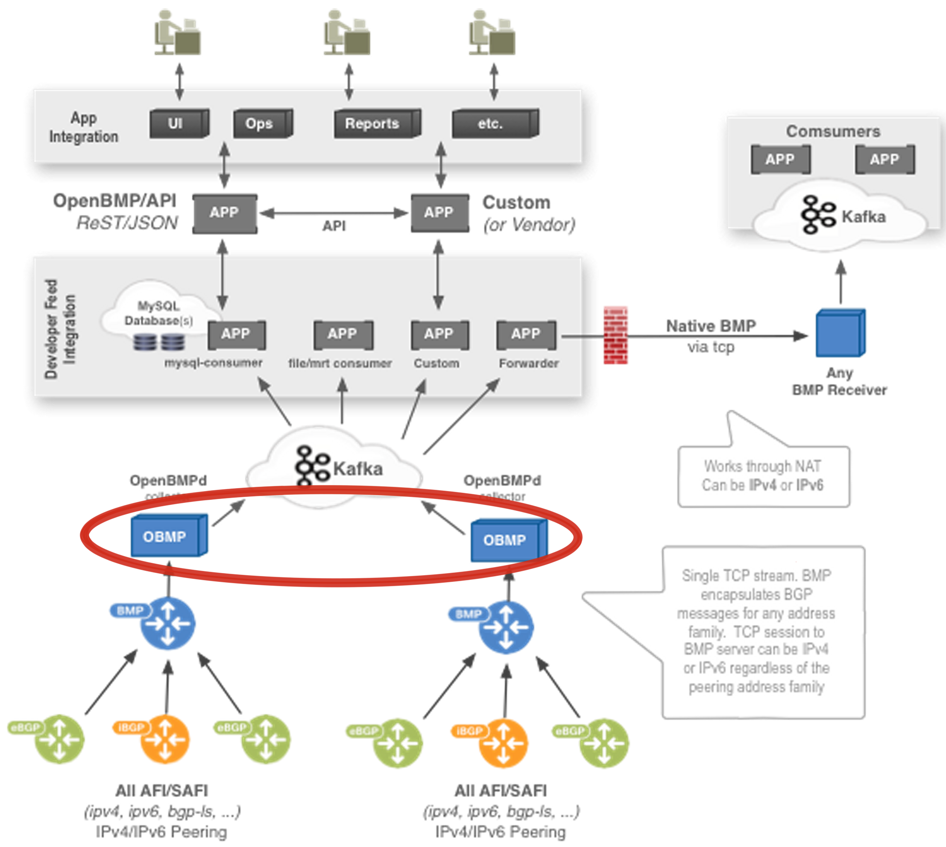
BMP & Open/GoBMP
BGP Monitoring Protocol (BMP) is an IETF standard: RFC7854
Available now – (Cisco, Juniper, Arista & FRR)
Consolidates peers/collectors
Splits collector, peer and update messages into separate streams
OpenBMP is OpenSource (under the Linux Foundation)
Latest update: 2018 ☹️
GoBMP
Latest update: September 2022 😀

Slide 20
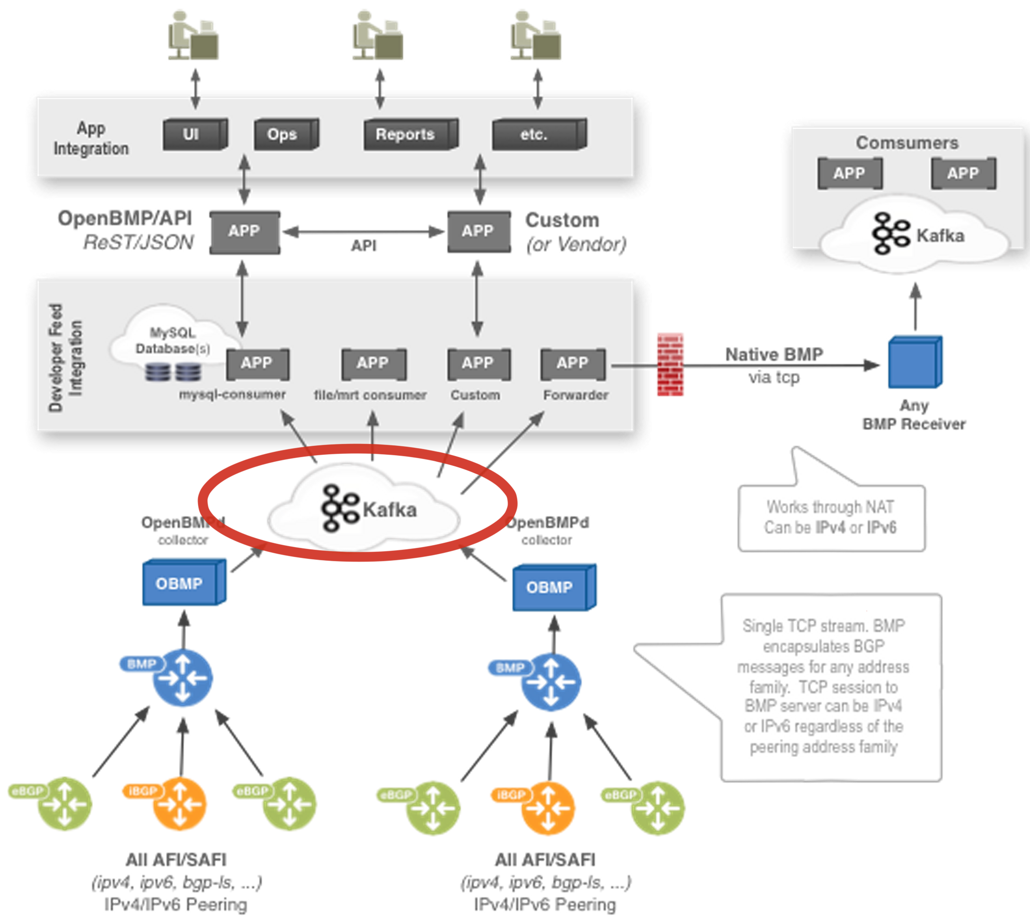
Apache Kafka
Apache Kafka comprises the message bus for OpenBMP
Proven to scale
Mature client API
Clients in 16 different programming languages
Send email to:
help@routeviews.org

Slide 21

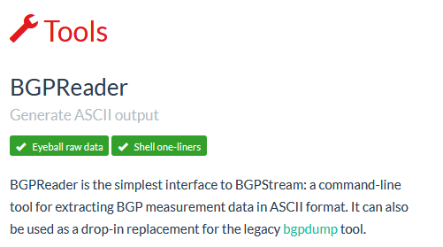
Use Cases
BGPStream is a project of CAIDA group at UC San Diego: https://bgpstream.caida.org

Slide 22
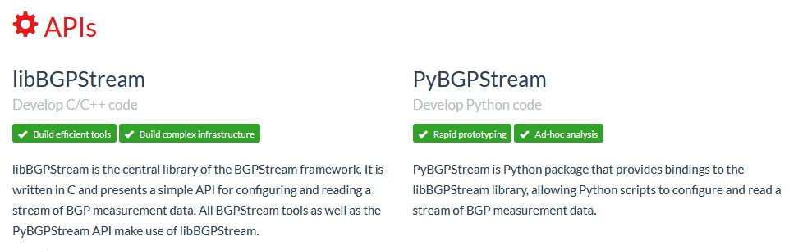
Use Cases
BGPStream is a project of CAIDA group at UC San Diego: https://bgpstream.caida.org

Slide 23
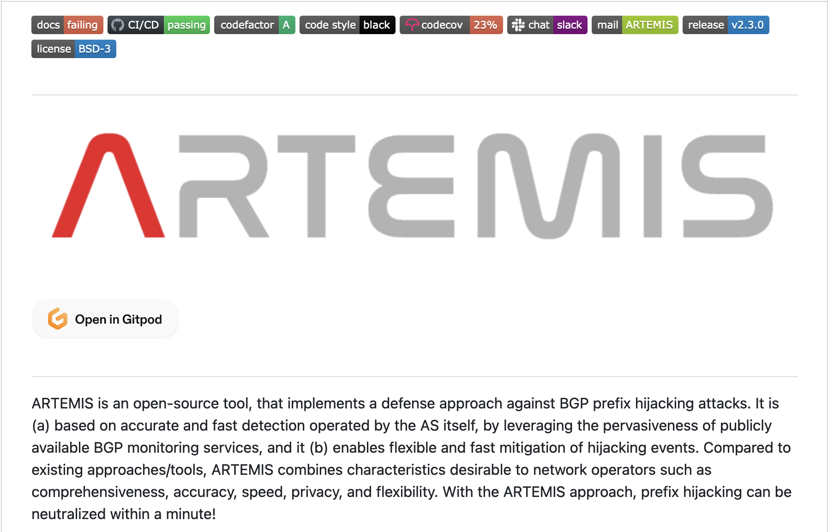
Use Cases
Other Open Source Tools: Artemis
An open-source tool to monitor, detect, and mitigate BGP hijacks
Real-time detection and notifications of BGP prefix hijacking attacks/events
https://github.com/FORTH-ICS-INSPIRE/artemis

Slide 24

Use Cases
Other Open Source Tools: BGPKIT
BGPKIT Parser
Rust-based MRT/BGP Data Parser
BGPKIT Broker
REST API for searching archive files across public data collection projects. Data updated in real-time.
BPPKIT Monocle
A commandline application to search, parse, and process BGP information in public sources
https://bgpkit.com/

Slide 25
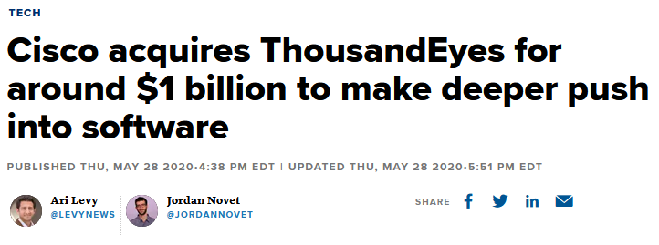
Use Cases
Not so Open Source Tools…

Slide 26
Use Cases
Operations
77 peers, multi-hop
route-views2.routeviews.org> sh ip bgp sum
IPv4 Unicast Summary (VRF default):
BGP router identifier 128.223.51.102, local AS number 6447 vrf-id 0
BGP table version 53814890
RIB entries 1867939, using 342 MiB of memory
Peers 77, using 54 MiB of memory
Neighbor V AS MsgRcvd MsgSent TblVer InQ OutQ Up/Down State/PfxRcd PfxSnt Desc
4.68.4.46 4 3356 0 36081 0 0 0 never Active 0 Level3
5.101.110.2 4 14061 0 0 0 0 0 never Connect 0 DIGITALOCEAN
12.0.1.63 4 7018 22762421 72706 0 0 0 2d13h50m 918220 0 ATT
37.139.139.17 4 57866 15583523 146075 0 0 0 4d03h24m 920755 0 Fusix
43.226.4.1 4 63927 0 0 0 0 0 never Connect 0 Rise
45.61.0.85 4 22652 21203029 146091 0 0 0 4d03h25m 921946 0 FIBRENOIRE
62.115.128.137 4 1299 63541287 73041 0 0 0 4d03h23m 903897 0 Telia
64.71.137.241 4 6939 20081396 73037 0 0 0 13:06:54 943729 0 Hurricane Electric
64.71.255.61 4 812 0 0 0 0 0 never Connect 0 Sprint
66.185.128.1 4 1668 0 0 0 0 0 never Connect 0 AOL
67.219.192.18 4 19653 0 0 0 0 0 never Active 0 CTSTelecom
68.67.63.245 4 22652 0 0 0 0 0 never Active 0 FIBRENOIRE
80.241.176.31 4 20771 0 0 0 0 0 never Connect 0 CAUCASUS
85.114.0.217 4 8492 25929838 146099 0 0 0 01w1d10h 932986 0 OBITRU
87.121.64.4 4 57463 5292260 72989 0 0 0 4d03h16m 443778 0 NETIXLTD
89.149.178.10 4 3257 21296299 73041 0 0 0 4d03h22m 918375 0 Tiscali
91.209.102.1 4 39756 0 0 0 0 0 never Connect 0 HOSTWAY-RO
91.218.184.60 4 49788 28486819 73045 0 0 0 01w1d03h 923119 0 NEXTHOPNO
Not all peers are up.. ☹️
Lots of full tables

Slide 27
Use Cases
Operations
BGP routing table entry for 41.77.223.0/24, version 53271948
Paths: (29 available, best #2, table default)
Not advertised to any peer
23673 6939 33763 37447
203.189.128.233 from 203.189.128.233 (203.189.128.233)
Origin IGP, valid, external, rpki validation-state: not found
Community: 23673:50 23673:4636 23673:65401
Last update: Sat Oct 28 00:55:33 2023
…
3257 37468 37273 37447 37447 37447 37447 37447 37447 37447 37447 37447 37447 37447 37447 37447 37447 37447 37447 37447 37447 37447
37447 37447 37447 37447 37447 37447 37447 37447 37447 37447 37447 37447 37447 37447 37447 37447 37447 37447 37447 37447 37447 37447
37447 37447 37447 37447 37447 37447 37447 37447 37447 37447 37447 37447 37447 37447 37447 37447 37447 37447 37447 37447 37447 37447
37447 37447 37447 37447 37447 37447 37447 37447 37447 37447 37447 37447 37447 37447 37447 37447 37447 37447 37447 37447 37447 37447
37447 37447 37447 37447 37447 37447 37447 37447 37447 37447 37447 37447 37447 37447 37447 37447 37447 37447
89.149.178.10 from 89.149.178.10 (213.200.83.26)
Origin incomplete, metric 10, valid, external, rpki validation-state: not found
Community: 3257:2993 3257:4000 3257:8027 3257:50001 3257:50110 3257:54400 3257:54401 65000:174 65000:1299 65000:3356 65000:4134
65000:10429
Last update: Fri Oct 27 01:38:19 2023
…
1299 6939 6939 33763 37447
62.115.128.137 from 62.115.128.137 (2.255.254.88)
Origin IGP, valid, external, rpki validation-state: not found
Last update: Wed Oct 25 14:02:01 2023
What is AS37447 trying to achieve by prepending 97 times??

Slide 28
Use Cases
AS64503 – this is RFC5398 Documentation ASN!
Invalid ROAs
I* 36.90.220.0/23 203.189.128.233 0 23673 55329 9304 7713 64503 i
I* 212.66.96.126 0 20912 49367 6762 7713 64503 i
I* 94.156.252.18 0 0 34224 6762 7713 64503 i
I*> 85.114.0.217 0 8492 3216 7713 64503 i
I* 43.255.37.0/24 203.189.128.233 0 23673 55329 6939 7473 9381 64021 i
I* 64.71.137.241 0 6939 7473 9381 64021 i
I* 12.0.1.63 0 7018 2914 64050 137451 i
I* 105.16.0.247 0 37100 2914 64050 137451 i
I* 212.66.96.126 0 20912 3257 2914 64050 137451 i
I* 94.156.252.18 0 0 34224 6453 9381 64021 ?
I*> 129.250.1.71 0 0 2914 64050 137451 i
…
AS64021 & AS137451 are origins?

Slide 29
Use Cases
43/8 was used by IPv6 Promotion Council of Japan for IPv6 transition experimental purposes
No specific entry for this /24 in any RIR database
Invalid ROAs
Whois says:
% whois -h jwhois.apnic.net 43.255.37.0/24
…
inetnum: 43.0.0.0 - 43.255.255.255
netname: APNIC-AP-ERX
descr: Asia Pacific Network Information Center, Pty. Ltd.
descr: Regional Internet Registry for the Asia-Pacific Region
…
remarks: This /8 was transfered from ARIN to APNIC on 30 Oct 2007
remarks: The original message for this range is as below.
remarks: Japan Inet has advised IANA to delegate the management of this /8 to APNIC.
remarks: OrgName: Japan Inet
remarks: OrgID: JAPANI
remarks: Address: Kokusai-Kougyou-Kanda Bldg.
remarks: Address: 2-3-4 Uchikanda
remarks: Address: Chiyoda-ku
remarks: City: Tokyo
remarks: Country: JP
…
remarks: RTechHandle: ZI92-ARIN
remarks: RTechName: IPv6 Promotion Council of Japan
remarks: RTechPhone: +81-3-3548-2601
remarks: RTechEmail: admin@v6nic.net

Slide 30
Uses Cases
Invalid ROAs
route-views2.routeviews.org> sh rpki prefix-table | include ^43.255
…
43.255.30.0 24 - 24 133199
43.255.30.0 24 - 24 133861
43.255.31.0 24 - 24 133199
43.255.31.0 24 - 24 133861
43.255.24.0 22 - 22 18119
43.255.36.0 22 - 22 0
43.255.53.0 24 - 24 59214
43.255.52.0 24 - 24 59214
43.255.54.0 24 - 24 59214
…
This /22 is in APNIC’s AS0 TAL – meaning it is unassigned (classed as a bogon)
RouteViews validators include LACNIC’s and APNIC’s AS0 TALs – so RouteViews sh bgp output can indicate prefixes in the BGP table that are flagged by the RIRs as unassigned.
Hence the invalid ROA displayed for 43.255.37.0/24
AS64021 & AS137451 are both announcing part of an IP address block that is not theirs to use.

Slide 31
Other Bits
RouteViews email list
https://lists.nsrc.org/listinfo/routeviews-users
Also available on the Contact page at routeviews.org
A place to ask questions and receive updates on RouteViews activities.
Hosted by the wonderful folks at NSRC.

Slide 32
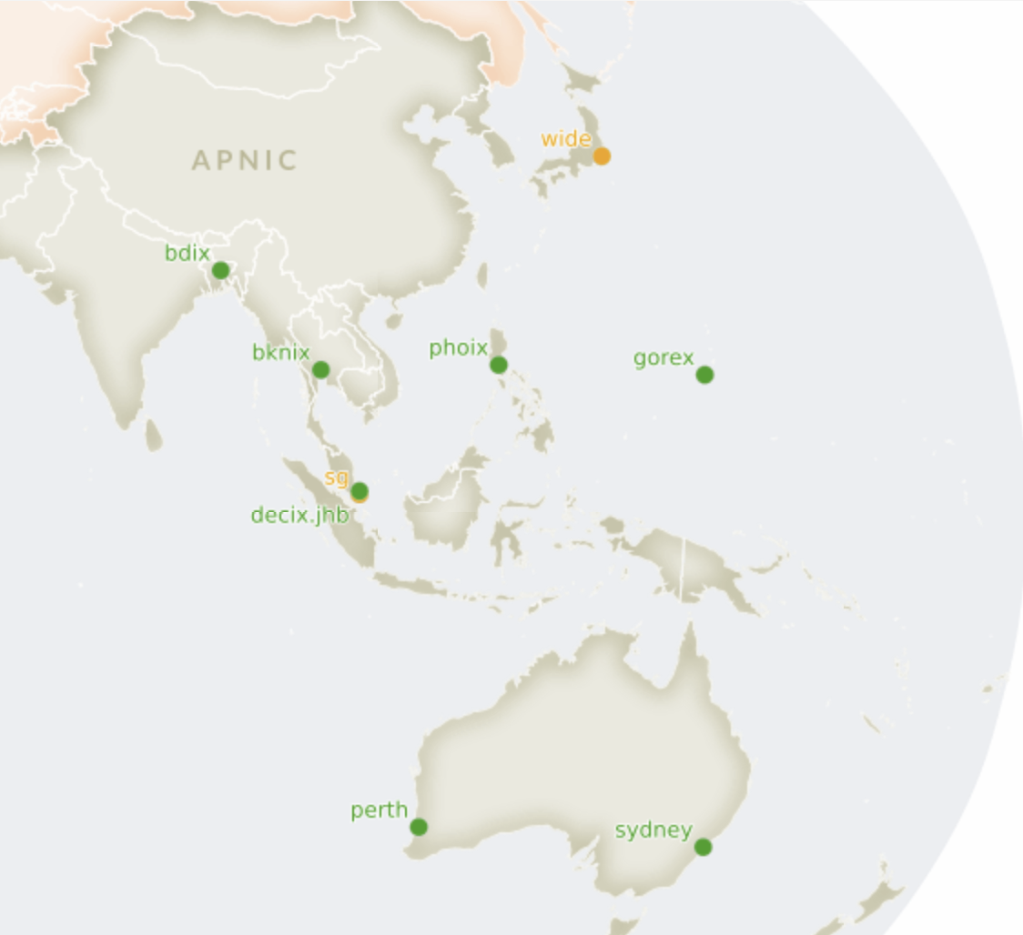
RouteViews in Asia
Looking for new Views
The RouteViews team is continually on the lookout for new locations
More views means better troubleshooting and diagnosis of the global BGP routing system
Preferences:
At an IX
Rich variety of domestic, regional, and international peers
IPv4 & IPv6 (of course!)
Host willing to sponsor either a VM or the hosting of a 1RU server

Slide 33
RouteViews Impact
Geoff Huston wrote in his report, “BGP in 2022 – the routing table”:
“I should take a moment to mention the RouteViews Project. It was originally intended to offer a multi-perspective real-time view of the inter-domain routing system, allowing network operators to examine the current visibility of route objects from various points in the inter-domain topology.
What makes RouteViews so unique is that it archives these routing tables every two hours and has done so for more than two decades. It also archives every BGP update message. This vast collection of data is a valuable research data source in its own right, and here we are just taking a tiny slice of this data set to look at longer-term routing growth trends.
The folk at the RouteViews Project, with support from the University of Oregon and the US National Science Foundation, should be commended for their efforts here. This is a very unique data set if you are interested in the evolution of the Internet over the years.”

Slide 34
RouteViews Impact
Aftab Siddiqui
"The MANRS Observatory relies heavily on BGPStream and GRIP for the detection of BGP related incidents such as BGP Leaks and BGP mis-origination. It is also very critical to verify that any incident highlighted by these services can be verified independently and to do that we require raw BGP data which is made available by 2 sources: RIPE RIS and RouteViews. Diversity of data sources is once again very important to verify any such incidents. NSRC, which manages the RouteViews project, ensures that the routing data they provide is accurate and they have promptly addressed any issues or concerns raised by the MANRS team, whether it is related to changes in the MRT format causing problems in data parsing or helping with BMP data. Actively maintaining RouteViews provides community service by NSRC.
MANRS has gained a lot of good reputation in the community due to the support and expertise provided by its partners such as NSRC. NSRC included MANRS Action explanation and implementation guidelines in their training courses for network operators and R&E networks, in their technical video content, and has been promoting various MANRS programs to respective communities specifically in Asia Pacific and Africa where the MANRS participation is low as compared to other regions.”

Slide 35
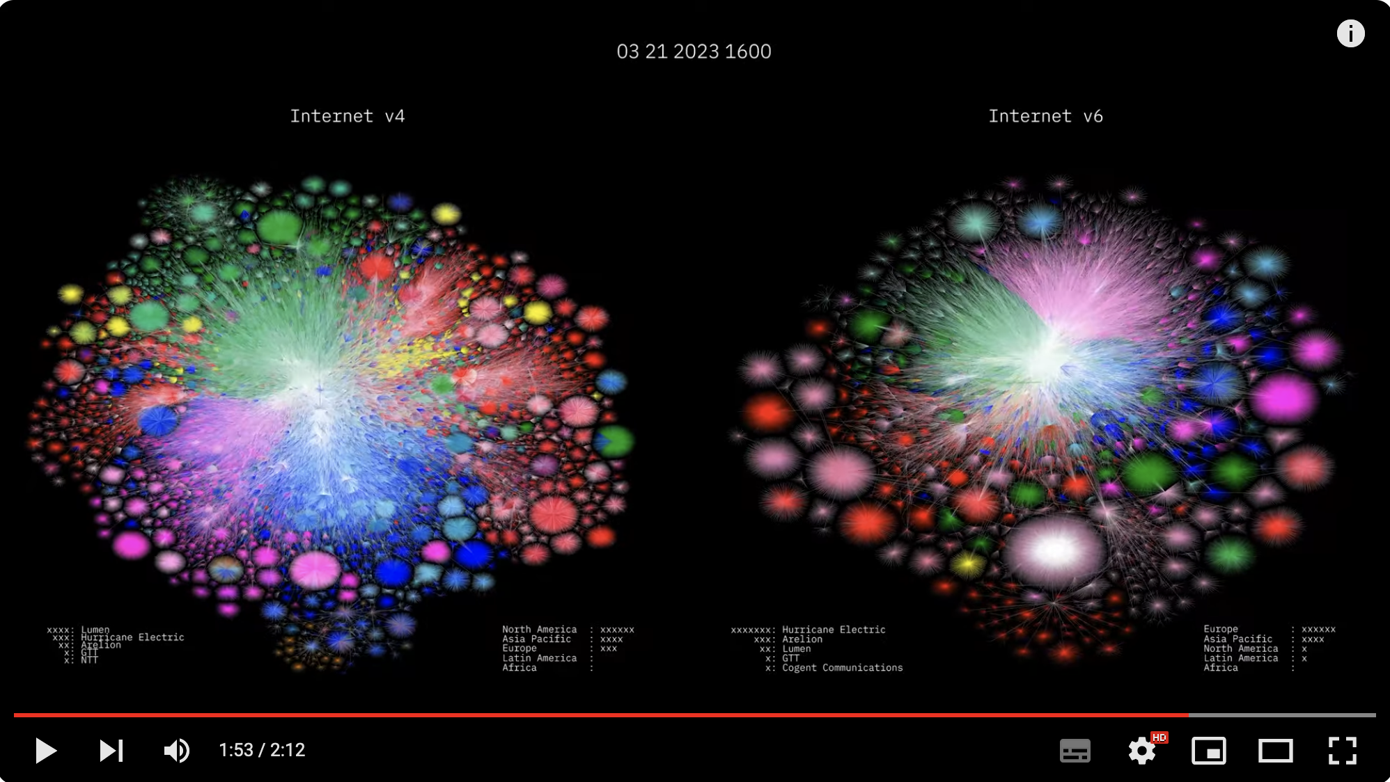
RouteViews Impact
Barrett Lyon: https://www.youtube.com/watch?v=vo5glK9czIE

Slide 36
THANK YOU
Questions?

