Slide 1



RouteViews
BGP Global Monitoring Infrastructure and Services
Presented by Greg Shepherd
shep@routeviews.org

Slide 2

RouteViews
NSRC
A collaborative router looking glass to share BGP views among network operators and researchers.
RouteViews was founded at the University of Oregon’s Advanced Network Technology Center (ANTC) in 1995. Data archives began in 1997 and amount to 50TBs (compressed) today.
The group is currently led by the Network Startup Resource Center (NSRC) group engineering team at the University of Oregon
  NSRC supports the growth of global Internet infrastructure by providing engineering assistance, collaborative technical workshops, training, and other resources to university, research & education networks worldwide. NSRC is partially funded by the IRNC program of the NSF and Google with other contributions from public and private organizations.
UNIVERSITY OF OREGON
The University of Oregon is a public research institution in Eugene, Oregon, USA founded in 1876. UO is renowned for its research prowess and commitment to teaching. Both NSRC and RouteViews are based at the UO.

Slide 3
Why RouteViews?
It’s YOUR Internet
Originally conceived in 1995 as a tool for Internet operators to look at the BGP table from different backbones and locations around the world to troubleshoot and to assess:
  reachability, hijacks, peer visibility, mass withdrawals, and RPKI status
Operators who find it a valuable tool also peer to contribute to the value
The 26-year data-set of BGP information archived by RouteViews since 1997 has become an invaluable research resource
  RouteViews data has been used in over 1000 research papers.
  http://www.routeviews.org/routeviews/index.php/papers/

Slide 4
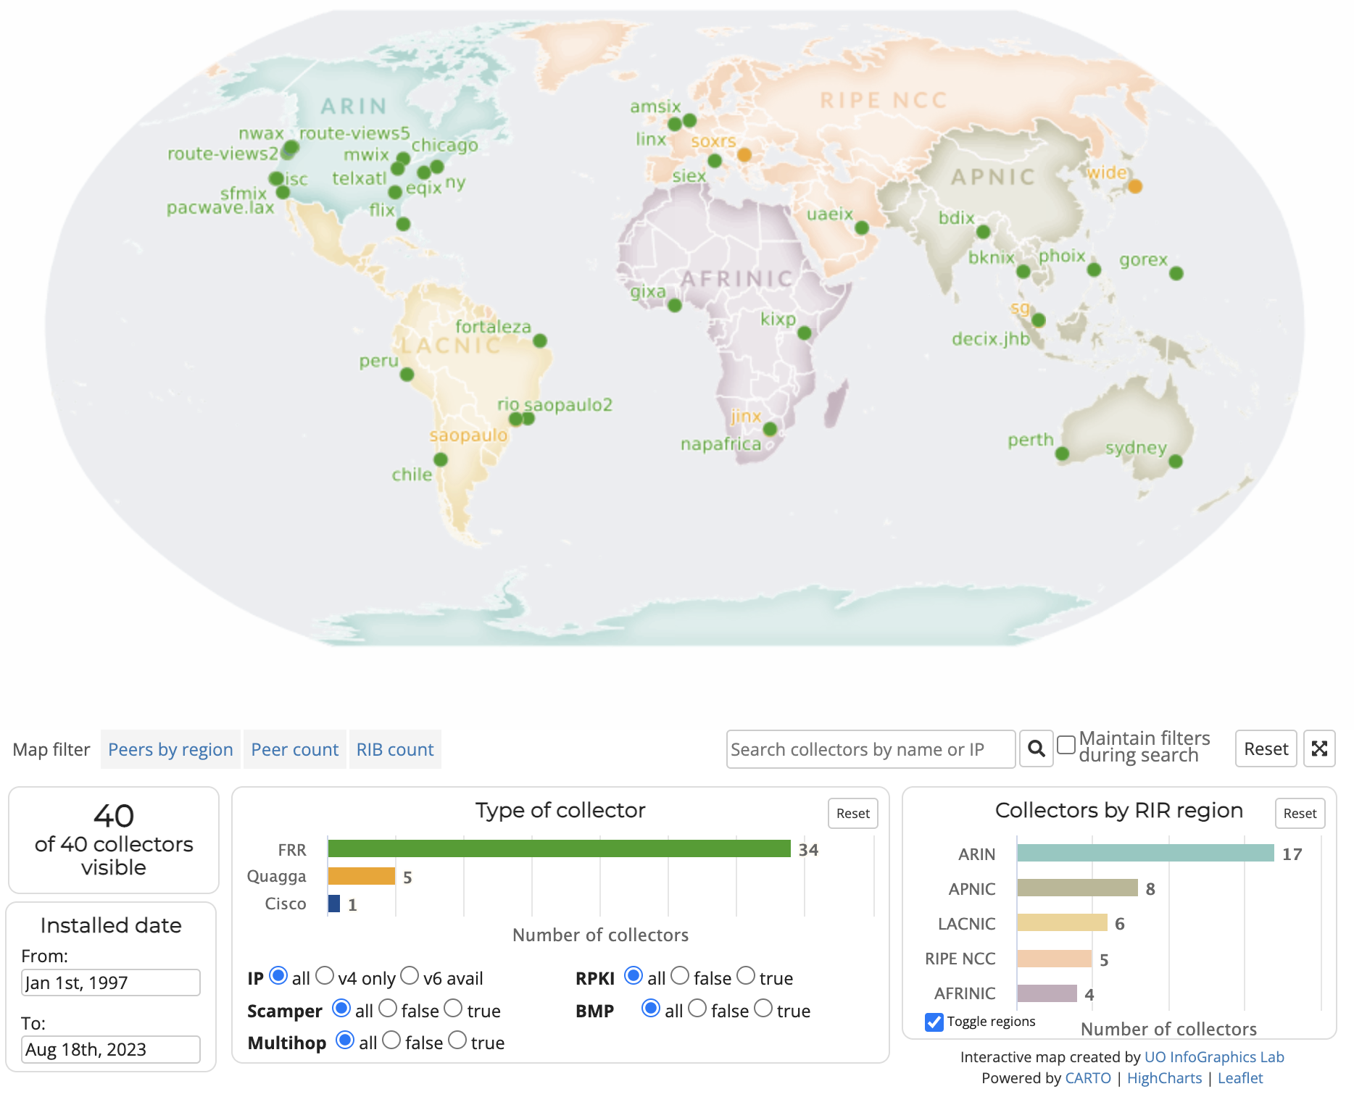
RouteViews Collector Map
http://www.routeviews.org/routeviews/index.php/map/

Slide 5
COLLECTOR DEPLOYMENT
Physical
  Off the shelf hardware.
  Shipped to the IX.
  Last resort option only.
  Preferred option.
  Much quicker deployment time.
  Easier to maintain.
  Easier to upgrade.
Virtual

Slide 6
Collectors
Hardware
Software
Commodity
8-16 Cores
32G-64G Ram
400GB-1TB SSD
10 GB eth
OpenSource
Linux/Centos and…
Quagga – bgpd
FRR – bgpd
Gobgpd
OpenBMP
GoBMP

Slide 7
Collector Deployment
Multi-hop
  Pros:
    If you can reach the collector, you can peer.
  Cons:
    Multi-hop peerings are subject to the routing anomalies RouteViews seeks to observe and archive.
IX-Hosted/co-located
  Pros:
    Better positioned to address multi-hop issues.
    Geographic diversity.
    Peering diversity.
    Scalable.
  Cons:
    More infrastructure to manage.

Slide 8
Collector Data
Multi-Threaded Routing Toolkit (MRT)
https://tools.ietf.org/html/rfc6396
MRT provides a standard for parsing or dumping routing information to a binary file.
RouteViews Dumps consist of BGP RIBs and UPDATES
  RIBs are archived every 2 hours
  UPDATEs are archived every 15 minutes
Data Access
MRT files are bzipped and rsynced back to http://archive.routeviews.org/ on above schedule
They can be accessed via http, ftp and rsync
Map view tool is interactive
Direct BGP Monitoring Protocol (BMP) Feed
New Model, in testing right now
BMP upstream from collectors, not FROM peers

Slide 9
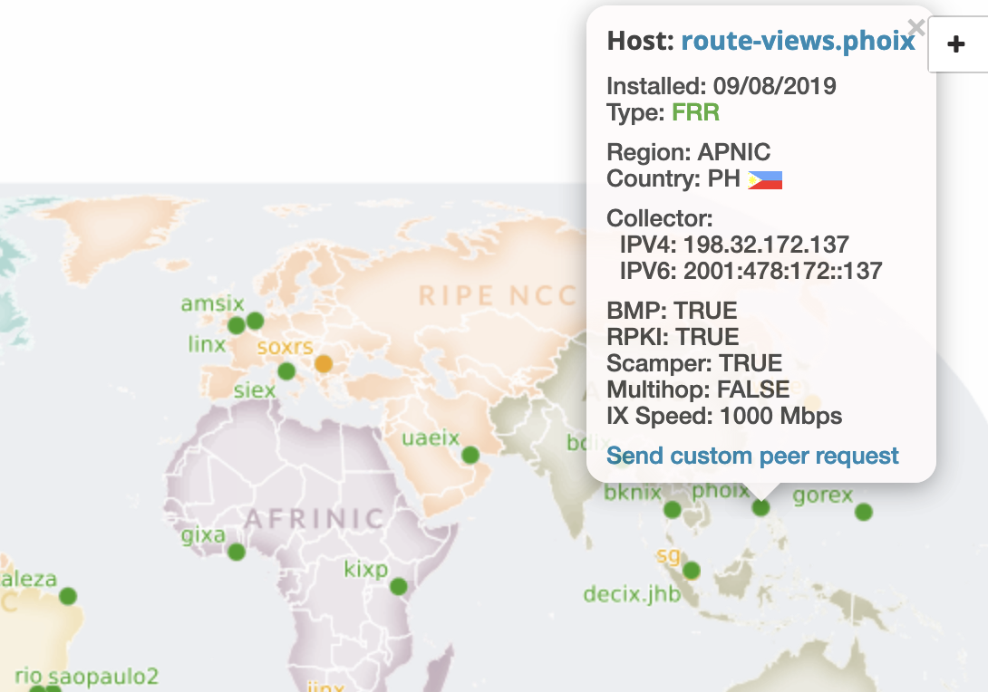
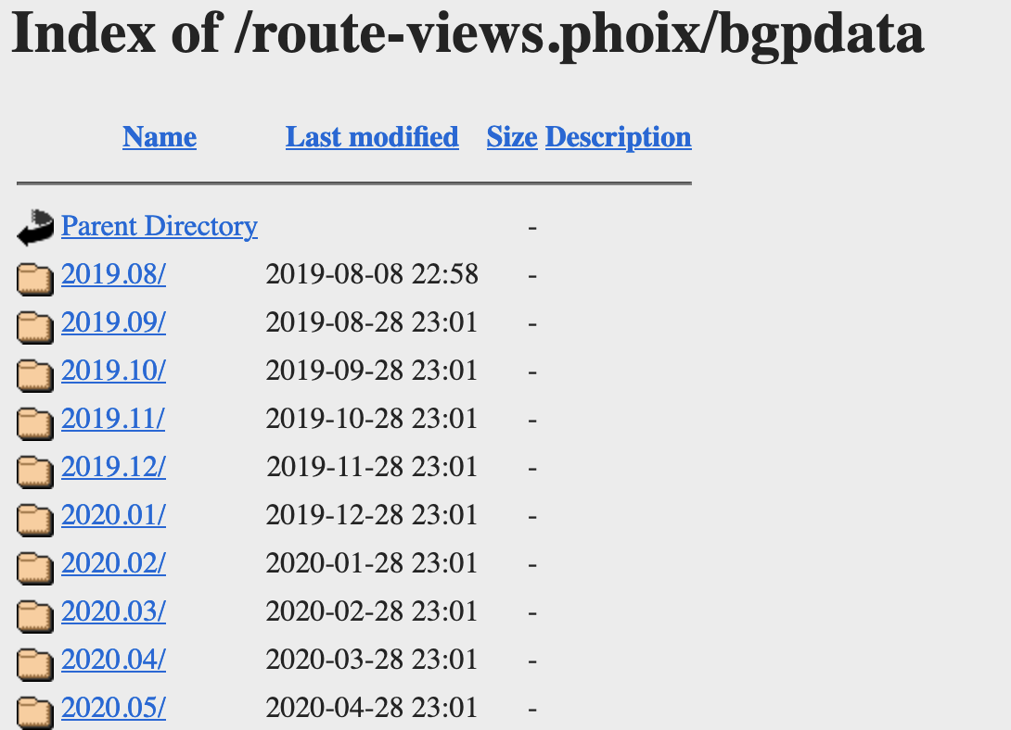
Collector Data
http://archive.routeviews.org/route-views.phoix/bgpdata/

Slide 10
PEERING HowTo
BGP Configuration
Send full-table if you can
Remove default route
Remove NULL routes
Remove RFC-1918 addresses
We don’t accept/want ADD-PATH TX/RX
We don’t send any routes to you
When peering with multi-hop collectors, set ebgp-multihop

Slide 11
MRT Tools
    https://bgpkit.com/ (BGP toolkit written in Rust)
      https://bgpkit.com/parser
    https://github.com/bgpkit
      https://github.com/bgpkit/bgpkit-parser
      https://github.com/bgpkit/peer-stats
      https://github.com/bgpkit/pybgpkit
    https://github.com/RIPE-NCC/bgpdump (Last updated 2020)
    https://github.com/cawka/bgpparser (Last updated 2015 ☹️)
    https://github.com/yasuhiro-ohara-ntt/bgpdump2
    https://github.com/t2mune/mrtparse (python)
    https://github.com/rfc1036/zebra-dump-parser (perl) (Last updated 2014 ☹️)
BGPKIT, RIPE LIBBGPDUMP, NTT BGPDUMP2, Etc

Slide 12
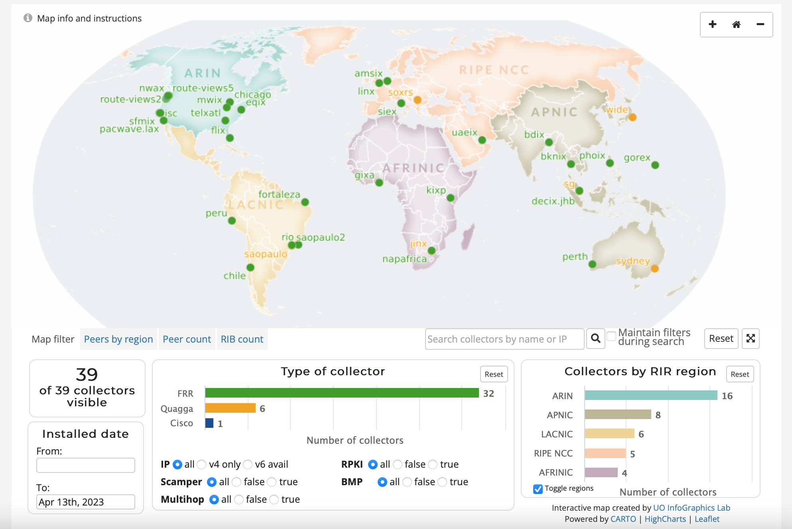
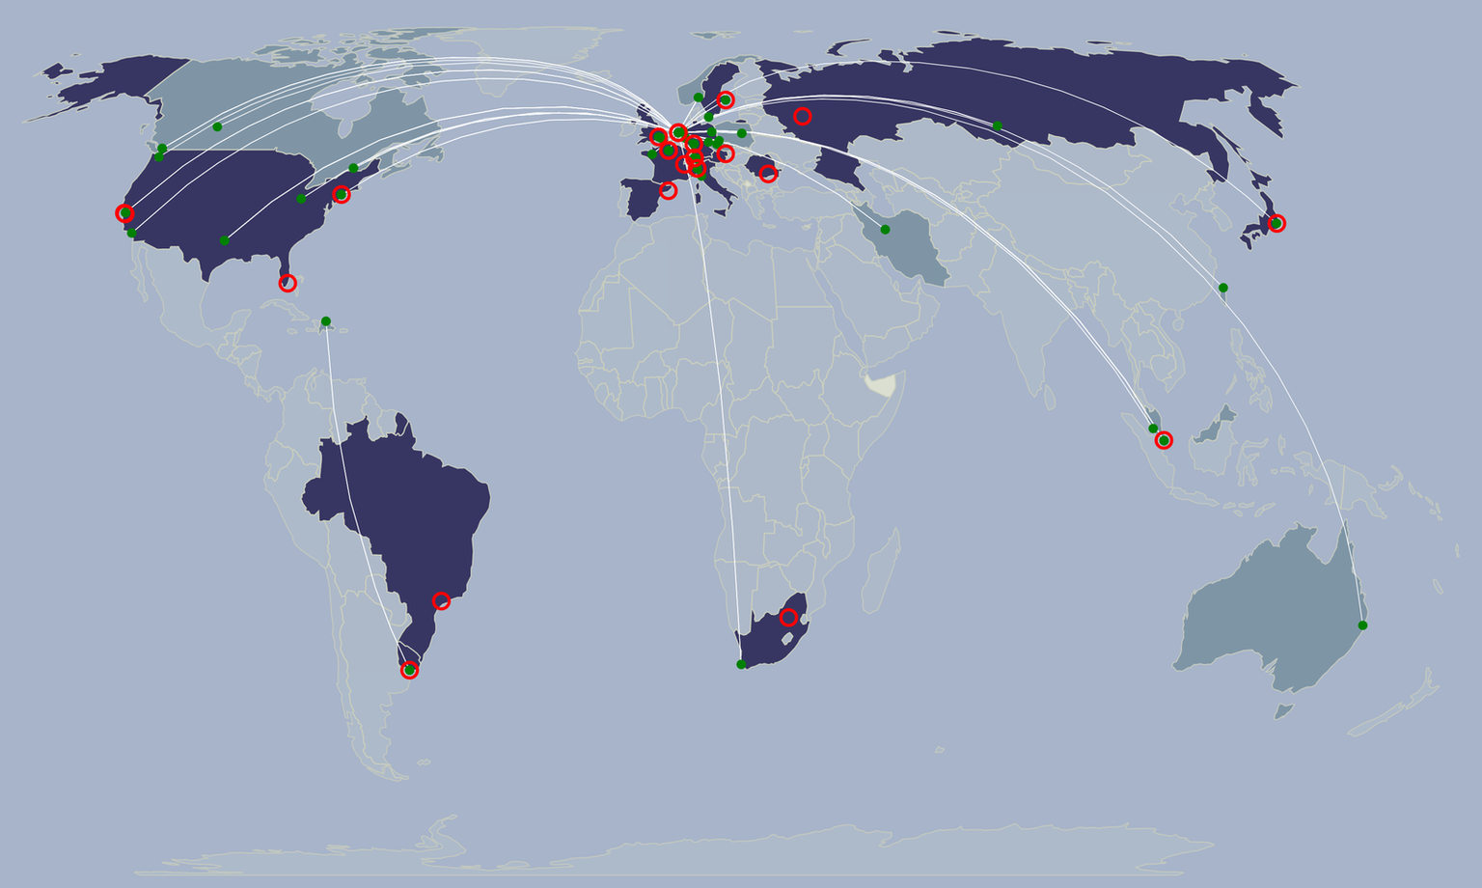
Route Collection: Global Community Cooperation
RIS Collector Map
RouteViews Collector Map
Extends coverage
Provides Redundancy
Complimentary Services
Common files/tools

Slide 13
RouteViews EU Collectors
route-views.amsix.routeviews.org> sh ip bg sum
IPv4 Unicast Summary (VRF default):
BGP router identifier 80.249.214.5, local AS number 6447 vrf-id 0
BGP table version 80501602
RIB entries 1823998, using 334 MiB of memory
Peers 62, using 44 MiB of memory
Two busiest collectors cannot endure more peers
Require additional collectors to expand in these locations
Would also like to expand into strategic EU locations:
Marseille anyone? :)
route-views.linx.routeviews.org> sh ip bg sum
IPv4 Unicast Summary (VRF default):
BGP router identifier 195.66.225.222, local AS number 6447 vrf-id 0
BGP table version 45222680
RIB entries 1824471, using 334 MiB of memory
Peers 76, using 54 MiB of memory

Slide 14
Use Cases
Operations
BGP is the backbone of the Global Routing Infrastructure.
To ensure its stability, it needs to be constantly monitored.
RouteViews provides:
  Command-Line/ Looking Glass
  Prefix Visibility, Verify Convergence, Path Stability
  Comparing Local/Regional/Global Views
  Troubleshooting Reachability
  Access to historical BGP data, i.e. “When did this happen??”

Slide 15
Use Cases
Accessing a Collector
telnet://route-views*.routeviews.org
No username necessary.
Users are able to run show commands, e.g. show ip bgp x.x.x.x/
Telnet access is rate-limited to prevent automation overuse
PLEASE don’t script. There is an API for that (http://api.routeviews.org).
Gotchas
Why not SSH?!
  RouteViews data are publicly available. We’ve got nothing to hide.
show ip route x.x.x.x next-hop is incorrect!
  Remember, this is a collector
  There’s no data-plane, thus no true FIB
  Kernel default-route points to transit provider next-hop

Slide 16
Use Cases
Operations
Worldwide CLI access – how to access a collector
telnet://route-views.routeviews.org
  route-views, route-views{2,3,4,6} are all housed at University of Oregon in the United States, and each collector has eBGP Multihop sessions with peers from around the world
Legacy Naming Scheme
  telnet://route-views.phoix.routeviews.org
  Other collector locations accessible via these 3rd level domains (replace “phoix”): amsix, eqix, telxatl, bknix, soxrs, chicago, bdix, uaeix, fortaleza, gixa, gorex, mwix, jinx, jhb, napafrica, peru, linx, flix, kixp, ny, isc, perth, nwax, rio, siex, sfmix, chile, saopaulo, sg, sydney & wide
New Naming Scheme
  (exchange).(closest airport).routeviews.org
  ie: decix.jhb.routeviews.org - Malaysia IX, Johor Bahru airport

Slide 17
Use Cases
New(er) Collector features
BMP
  BMP data will feed tools like BGPStream and ARTEMIS.
  Or write your own Kafka consumer for raw BMP data.
  Limited access at first.
  Wider availability to follow.
  RPKI data will be accessible directly from the collectors.
  We also are establishing an archive of RPKI ROA data.
  Working on back-filling that data set from the RIR/CAs.
RPKI

Slide 18
Use Cases
BGP Data Distribution
  “Message-based” data distribution (Kafka)
    Real-time streaming telemetry
    Per-message timestamps, with meta-data
    Middle-layer abstraction, multi-client access (facilitates analysis and services)
    Automated consolidating and sequencing
  RPKI validation and archival

Slide 19
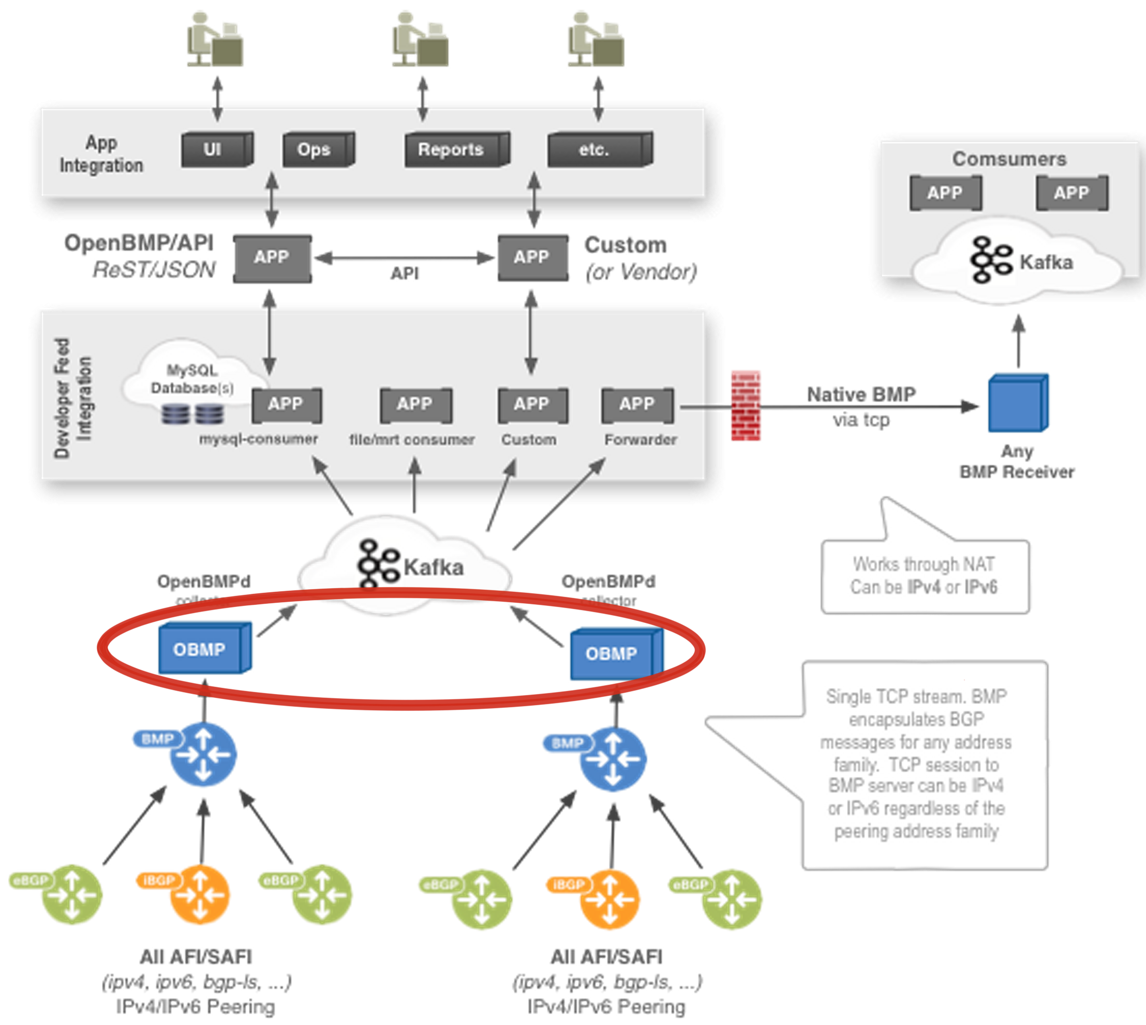
BMP & Open/GOBMP
BGP Monitoring Protocol (BMP) is an IETF standard rfc7854
  Available now – (Cisco, Juniper, Arista & FRR)
  Consolidates peers/collectors
  Splits collector, peer and update messages into separate streams
OpenBMP is OpenSource (under the Linux Foundation)
  Latest update: 2018 ☹️
GoBMP
  Latest update: September 2022 😀
Notes:
Collectors use BMP to send messages to OpenBMPd servers
OpenBMP currently supported by CAIDA (Center for Applied Internet Data Analysis) in conjunction with RouteViews
Allows high level of specificity/granularity

Slide 20
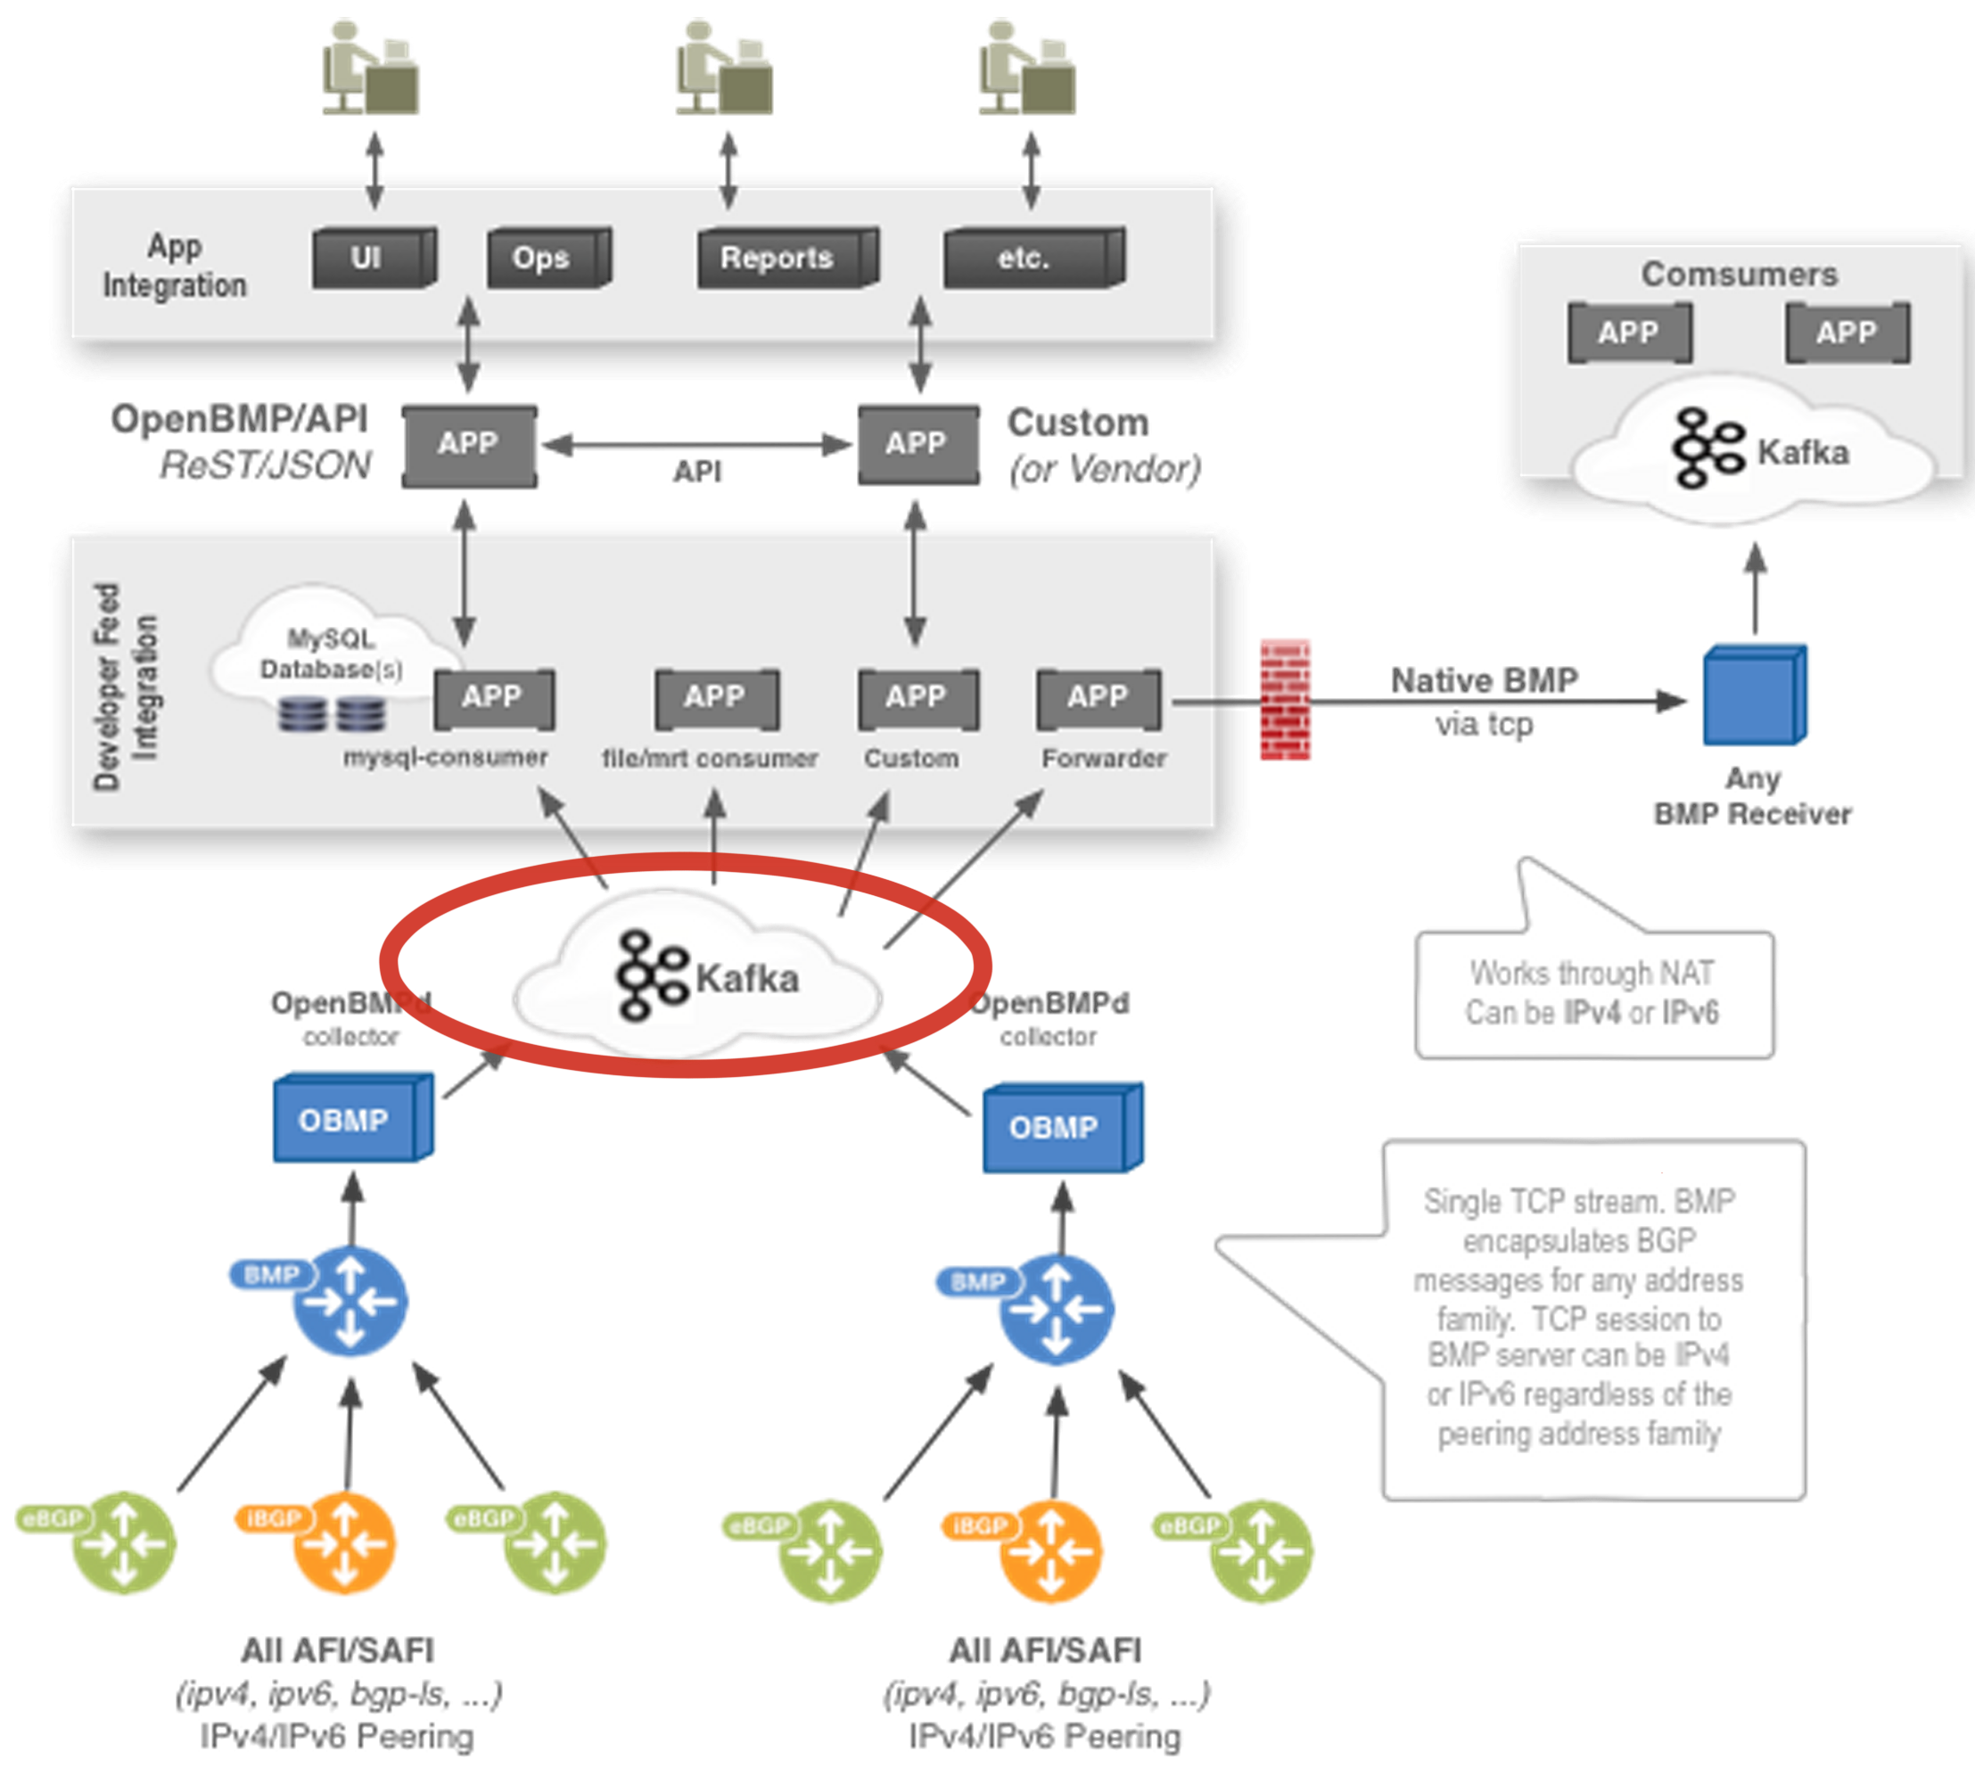
Apache Kafka
Apache Kafka comprises the message bus for OpenBMP
  Proven to scale
  Mature client API
    Clients in 16 different programming languages

Slide 21
Apache Kafka
Send email to:
  help@routeviews.org

Slide 22

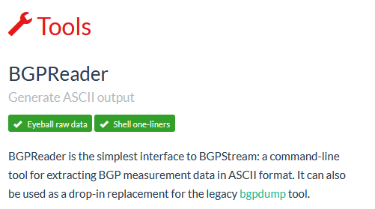
Use Cases
BGPStream is a project of CAIDA group at UC San Diego:
https://bgpstream.caida.org

Slide 23
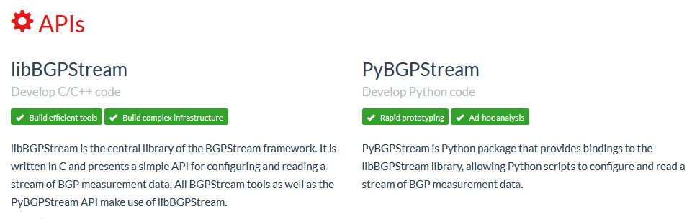
Use Cases
BGPStream is a project of CAIDA group at UC San Diego: https://bgpstream.caida.org

Slide 24
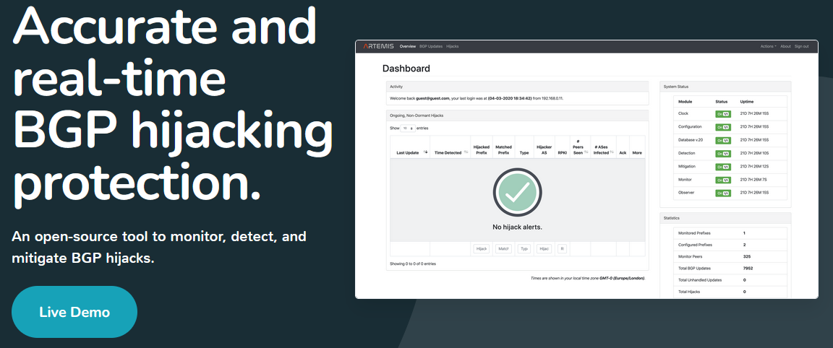
Use Cases
Other Open-Source tools: Artemis
ARTEMIS
  An open-source tool to monitor, detect, and mitigate BGP hijacks
  Real-time detection and notifications of BGP prefix hijacking attacks/events
  https://bgpartemis.org

Slide 25

Use Cases
Other Open-Source tools: BGPKIT
BGPKIT Parser
  Rust-based MRT/BGP Data Parser
BGPKIT Broker
  REST API for searching archive files across public data collection projects. Data updated in real-time.
BPPKIT Monocle
  A commandline application to search, parse, and process BGP information in public sources
https://bgpkit.com/

Slide 26
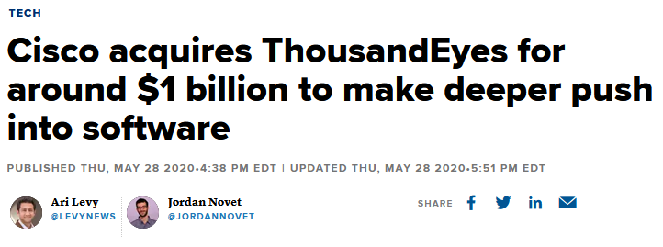
Use Cases
NOt-so open-source tools…

Slide 27
Use Cases
OPERATIONS
77 peers, multi-hop
route-views2.routeviews.org> sh ip bg sum
IPv4 Unicast Summary (VRF default):
BGP router identifier 128.223.51.102, local AS number 6447 vrf-id 0
BGP table version 14375055
RIB entries 1786807, using 327 MiB of memory
Peers 77, using 54 MiB of memory
Neighbor V AS MsgRcvd MsgSent TblVer InQ OutQ Up/Down State/PfxRcd PfxSnt Desc
4.68.4.46 4 3356 0 15732 0 0 0 never Active 0 Level3
5.101.110.2 4 14061 0 0 0 0 0 never Connect 0 DIGITALOCEAN
12.0.1.63 4 7018 9318817 31942 0 0 0 03w1d04h 909294 0 ATT
37.139.139.17 4 57866 9727660 63869 0 0 0 03w1d04h 911576 0 Fusix
43.226.4.1 4 63927 0 0 0 0 0 never Connect 0 Rise
45.61.0.85 4 22652 8018158 63869 0 0 0 03w1d04h 913095 0 FIBRENOIRE
62.115.128.137 4 1299 31136526 31866 0 0 0 01w3d16h 892007 0 Telia
64.71.137.241 4 6939 7260005 31935 0 0 0 03w1d04h 936399 0 Hurricane Electric
64.71.255.61 4 812 0 0 0 0 0 never Connect 0 Sprint
66.185.128.1 4 1668 0 0 0 0 0 never Connect 0 AOL
67.219.192.18 4 19653 0 0 0 0 0 never Active 0 CTSTelecom
68.67.63.245 4 22652 0 0 0 0 0 never Active 0 FIBRENOIRE
80.241.176.31 4 20771 0 0 0 0 0 never Connect 0 CAUCASUS
85.114.0.217 4 8492 13486557 63875 0 0 0 01w4d01h 924556 0 OBITRU
87.121.64.4 4 57463 13008288 32486 0 0 0 01w3d12h 413863 0 NETIXLTD
89.149.178.10 4 3257 8721640 31936 0 0 0 03w1d04h 909050 0 Tiscali
91.209.102.1 4 39756 0 0 0 0 0 never Connect 0 HOSTWAY-RO
91.218.184.60 4 49788 17361887 31939 0 0 0 01w3d15h 915046 0 NEXTHOPNO
…
Total number of neighbors 77
Not all peers are up..
Lots of full tables

Slide 28
Use Cases
OPERATIONS
route-views2.routeviews.org> sh ip bgp 45.235.208.0/22
BGP routing table entry for 45.235.208.0/22, version 1474520
Paths: (30 available, best #25, table default)
Not advertised to any peer
11686 52320 22381 22381 22381 22381 11432 11432 11432 11432 11432 11432 11432 11432 11432 11432 11432 11432 11432 11432 11432 11432 11432 11432 11432 11432 11432 11432 11432 268214
96.4.0.55 from 96.4.0.55 (96.4.0.55)
Origin IGP, valid, external, rpki validation-state: not found
Community: 11686:294
Last update: Tue May 9 04:34:01 2023
22652 4230 11432 268214
45.61.0.85 from 45.61.0.85 (184.95.245.30)
Origin IGP, valid, external, rpki validation-state: not found
Community: 4230:11 4230:30 4230:511 4230:5101
Last update: Sat May 6 08:05:45 2023
8492 31133 3356 268214 268214
85.114.0.217 from 85.114.0.217 (85.114.0.104)
Origin IGP, valid, external, rpki validation-state: not found
Community: 8492:1104 8492:1601
Last update: Thu May 4 05:57:42 2023
…
What is ASN:11432 trying to achieve by prepending 23 times??

Slide 29
Use Cases
OPERATIONS
ASn: 203905 ??
route-views2.routeviews.org> sh ip bgp rpki invalid
...
I* 212.193.8.0/24 168.209.255.56 0 3741 5511 6453 8551 203905 i
I* 194.153.0.253 0 5413 8551 203905 i
I* 45.61.0.85 0 22652 6453 8551 203905 i
I* 91.218.184.60 0 49788 12552 8551 203905 i
I* 198.129.33.85 710 0 293 6453 8551 203905 i
I* 212.66.96.126 0 20912 49367 6762 61135 61135 60446 204843 204843 204843 i
I* 202.232.0.3 0 2497 6453 8551 203905 i
I*> 85.114.0.217 0 8492 8551 203905 i
I* 203.189.128.233 0 23673 23764 8551 203905 i
I* 94.156.252.18 0 0 34224 6453 8551 203905 i
ASn: 204843 ??
Two ASN: of origin ??

Slide 30
Use Cases
OPERATIONS
WHOIS Lookup ( 212.193.8.0 )
inetnum: 212.193.8.0 - 212.193.8.255
netname: AjyalFiCompanyLLC
country: PS
admin-c: KB5060-RIPE
tech-c: KB5060-RIPE
status: ASSIGNED PA
abuse-c: AR68281-RIPE
mnt-by: lir-ae-rcstechnologies-1-MNT
mnt-by: interlir-mnt
created: 2023-01-12T18:31:35Z
last-modified: 2023-01-12T18:31:35Z
source: RIPE
Palestine

Slide 31
Use Cases
OPERATIONS
WHOIS Lookup ( AS204843 )
...
organisation: ORG-SVMY1-RIPE
org-name: STERLY VERI MERKEZI YAZILIM VE SIBER GUVENLIK HIZMETLERI A.S.
country: TR
org-type: OTHER
address: KONAK MAH. BARIS(120) SK. OFIS ARTI BLOK NO:3 IC KAPI NO:10 NILUFER/BURSA
abuse-c: ACRO48320-RIPE
mnt-ref: ulasatakan
mnt-ref: bggroupittelecom-mnt
mnt-by: lir-tr-teknosos-1-MNT
mnt-by: Teknosos-TR
created: 2022-05-27T09:14:49Z
last-modified: 2022-12-01T17:27:16Z
source: RIPE # Filtered
From Turkey ??

Slide 32
Use Cases
OPERATIONS
WHOIS Lookup ( AS203905 )
...
as-block: AS196608 - AS207419
...
admin-c: KB5060-RIPE
tech-c: KB5060-RIPE
status: ASSIGNED
mnt-by: RIPE-NCC-END-MNT
mnt-by: DigiComm-MNT
created: 2015-10-06T13:35:54Z
last-modified: 2023-02-04T17:55:17Z
source: RIPE # Filtered
organisation: ORG-DCL18-RIPE
org-name: Digital Communication Company for Telecommunications and Information Technology LTD
country: PS
org-type: LIR
address: Omar Al-Mokhtar st., Khaduir Building Floor #2
address: 9990300
address: Gaza Al-Remal
address: PALESTINE, STATE OF
From Palestine

Slide 33
Use Cases
OPERATIONS
ASN: 203905
route-views2.routeviews.org> sh ip bgp rpki invalid
...
I* 212.193.8.0/24 168.209.255.56 0 3741 5511 6453 8551 203905 i
I* 194.153.0.253 0 5413 8551 203905 i
I* 45.61.0.85 0 22652 6453 8551 203905 i
I* 91.218.184.60 0 49788 12552 8551 203905 i
I* 198.129.33.85 710 0 293 6453 8551 203905 i
I* 212.66.96.126 0 20912 49367 6762 61135 61135 60446 204843 204843 204843 i
I* 202.232.0.3 0 2497 6453 8551 203905 i
I*> 85.114.0.217 0 8492 8551 203905 i
I* 203.189.128.233 0 23673 23764 8551 203905 i
I* 94.156.252.18 0 0 34224 6453 8551 203905 i
ASn: 204843 Not valid origin ?
Mis-configuration? prefix Hijack??

Slide 34
OTHER BITS..
RouteViews email list
  https://lists.nsrc.org/listinfo/routeviews-users
  Also available on the Contact page at routeviews.org
  A place to ask question and receive updates on RouteViews activities.
  Hosted by the wonderful folks at NSRC.

Slide 35
RouteViews Impact
Geoff Huston wrote in his report, “BGP in 2022 – the routing table”:
“I should take a moment to mention the RouteViews Project. It was originally intended to offer a multi-perspective real-time view of the inter-domain routing system, allowing network operators to examine the current visibility of route objects from various points in the inter-domain topology.
What makes RouteViews so unique is that it archives these routing tables every two hours and has done so for more than two decades. It also archives every BGP update message. This vast collection of data is a valuable research data source in its own right, and here we are just taking a tiny slice of this data set to look at longer-term routing growth trends.
The folk at the RouteViews Project, with support from the University of Oregon and the US National Science Foundation, should be commended for their efforts here. This is a very unique data set if you are interested in the evolution of the Internet over the years.”

Slide 36
RouteViews Impact
Aftab Siddiqui:
"The MANRS Observatory relies heavily on BGPStream and GRIP for the detection of BGP related incidents such as BGP Leakss and BGP mis-origination. It is also very critical to verify that any incident highlighted by these services can be verified independently and to do that we require raw BGP data which is made available by 2 sources: RIPE RIS and RouteViews. Diversity of data sources is once again very important to verify any such incidents. NSRC, which manages the RouteViews project, ensures that the routing data they provide is accurate and they have promptly addressed any issues or concerns raised by the MANRS team, whether it is related to changes in the MRT format causing problems in data parsing or helping with BMP data. Actively maintaining RouteViews provides community service by NSRC.
MANRS has gained a lot of good reputation in the community due to the support and expertise provided by its partners such as NSRC. NSRC included MANRS Action explanation and implementation guidelines in their training courses for network operators and R&E networks, in their technical video content, and has been promoting various MANRS programs to respective communities specifically in Asia Pacific and Africa where the MANRS participation is low as compared to other regions.”

Slide 37
THANK YOU
Questions?

