Slide 1
Securing Internet Routing:
The Puzzle Pieces
BPF2024 | 30 May 2024| Bangkok
Tashi Phuntsho
Network Engineer/Trainer @NSRC

Slide 2
Acknowledgment
Slides/ideas from
  Randy Bush (IIJ Labs/Arrcus)
  Geoff Huston (APNIC)
  Aftab Siddiqui (ISOC)
  Job Snijders (Fastly)
  Alexander Azimov (Yandex)
  Alexander Lyamin (Qrator)
  Yoshinobu Matsuzaki (IIJ/APNIC)

Slide 3
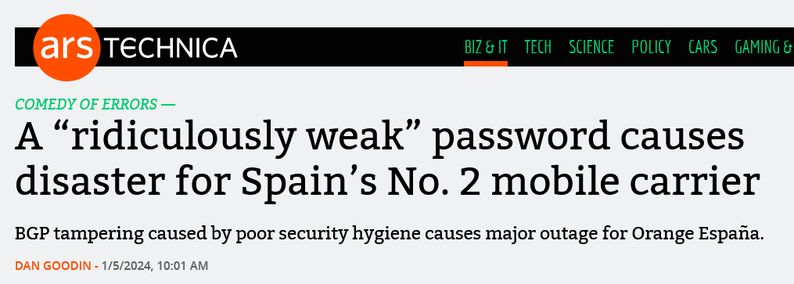
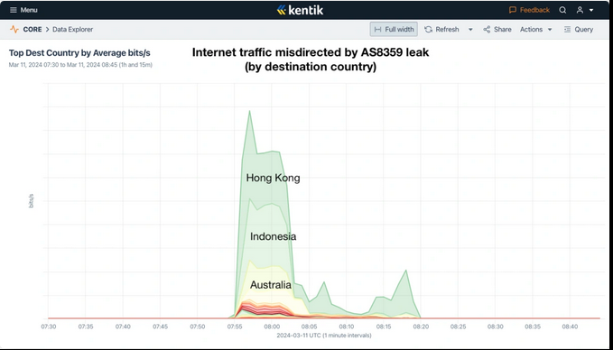
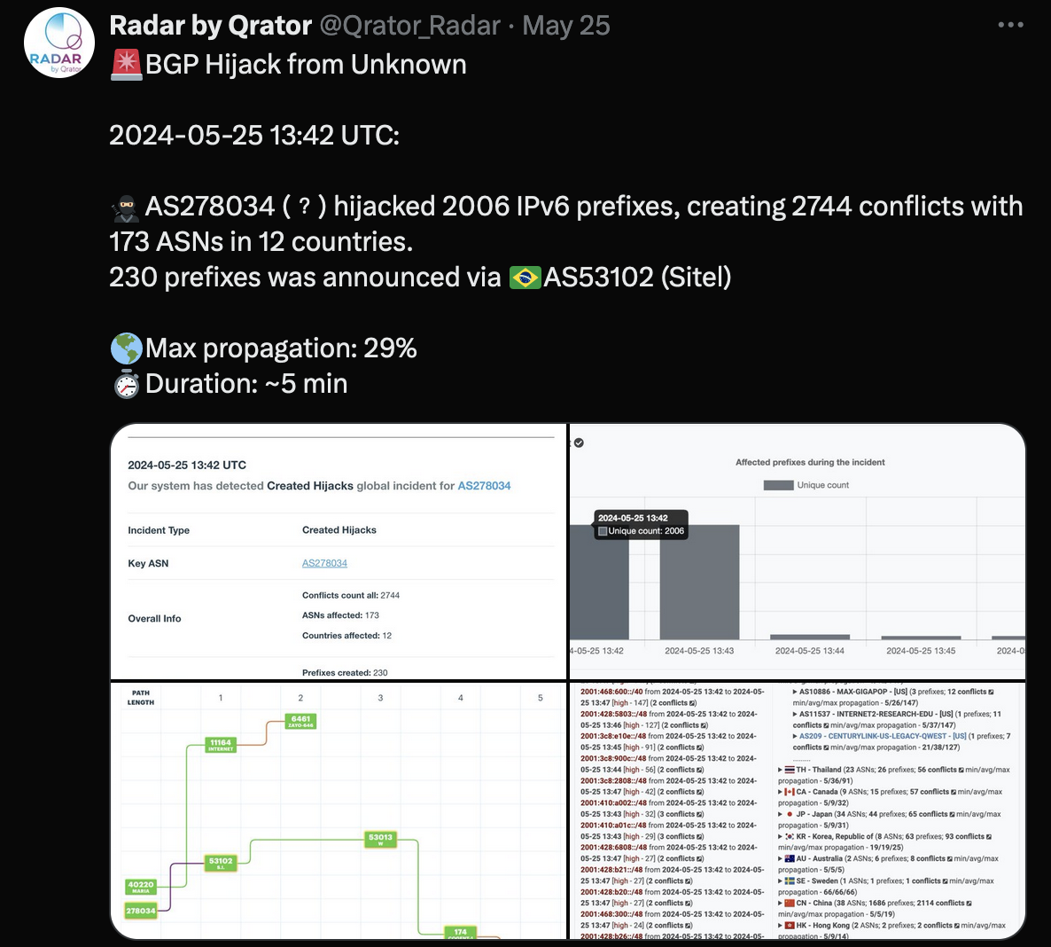
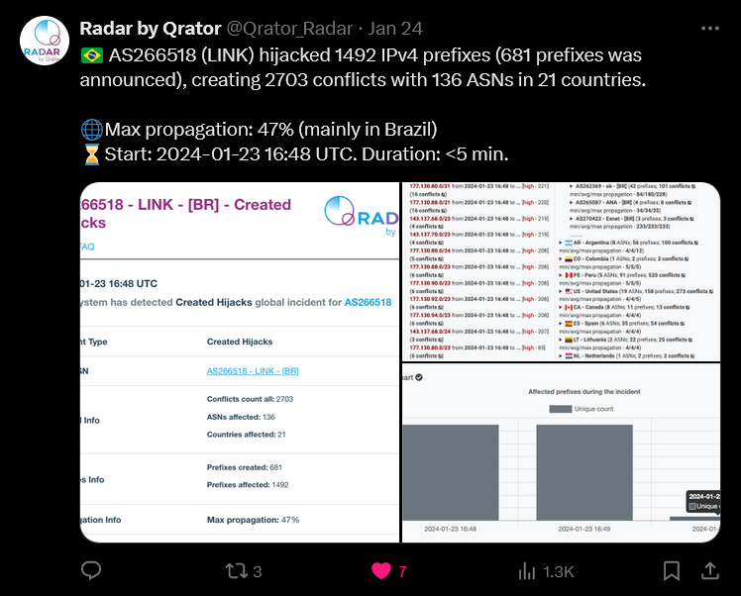
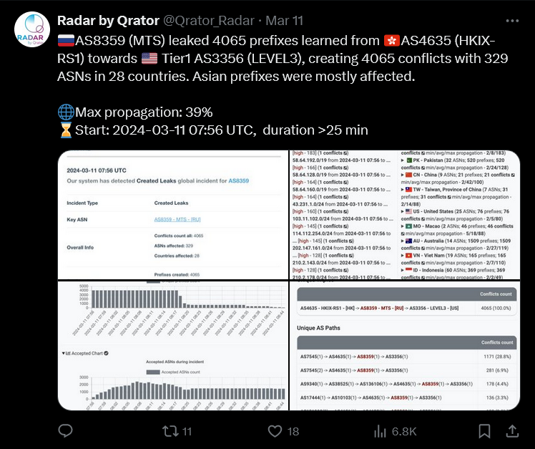
Headlines/Incidents
Notes:
Orange Spain: 4 Jan (Wed)
Saturday, 25 may: an unallocated ASN

Slide 4
WHY
NO ONE is in charge?
  No single authority point for the Internet
  No REFERENCE point for what’s RIGHT in routing

Slide 5
WHY
Routing works by RUMOUR
  TELL what you know to your neighbours/LEARN what your neighbours know
  Assume everyone is CORRECT/HONEST
    Is the originating network the rightful owner?

Slide 6
WHY
Routing works in REVERSE
  What you TELL others (outbound adv) affects inbound traffic
  What you TRUST and ACCEPT (inbound adv) affects outbound traffic

Slide 7
WHY
And sadly, there is no EVIL (E-bit) bit
  RFC3514 was a humorous attempt ☺
Since a bad routing update does not identify itself as BAD:
  Can we identify GOOD updates?
  How do we identify what is GOOD?

Slide 8
Identifying GOOD
Back to basics - can we use Digital Signatures to convey the Authority to use?
  Private key to sign the Authority, and
  Public key to validate the Authority
If the holder of the resource has the private key, it can sign/authorise the use of the resource(s)!

Slide 9
Identifying GOOD
Ok, let us use digital signatures, but how do we establish TRUST in this framework?
  Follow the numbered resource allocation hierarchy
Regional Internet Registries (RIRs)
CERT (CA)
CERT (CA)
National IRs
CERT (EE)
CERT (EE)
ISP
ISP

Slide 10
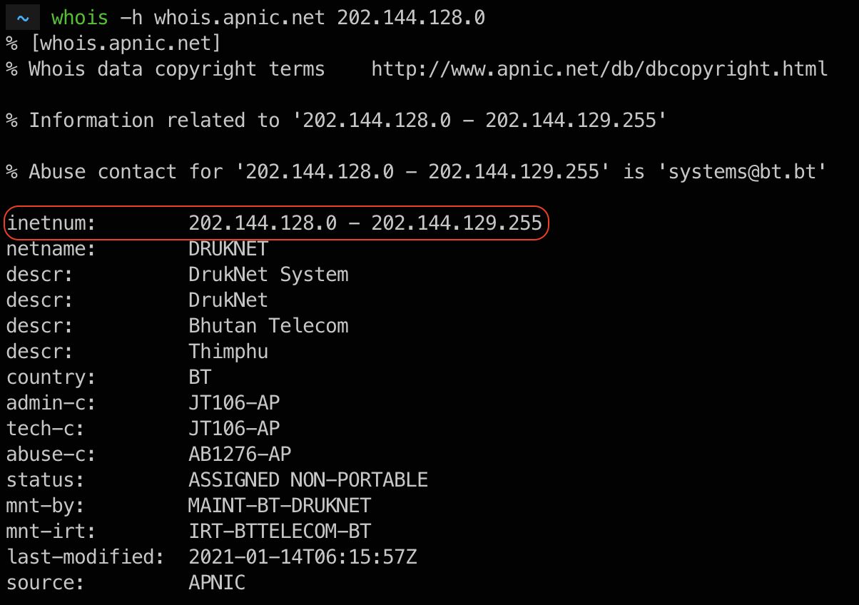
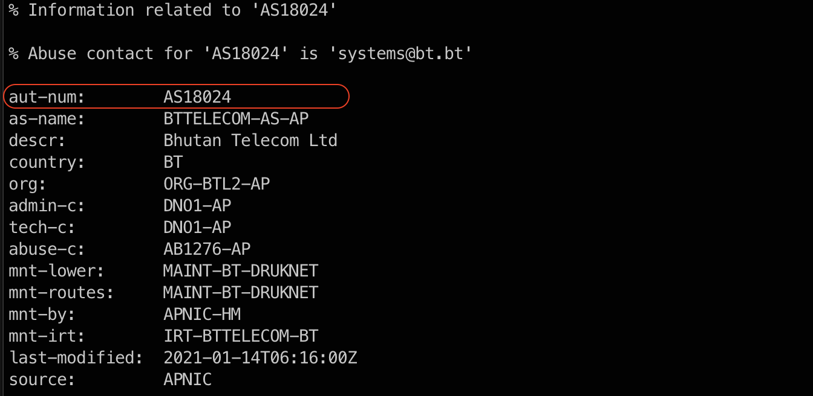
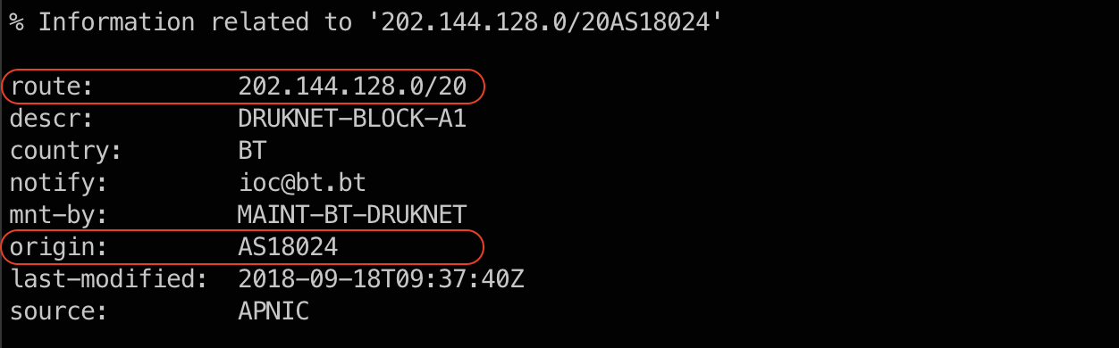
Puzzle Pieces
WHOIS lookup – to verify the holder of a resource(s)

Slide 11
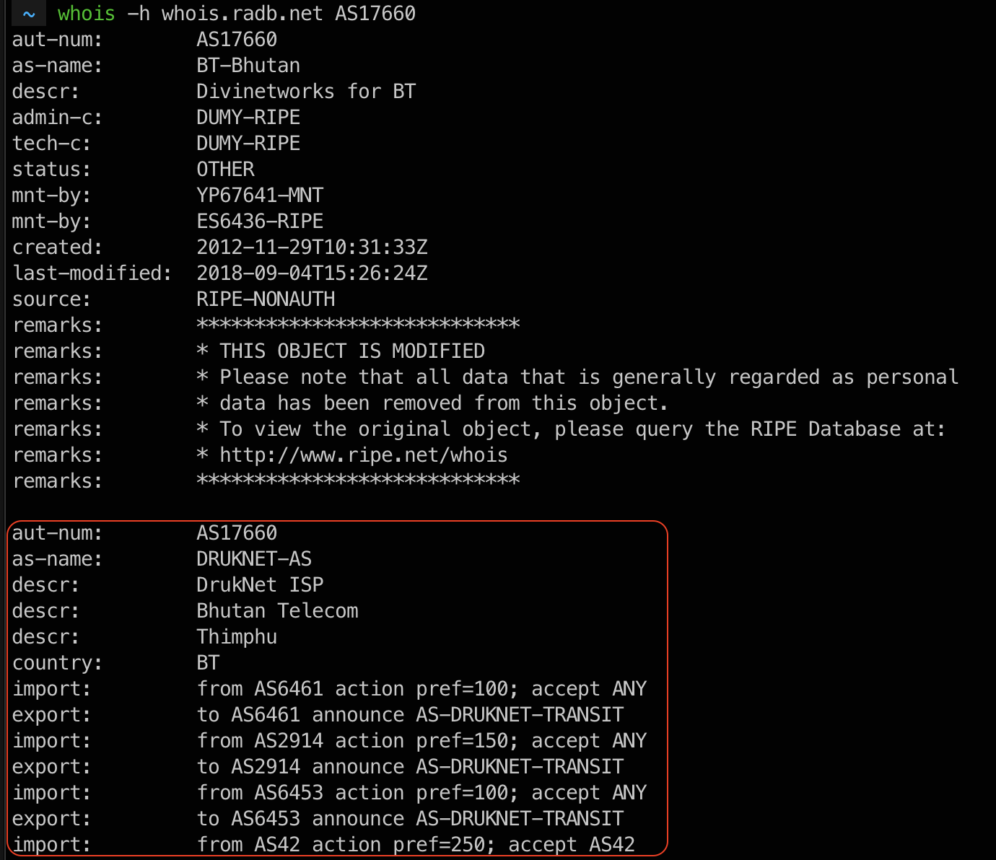
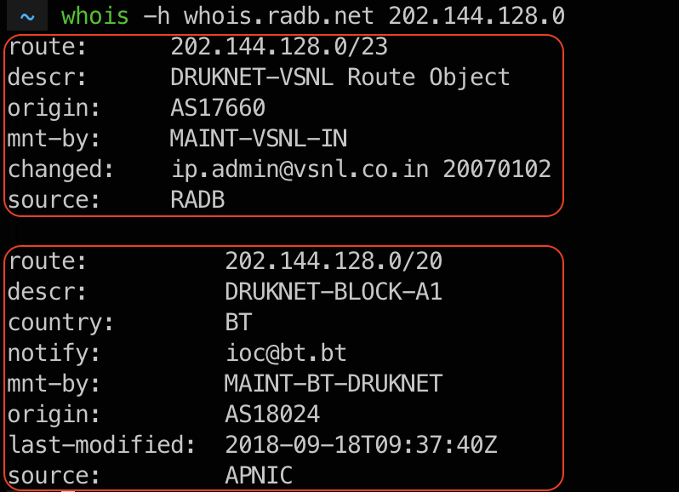
Puzzle Pieces
IRR (Internet Routing Registry) lookup
  Publish my routing intent (route origination) and in some cases, inter-AS routing policies

Slide 12
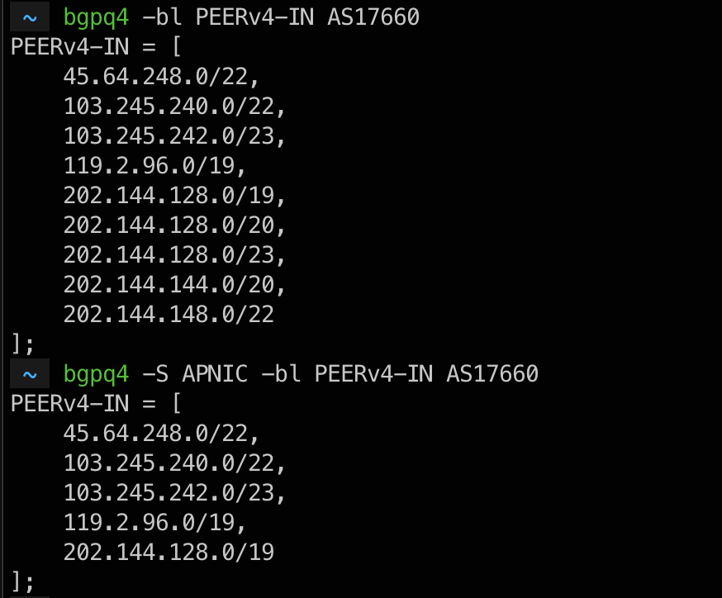
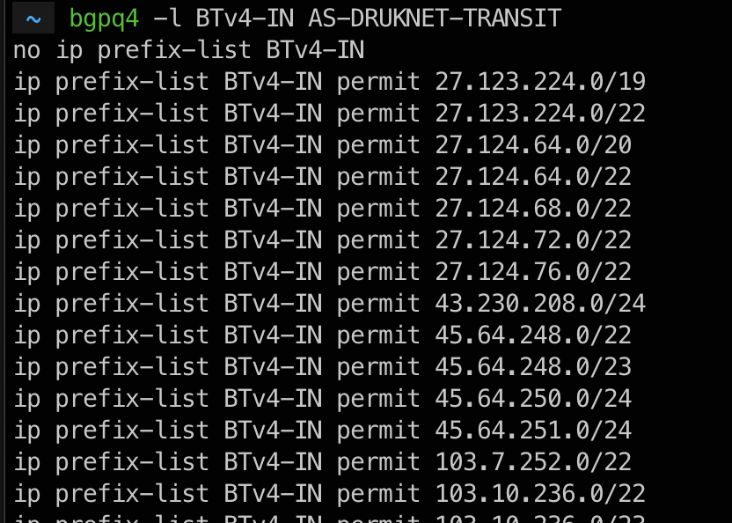
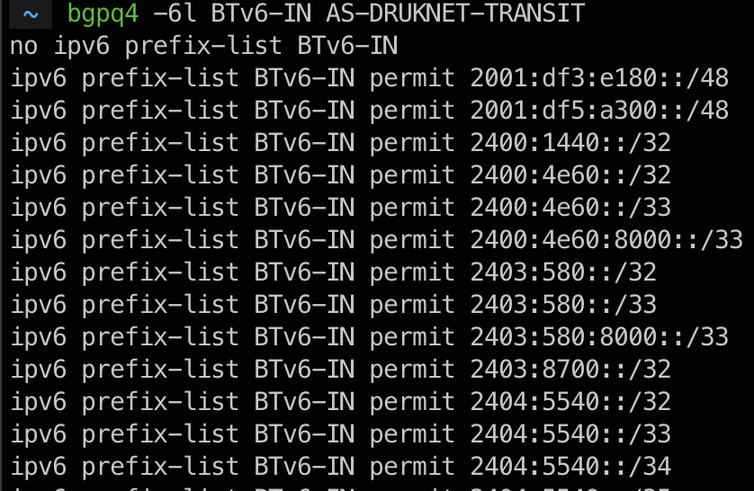
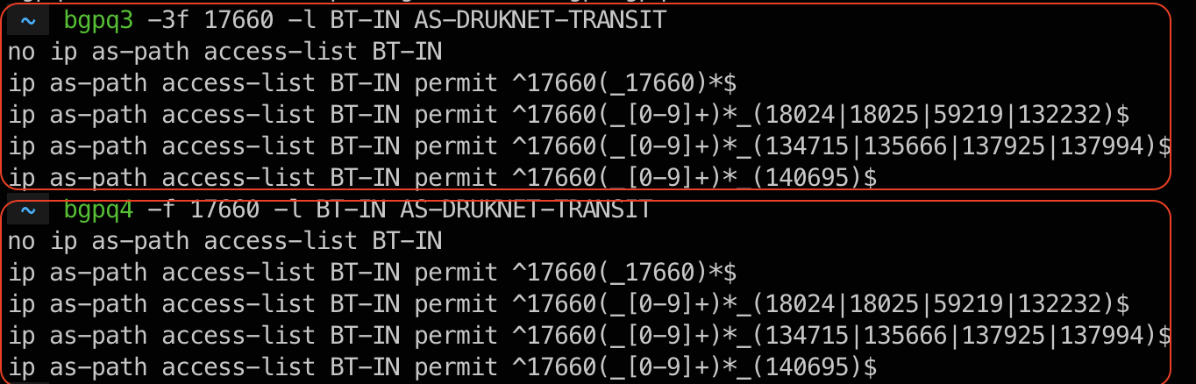
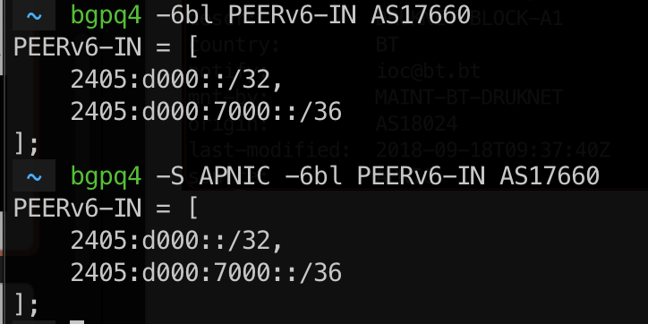
Puzzle Pieces
IRR (Internet Routing Registry) entries
  Helps craft route filters (prefix/as-path) with RPSL tools (rtconfig/bgpq3-4)

Slide 13
Puzzle Pieces
Issues with IRR
  No single authority model
    Is an entry genuine/correct?
  Too many RRs
    If two RRs contain conflicting data - which one to use/trust?
  Incomplete data
    If a route is not in a RR ~ invalid or is the RR just missing data?
Issues with IRR Filters
  Your filters ONLY as good as the correctness of the IRR entries!
    GOOD idea to rely on authoritative sources:
      -S in bgpq3/4, or –s in rtconfig

Slide 14
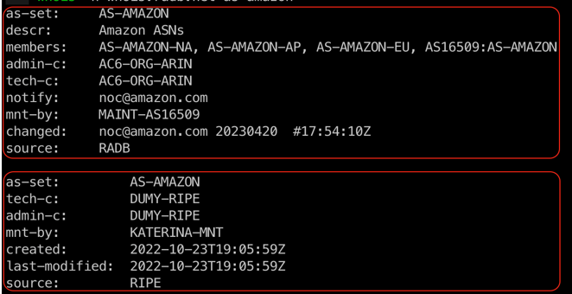
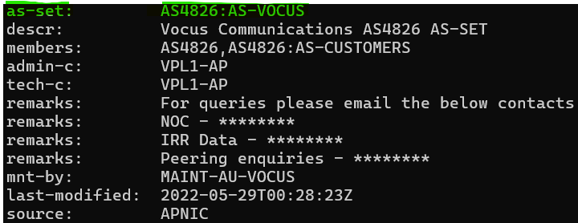
Aside – IRR improvements
prop-151 (Aftab): restricting non-hierarchical as-set
  Helps fix name collision issues
  as-set can ONLY be created by the maintainer of the ASN in the object
Hierarchical as-set (RFC2622)
  AS-DRUKNET-TRANSIT
    non-hierarchical as-set
  AS4826:AS-VOCUS
    hierarchical as-set
    <AS#>:AS-<as_set_name>

Slide 15
Aside – IRR improvements
RADB & RPKI
    RADB migrated to IRRDv4 on 13th November 2023
    New RPKI based features implemented
      route/route6 objects that is inconsistent with a corresponding ROA will be rejected
      RPKI Invalid objects will no longer be visible in a query
      Not Found or Valid will not be affected
Route: 1.1.1.0/24
Origin: AS13335
Source: RADB
Prefix: 1.1.1.0/24
ASN: 13335
Route: 1.1.1.0/25
Origin: AS13335
Source: RADB
Route: 1.1.1.0/25
Origin: AS12345
Source: RADB

Slide 16
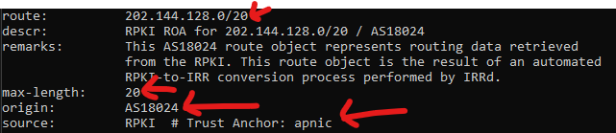
Puzzle Pieces
Route Origin Authorization (ROA)
    Binding of prefixes & nominated ASN
    Can be verified crypto-magically
    Multiple ROAs can exist for the same prefix
CA
X.509 CERT
RFC 3779
EXTENSION
IP RESOURCES
(ADDRESS & ASN)
Signed by parent’s pvt key
Prefix | 202.144.128.0/20
Max-length | /20
Origin ASN | AS18024
SIA
(URI WHERE THIS PUBLISHES)
OWNER’S PUBLIC KEY

Slide 17
Puzzle Pieces
Route Origin Validation (ROV)
    Validating received routes against validated ROAs
  What can it help with?
    Validate if an ASN is permitted to originate a route
    Prevent Origin hijack/fat fingers
2001:DB8::/36
64552
64551
64550
2001:DB8::/32-36
64550
Validator
64553
RPKI Repo
RPKI-to-Router
2001:DB8::/36 64552 64551 64550 i
Valid
rsync/RRDP
2001:DB8::/36 65501 65500 i
Invalid
2001:DB8::/32-36
64550
65501
2001:DB8::/36
65500

Slide 18
Puzzle Pieces
ROA BCPs
  Use max-length judiciously
    Only cover those prefixes announced in BGP ~ minimal ROA RFC9319
  Multi-ASN network?
    Aggregates/sub-aggs: Transit ASN
    More specifics: Access ASN
  ROA with AS0 origin (RFC7607)
    Not to be confused with undelegated/unassigned AS0 ROA
ROV BCPs
  Default routes?
  Secure the RTR session
    SSH/MD5/TLS/TCP-AO/TLS
  iBGP propagation – RFC8097
  Know your platform:
    RTR refresh timer → route refresh (Adj_RIB_In or soft reconfig in)
https://blog.apnic.net/2022/04/04/rpki-2021-retrospective/
https://blog.apnic.net/2020/04/10/rise-of-the-invalids/

Slide 19
Puzzle Pieces
Are ROAs and ROV enough?
  Forged origin ASN: will PASS the ROV test & will be accepted as GOOD
Ideas?
  Secure the PATH ~ AS path validation (per prefix) → BGPsec
Cert (CA)
Prefix EE
ROA
RIR
202.144.128.0/19
202.144.128.0/20
CA
Bhutan Telecom
Public Key
AS17660
Encodes ASN and Router ID
Cert (CA)
202.144.128.0/19
AS17660
Bhutan Telcom
CA
Router EE
AS Cert
Router EE
Router EE
AS17660
AS17660
rtr-00
Public Key
AS17660
rtr-00
AS17660
rtr-00
Public Key
Public Key
Public Key
Public Key
Notes:
Per router keys (as opposed to per ASN key)

Slide 20
Puzzle Pieces
BGPsec (RFC8205)
  Forward Path Signing
    AS1 signs the message to AS2
    AS2 signs the message to AS3/AS4, encapsulating AS1’s message
  Validation
    ROA check for the prefix and origin AS
    validate the received AS path against the chain of signatures (for each AS in the AS path) with AS key
AS2->AS3
(signed AS2)
AS1 -> AS2
(Signed AS1)
AS3
AS1
AS2
AS1 -> AS2
(Signed AS1)
AS4
AS2->AS4
(signed AS2)
AS1 -> AS2
(Signed AS1)

Slide 21
Puzzle Pieces
BGPsec (RFC8205) Challenges
  Cannot jump across non-BGPsec routers/networks
    traditional BGP (no BGPsec UPDATE messages)
  Complex crypto & key distribution mechanism
    CPU intensive (validate signatures)
    Memory intensive (per prefix BGPsec UPDATE; new attributes to carry signatures and certs/key IDs for every AS in the AS path)
  Possible hack
    Routers could generate key pair -> send cert request to RPKI for signing
  Lack of clarity
    distributing the collection of certs required to validate path signature

Slide 22
Puzzle Pieces
Route leak prevention
    We already talked whitelist of customer/peer prefixes under IRR filtering
  Don’t announce routes/prefixes learned from your peers to other peers
  Apply max prefix limits ~ doesn’t help against partial leaks.

Slide 23
Puzzle Pieces
Peerlock-lite ~ adapted from Job’s NANOG67
    Wikipedia says [7018, 7922, 3320, 3257, 6830, 3356, 2914, 5511, 3491, 1239, 6453, 6762, 1299, 12956, 701, 6461]
      https://en.wikipedia.org/wiki/Tier_1_network
  Will you sell transit to these networks?
      REJECT any prefixes you receive from your customers which contains a big network ASN anywhere in the AS_PATH
ip as-path access-list 99 permit \
_(174|701|1239|1299|2828|2914|3257|3320|3356 \
|3549|5511|6453|6461|6762|7018|12956)_
route-map ebgp-customer-in deny 1
match as-path 99

Slide 24
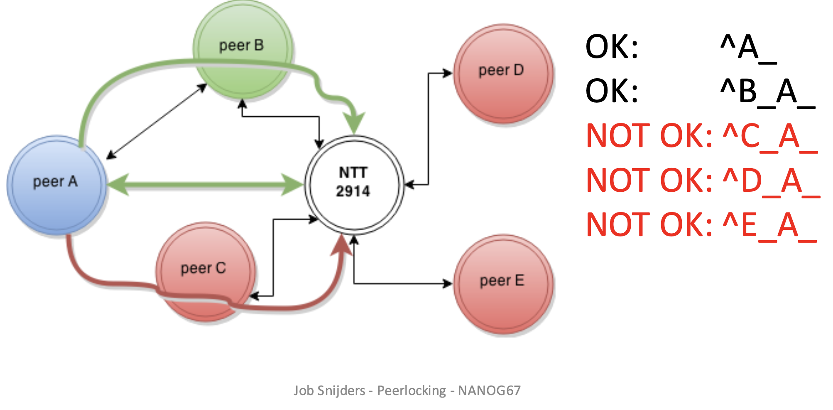
Puzzle Pieces
Peerlock~ adapted from Job’s NANOG67 talk
      Given ASNs A, B, C, D, and E as NTT’s peers.
      Peer A subscribes to the peerlock idea (Protected ASN) and indicates that peer B is an ”Allowed Upstream”

Slide 25
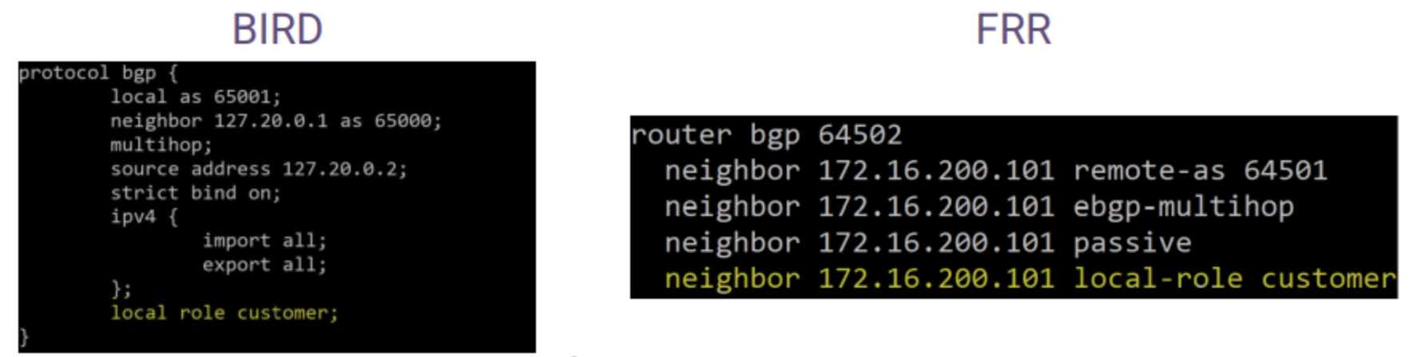
Puzzle Pieces
BGP Roles
    Update to the BGP OPEN message ~ BGP Role Capability
    Must be advertised to and received from a peer
      If advertised and but not received: SHOULD ignore and establish traditional session
      Strict mode: if advertised and not received - REJECT
    Roles:
      Provider | Customer | Peer | RS | RS-client
    Allowed relationship pairs:
      Provider <-> Customer
      Customer <-> Provider
      RS <-> RS-Client
      RS-Client <-> RS
      Peer <-> Peer
https://blog.qrator.net/en/route-leak-prevention-and-detection-rfc9234_162/

Slide 26
Puzzle Pieces
BGP Roles
  Only to Customer (OTC) attribute
    Optional non-transitive attribute
  Ingress procedure:
    If a route with the OTC Attribute is received from a Customer or an RS-Client, then it is a route leak and MUST be considered ineligible.
  Egress procedure:
    If a route contains the OTC Attribute, it MUST NOT be propagated to Providers, Peers, or RSes
Solution | Status | Version
BIRD | + | Appeared in 2.0.11
FRR | + | Appeared in 8.4
OpenBGPD | + | 7.5
Mikrotik | Reduced functionality | Appeared before RFC
https://blog.qrator.net/en/route-leak-prevention-and-detection-rfc9234_162/

Slide 27
Puzzle Pieces
ASPA (AS Provider Authorization)
    Looks at malformed AS_PATHs from customers and peers to detect malicious hijacks and route leaks
  ASPA is a digitally signed object that binds
    Set of Provider ASNs (SPAS) to a Customer ASN (CAS) for a specific AFI – signed by the holder of the Customer ASN
  For Routing, the ASPA is an attestation
    that the AS holder (CAS) has authorized the SPAS to propagate its announcements onwards (upstreams/peers)

Slide 28
Puzzle Pieces
ASPA (AS Provider Authorization) object
ASPA := {
customer_asn (signer)
providers (authorized to propagate to peers/upstreams)
AFI (IPv4/IPv6)
}

Slide 29
Puzzle Pieces
Pair Verification (AS1, AS2)
    Retrieve cryptographically valid ASPA in a selected AFI with a customer value of AS1.
    If there is no valid ASPA record for AS1 the procedure exits with an outcome of unknown
    If AS2 is included in the SPAS, then the procedure exits with an outcome of valid
    Otherwise, the procedure exits with an outcome of invalid

Slide 30
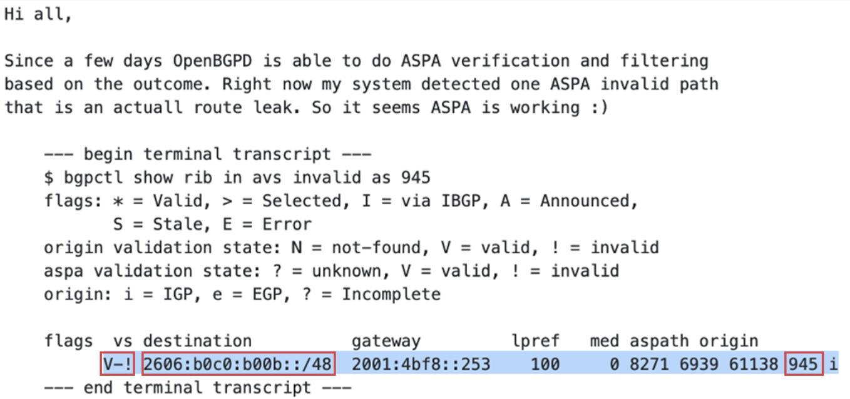
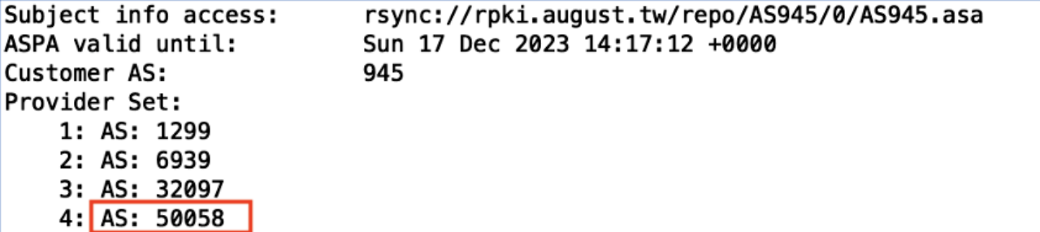
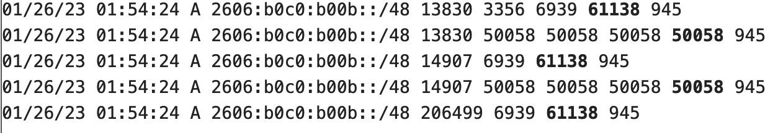
Puzzle Pieces
ASPA in ACTION - 26 January’23
https://www.manrs.org/2023/02/unpacking-the-first-route-leak-prevented-by-aspa/

Slide 31
Puzzle Pieces
ASPA ~ Timeline [BGP, RP, RTR, Signer]
OpenBSD rpki-client and OpenBGPD
Routinator, Krill and RTRTR, StayRTR, rpki-prover, and RIPE NCC have either released ASPA-capable software or are in advanced stages to do so.
APNIC signer demo - https://github.com/APNIC-net/rpki-aspa-demo
2023
2024
6-10 months for IETF to ratify ASPA
SIDROPS in later stages of specifying the ASPA standard
Tom Harrison (APNIC RPKI Lead): will start hosted in 2024
2025
RIRs make Signers available
2026
COTS BGP Speakers implementations
https://www.manrs.org/2023/05/estimating-the-timeline-for-aspa-deployment/

Slide 32
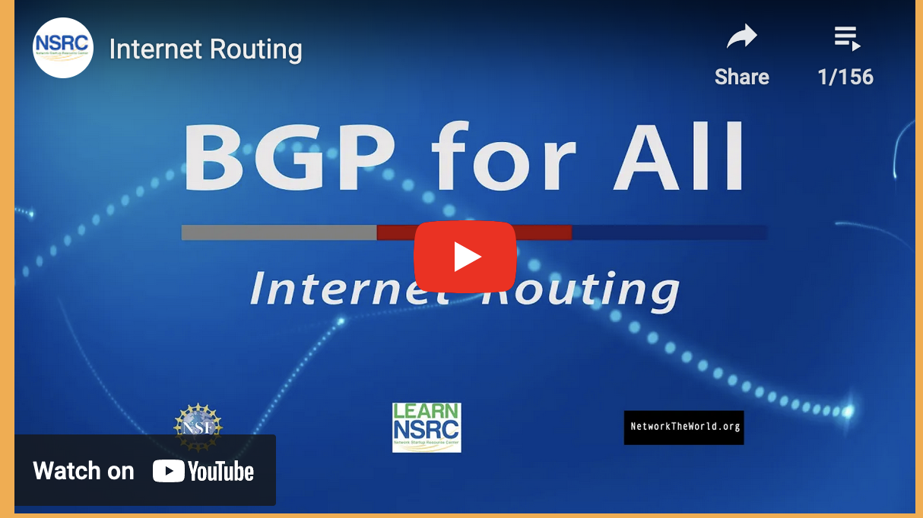
Need Help?
Want to learn more about:
  crafting route filters,
  securing Internet routing best practices/tools
    RPKI
    ROV
    MANRS
Refer to NSRC’s free training videos at:
  https://learn.nsrc.org/bgp

Slide 33
Troubleshooting Tools
How/where do engineers, researchers, and analysts find the data about the incidents discussed so far?
  Many network operators (ISPs) run their own looking glass.
  Many of us rely on globally distributed collectors like:
    RouteViews (the original looking glass since 1995), and
    RIPE’s RIS (routing information service)

Slide 34

RouteViews
A collaborative router looking glass to share BGP views among network operators and researchers.
    RouteViews was founded at the University of Oregon’s Advanced Network Technology Center (ANTC) in 1995. Data archives (every 2 hours) began in 1997 and amount to 50TBs (compressed) today.
    The group is currently led by the Network Startup Resource Center (NSRC) group engineering team at the University of Oregon.

Slide 35
Why RouteViews?
Originally conceived in 1995 as a tool for Internet Operators to look at the BGP table from different locations/backbones around the world to troubleshoot and assess:
  reachability, hijacks, peer visibility, mass withdrawals, and RPKI status
The 27-year data-set of BGP information archived by RouteViews since 1997 has become an invaluable research resource
      RouteViews data has been used in over 1000 research papers.
      http://www.routeviews.org/routeviews/index.php/papers/

Slide 36
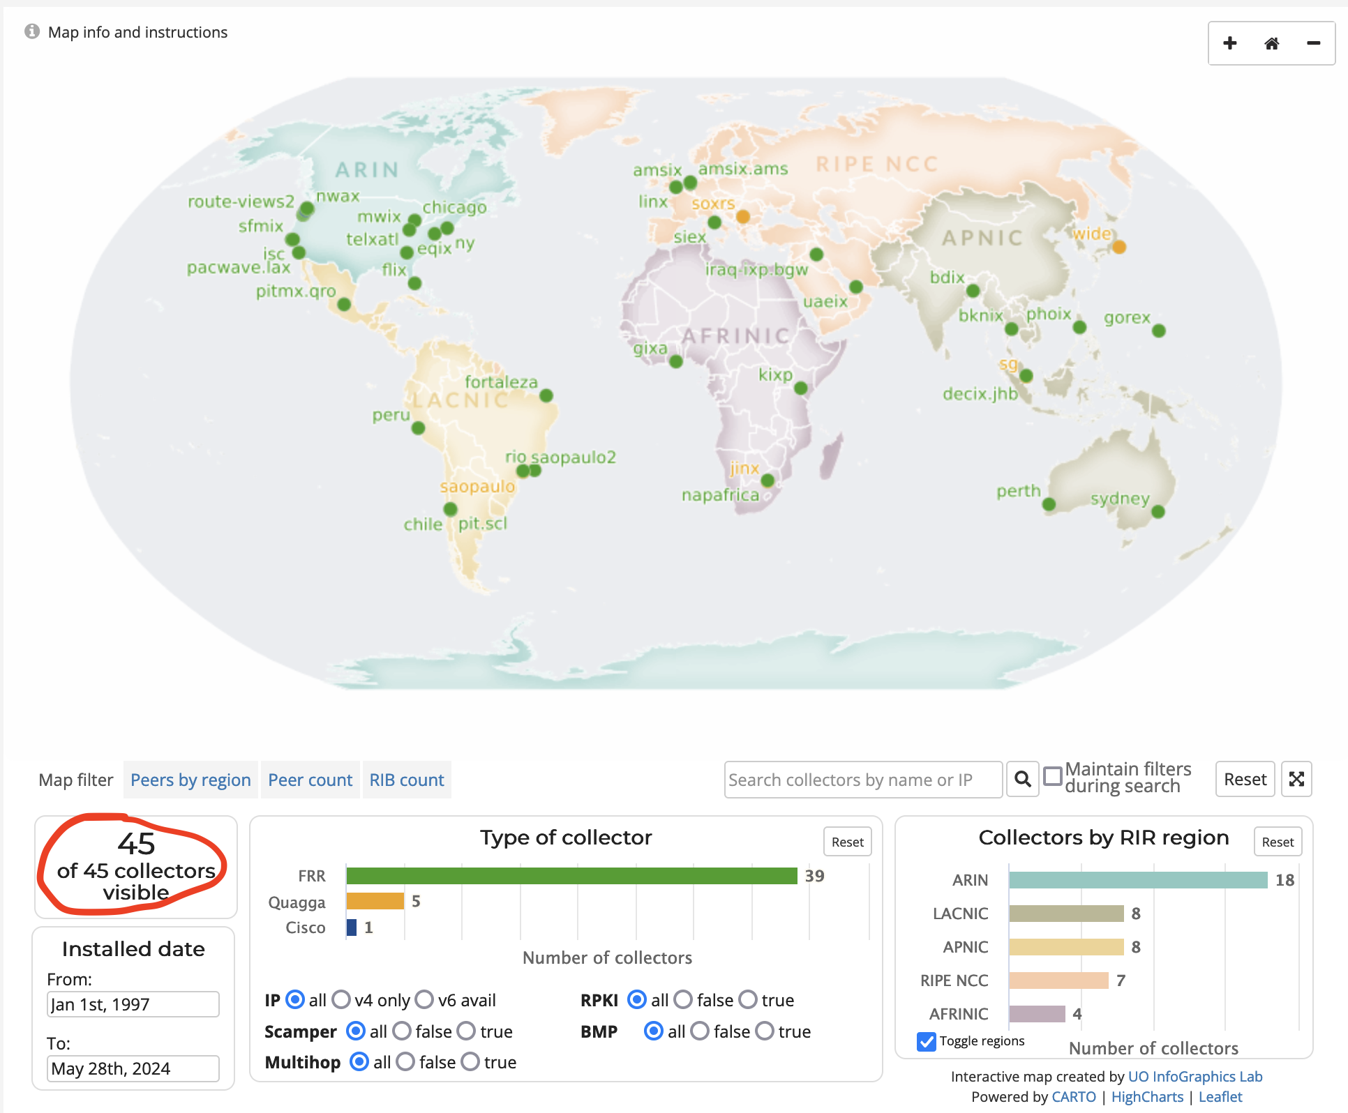
RouteViews Collector Map
http://www.routeviews.org/routeviews/index.php/map/
Notes:
28/05/2024

Slide 37
Peering with RouteViews
  Send full table (if you can)
  Remove default routes
  Remove NULL routes
  Remove RFC1981 addresses
  RouteViews don’t accept/want ADD-PATH (TX/RX)
  RouteViews don’t send routes to you (ONLY collects)
  When peering with multi-hop collectors, set ebgp-multihop
https://www.routeviews.org/routeviews/index.php/peering-request-form/

Slide 38

  khàawp Khun Kráp
  ขอบคุณ ครับ

