Slide 1
The Value of a full route peer for a route collector project
Nina Bargisen
RIPE 91
Edinburgh, Scotland
Last updated 25th March 2026

Slide 2
What is RouteViews
A tool that allows Internet network operators to look at the BGP table from different backbones and locations around the world to troubleshoot and to assess:
  Reachability, hijacks, bugs, peer visibility, mass withdrawals, RPKI status,…
Operators who find it a valuable tool also peer to contribute to the value
RouteViews operates collectors strategically positioned at IXPs around the world.
  It also hosts a few multi-hop collectors at UO for those operators who are not present at IXPs.

Slide 3
Background
RouteViews was first started in 1995
Now a growing network of 40+ collectors positioned strategically at Internet Exchange Points around the world
RouteViews collaborates with the Center for Applied Internet Data Analysis (CAIDA) working with NSF grants that support Designing a Global Measurement Infrastructure to Improve Internet Security, GMI3S (OAC-2131987), and an Integrated Library for Advancing Network Data Science, ILANDS (CNS-2120399).
RouteViews is supported with financial and in-kind donations by multiple organizations
RouteViews is based at the University of Oregon and operated by NSRC
NSRC supports the growth of global Internet infrastructure by providing engineering assistance, collaborative technical workshops, training, and other resources to university, research & education networks worldwide.
NSRC is partially funded by the IRNC program of the NSF (OAC-2029309) and Google with other contributions from public and private organizations.
The University of Oregon is a public research institution in Eugene, Oregon, USA founded in 1876.

Slide 4
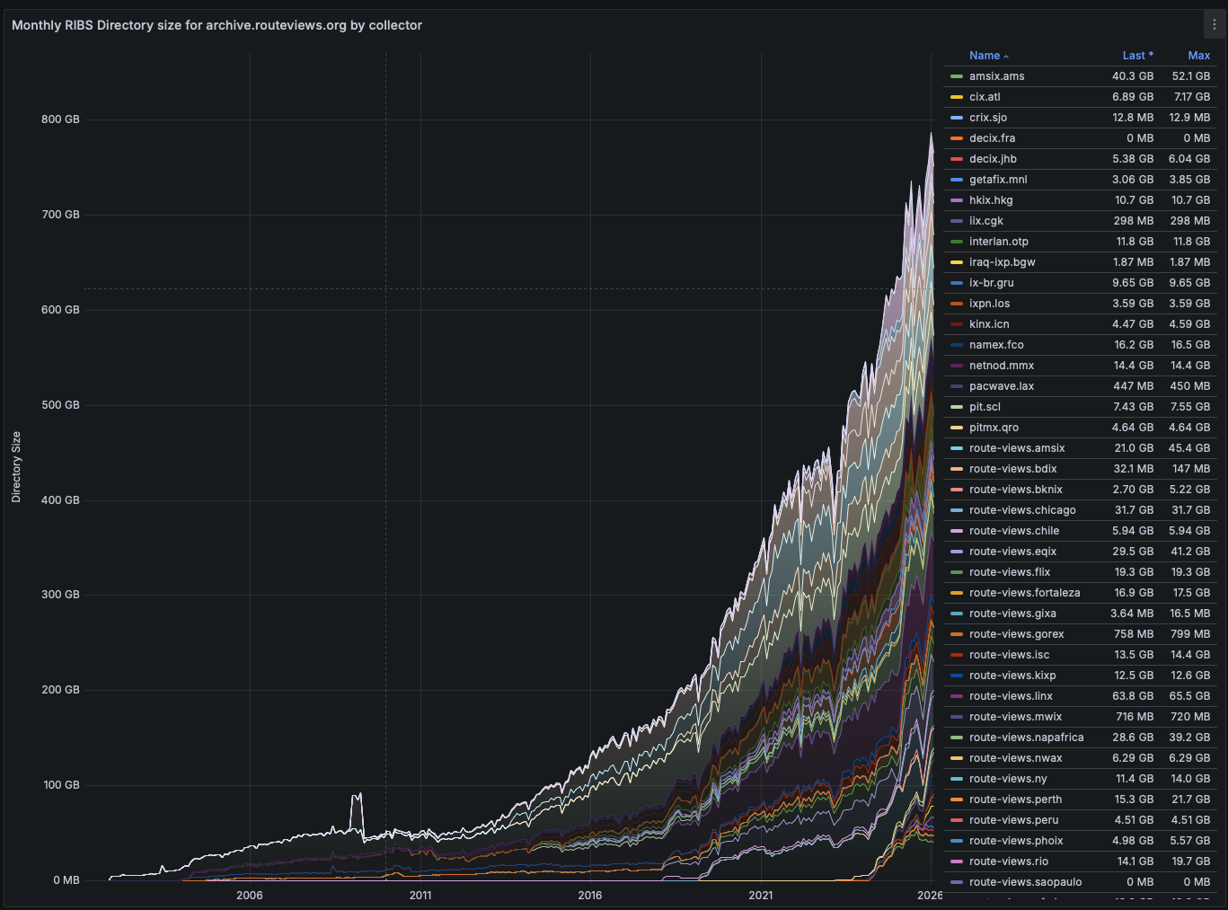
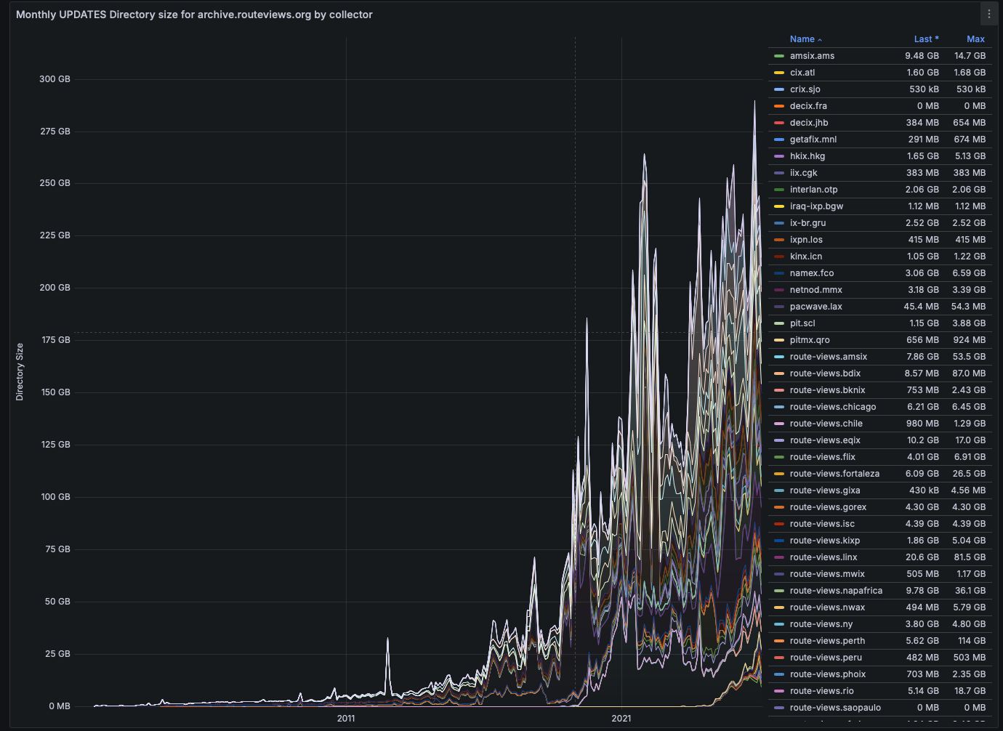
The Challenges
Storage growth

Slide 5
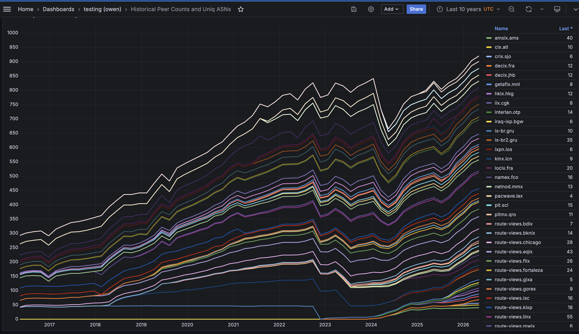
The Challenges
Peer growth

Slide 6
Selective peering policy/strategy
FULL ROUTES PEERS from the edge of the Internet

Slide 7
The Value of a session
What is the new information a session brings to the total dataset?
  Unique prefixes
  Unique origins
  Unique edges
  Unique paths
  Shorter paths
This can be rolled up to create a value of an ASN – the value of a peer

Slide 8
Edges
Unordered pairs of adjacent ASNs in AS paths
For path `[A, B, C, D]`, the edges are `{A,B}`, `{B,C}`, `{C,D}`.
Captures: **AS-level connectivity** — which ASNs peer or transit with each other.

Slide 9
Paths
AS paths with position 0 (the peer's own ASN) removed. For a target session with path `[16276, A, B, C]`, the path observation is `(A, B, C)`.
Position 0 is excluded because every path from a target session trivially starts with the target ASN — including it would make every path unique by definition, rendering the comparison meaningless.
Captures: **routing policy diversity**
Two peers might contribute the same edges but show different paths, revealing distinct routing policies.

Slide 10
Example - tier 1 provider AS3491
Global baseline: 26,890 sessions | 480,638 edges | 9,341,959 paths | 1,251,468 prefixes
Session contributions
Peer IP | Collector | Edges | Paths | Prefixes | Origins | ShortPaths
123.255.90.244 | hkix.hkg | 1 | 170 | 0 | 2 | 1
196.216.148.94 | ixpn.los | 0 | 4 | 0 | 0 | 0
196.223.21.89 | route-views.kixp | 0 | 2 | 0 | 0 | 0
195.66.224.167 | route-views.linx | 1 | 30 | 0 | 1 | 14
196.60.8.152 | route-views.napafrica | 0 | 14 | 0 | 0 | 0
27.111.228.43 | route-views.sg | 0 | 6 | 0 | 0 | 0
ASN 3491 aggregate (6 sessions)
Metric | Seen | Unique | % of global
Edges | 121,615 | 11 | 0.00%
Paths | 183,703 | 1,886 | 0.02%
Prefixes | 1,037,193 | 0 | 0.00%
Origins | — | 3 | —
ShortPaths | — | 2,854 | —

Slide 11
Example - tier 1 provider AS3491
Global baseline: 20,393 sessions | 256,791 edges | 2,809,479 paths | 297,959 prefixes
Session contributions
Peer IP | Collector | Edges | Paths | Prefixes | Origins | ShortPaths
2001:7fa:0:1::ca28:a0f4 | hkix.hkg | 0 | 29 | 0 | 0 | 0
2001:43f8:bb1::94 | ixpn.los | 0 | 0 | 0 | 0 | 0
2001:43f8:60:1::89 | route-views.kixp | 0 | 0 | 0 | 0 | 0
2001:7f8:4::da3:1 | route-views.linx | 1 | 10 | 0 | 1 | 1
2001:43f8:6d0::1b | route-views.napafrica | 0 | 3 | 0 | 0 | 0
2001:de8:4::3491:1 | route-views.sg | 0 | 31 | 0 | 0 | 0
ASN 3491 aggregate (6 sessions)
Metric | Seen | Unique | % of global
Edges | 52,228 | 44 | 0.02%
Paths | 76,038 | 852 | 0.03%
Prefixes | 233,370 | 0 | 0.00%
Origins | — | 1 | —
ShortPaths | — | 1,617 | —

Slide 12
Example - content provider AS32590
Global baseline: 26,890 sessions | 480,638 edges | 9,341,959 paths | 1,251,468 prefixes
Session contributions (1 of 2)
Peer IP | Collector | Edges | Paths | Prefixes | Origins | ShortPaths
206.71.12.85 | cix.atl | 72 | 2,570 | 169 | 170 | 2
123.255.90.17 | hkix.hkg | 160 | 15,787 | 4 | 7 | 36
86.104.125.165 | interlan.otp | 2 | 2,614 | 0 | 0 | 0
187.16.218.161 | ix-br.gru | 1,958 | 803 | 589 | 707 | 157
139.150.100.182 | kinx.icn | 21 | 443 | 8 | 11 | 246
185.1.166.191 | locix.fra | 0 | 375 | 0 | 0 | 0
194.68.123.224 | netnod.mmx | 133 | 2,175 | 0 | 0 | 96
45.68.16.190 | pit.scl | 67 | 1,829 | 3 | 4 | 87
208.115.136.103 | route-views.chicago | 103 | 5,352 | 0 | 0 | 2
206.126.237.32 | route-views.eqix | 73 | 772 | 4 | 5 | 1
195.66.226.130 | route-views.linx | 315 | 568 | 0 | 0 | 0
196.60.9.21 | route-views.napafrica | 389 | 10,393 | 0 | 0 | 15

Slide 13
Example - content provider AS32590
Global baseline: 26,890 sessions | 480,638 edges | 9,341,959 paths | 1,251,468 prefixes
Session contributions (2 of 2)
Peer IP | Collector | Edges | Paths | Prefixes | Origins | ShortPaths
45.183.47.120 | route-views.peru | 88 | 11,960 | 80 | 232 | 467
27.111.228.176 | route-views.sg | 175 | 6,792 | 8 | 9 | 1
185.1.27.59 | route-views.soxrs | 686 | 297 | 63 | 70 | 3
185.1.8.55 | route-views.uaeix | 29 | 5,239 | 3 | 3 | 11
ASN 32590 aggregate (16 sessions)
Metric | Seen | Unique | % of global
Edges | 165,395 | 6,501 | 1.35%
Paths | 943,958 | 83,786 | 0.90%
Prefixes | 1,104,294 | 934 | 0.07%
Origins | — | 1,222 | —
ShortPaths | — | 1,176 | —

Slide 14
Example - content provider AS32590
Global baseline: 20,393 sessions | 256,791 edges | 2,809,479 paths | 297,959 prefixes
Session contributions (1 of 2)
Peer IP | Collector | Edges | Paths | Prefixes | Origins | ShortPaths
2001:504:40:12::1:85 | cix.atl | 47 | 15 | 0 | 0 | 24
2001:7fa:0:1::ca28:a011 | hkix.hkg | 107 | 3,014 | 0 | 1 | 42
2001:7f8:64:225:0:3:2590:1 | interlan.otp | 3 | 124 | 0 | 0 | 0
2001:12f8::218:161 | ix-br.gru | 1,866 | 385 | 117 | 118 | 48
2001:7fa:8::5b | kinx.icn | 15 | 526 | 0 | 0 | 22
2001:7f8:f2:e1:0:3:2590:1 | locix.fra | 0 | 104 | 0 | 0 | 0
2001:7f8:d:ff::224 | netnod.mmx | 120 | 154 | 2 | 2 | 4
2801:14:9000::3:2590:1 | pit.scl | 62 | 566 | 8 | 8 | 1
2001:504:0:4:0:3:2590:1 | route-views.chicago | 62 | 714 | 1 | 1 | 0
2001:504:0:2:0:3:2590:1 | route-views.eqix | 52 | 122 | 0 | 0 | 2
2001:7f8:4::7f4e:1 | route-views.linx | 226 | 161 | 0 | 0 | 1
2001:43f8:6d0::9:21 | route-views.napafrica | 176 | 285 | 1 | 1 | 0

Slide 15
Example - content provider AS32590
Global baseline: 20,393 sessions | 256,791 edges | 2,809,479 paths | 297,959 prefixes
Session contributions (2 of 2)
Peer IP | Collector | Edges | Paths | Prefixes | Origins | ShortPaths
2803:cd60:6411:5::2c | route-views.peru | 123 | 6,824 | 70 | 87 | 448
2001:de8:4::3:2590:1 | route-views.sg | 139 | 1,260 | 0 | 0 | 20
2001:7f8:1e::59 | route-views.soxrs | 172 | 84 | 5 | 7 | 1
2001:de8:6::3:2590:1 | route-views.sydney | 113 | 1,855 | 0 | 0 | 2
2001:7f8:73::7f4e:0:1 | route-views.uaeix | 61 | 2,038 | 0 | 0 | 0
ASN 32590 aggregate (17 sessions)
Metric | Seen | Unique | % of global
Edges | 77,378 | 5,020 | 1.95%
Paths | 298,588 | 23,940 | 0.85%
Prefixes | 259,260 | 206 | 0.07%
Origins | — | 228 | —
ShortPaths | — | 629 | —

Slide 16
Example - content provider AS16276
Global baseline: 26,879 sessions | 481,023 edges | 9,384,044 paths | 1,254,898 prefixes
Session contributions
Peer IP | Collector | Edges | Paths | Prefixes | Origins | ShortPaths
151.80.174.184 | route-views7 | 3 | 41 | 0 | 0 | 0
151.80.174.185 | route-views7 | 0 | 15 | 0 | 0 | 0
151.80.174.186 | route-views7 | 14 | 339 | 0 | 1 | 32
151.80.174.187 | route-views8 | 168 | 1,187 | 0 | 0 | 11
151.80.174.188 | route-views8 | 163 | 4,129 | 0 | 0 | 0
151.80.174.189 | route-views8 | 235 | 110,575 | 2 | 35 | 507
ASN 16276 aggregate (6 sessions)
Metric | Seen | Unique | % of global
Edges | 147,754 | 5,454 | 1.13%
Paths | 461,190 | 116,817 | 1.24%
Prefixes | 1,063,991 | 551 | 0.04%
Origins | — | 608 | —
ShortPaths | — | 700 | —

Slide 17
Example - content provider AS16276
Global baseline: 20,921 sessions | 257,608 edges | 2,841,900 paths | 298,124 prefixes
Session contributions
Peer IP | Collector | Edges | Paths | Prefixes | Origins | ShortPaths
2001:41d0:d01:9600:1::1 | route-views7 | 2 | 21 | 0 | 0 | 0
2001:41d0:d01:9600:1::2 | route-views7 | 1 | 0 | 0 | 0 | 0
2001:41d0:d01:9600:1::3 | route-views7 | 6 | 1,267 | 0 | 0 | 0
2001:41d0:d01:9600:1::4 | route-views8 | 149 | 146 | 0 | 1 | 0
2001:41d0:d01:9600:1::5 | route-views8 | 91 | 308 | 0 | 1 | 0
2001:41d0:d01:9600:1::6 | route-views8 | 199 | 44,608 | 0 | 1 | 158
ASN 16276 aggregate (6 sessions)
Metric | Seen | Unique | % of global
Edges | 63,999 | 3,675 | 1.43%
Paths | 161,910 | 46,684 | 1.64%
Prefixes | 252,899 | 43 | 0.01%
Origins | — | 51 | —
ShortPaths | — | 528 | —

Slide 18
Example - regional peer AS9902
Global baseline: 26,780 sessions | 480,770 edges | 9,535,546 paths | 1,255,327 prefixes
Session contributions
Peer IP | Collector | Edges | Paths | Prefixes | Origins | ShortPaths
27.111.228.211 | route-views.sg | 0 | 20 | 0 | 0 | 11
ASN 9902 aggregate (1 sessions)
Metric | Seen | Unique | % of global
Edges | 64 | 0 | 0.00%
Paths | 63 | 20 | 0.00%
Prefixes | 598 | 0 | 0.00%
Origins | — | 0 | —
ShortPaths | — | 11 | —

Slide 19
Example - regional peer AS9902
Global baseline: 20,868 sessions | 257,392 edges | 2,851,413 paths | 298,626 prefixes
Session contributions
Peer IP | Collector | Edges | Paths | Prefixes | Origins | ShortPaths
2001:de8:4::9902:1 | route-views.sg | 238 | 6 | 0 | 0 | 1
ASN 9902 aggregate (1 sessions)
Metric | Seen | Unique | % of global
Edges | 16,783 | 238 | 0.09%
Paths | 16,164 | 6 | 0.00%
Prefixes | 62,037 | 0 | 0.00%
Origins | — | 0 | —
ShortPaths | — | 1 | —

Slide 20
Example - regional provider AS30844
Global baseline: 26,780 sessions | 480,770 edges | 9,535,546 paths | 1,255,327 prefixes
Session contributions
Peer IP | Collector | Edges | Paths | Prefixes | Origins | ShortPaths
80.249.211.45 | amsix.ams | 0 | 0 | 0 | 0 | 0
196.216.148.55 | ixpn.los | 0 | 0 | 0 | 0 | 0
196.223.21.44 | route-views.kixp | 1 | 1 | 0 | 0 | 3
196.60.8.215 | route-views.napafrica | 1 | 0 | 0 | 1 | 0
ASN 30844 aggregate (4 sessions)
Metric | Seen | Unique | % of global
Edges | 114,868 | 153 | 0.03%
Paths | 119,718 | 213 | 0.00%
Prefixes | 1,042,193 | 0 | 0.00%
Origins | — | 11 | —
ShortPaths | — | 599 | —

Slide 21
Example - regional provider AS30844
Global baseline: 20,868 sessions | 257,392 edges | 2,851,413 paths | 298,626 prefixes
Session contributions
Peer IP | Collector | Edges | Paths | Prefixes | Origins | ShortPaths
2001:7f8:1::a503:844:1 | amsix.ams | 0 | 0 | 0 | 0 | 0
2001:43f8:bb1::55 | ixpn.los | 0 | 0 | 0 | 0 | 0
2001:43f8:60:1::44 | route-views.kixp | 3 | 15 | 0 | 1 | 1
2001:43f8:6d0::215 | route-views.napafrica | 0 | 0 | 0 | 0 | 0
ASN 30844 aggregate (4 sessions)
Metric | Seen | Unique | % of global
Edges | 47,901 | 79 | 0.03%
Paths | 48,545 | 1,041 | 0.04%
Prefixes | 234,566 | 0 | 0.00%
Origins | — | 1 | —
ShortPaths | — | 46 | —

Slide 22
Summary - unique contributions per ASN
Unique contributions per ASN
ASN | Description | Family | Unique Edges | Unique Paths | Unique Prefixes | Shorter Paths
AS3491 | Tier 1 provider | IPv4 | 11 | 1,886 | 0 | 2,854
AS3491 | Tier 1 provider | IPv6 | 44 | 852 | 0 | 1,617
AS32590 | Content provider | IPv4 | 6,501 | 83,786 | 934 | 1,176
AS32590 | Content provider | IPv6 | 5,020 | 23,940 | 206 | 629
AS16276 | Content provider | IPv4 | 5,454 | 116,817 | 551 | 700
AS16276 | Content provider | IPv6 | 3,675 | 46,684 | 43 | 528
AS30844 | Regional provider | IPv4 | 153 | 213 | 0 | 599
AS30844 | Regional provider | IPv6 | 79 | 1,041 | 0 | 46
AS9902 | Regional peer | IPv4 | 0 | 20 | 0 | 11
AS9902 | Regional peer | IPv6 | 238 | 6 | 0 | 1

Slide 23
Conclusion
Not all sessions are equal — value is the new information a session adds to the global dataset when considering the topology of the Internet
Edge networks announcing full routes — content providers and regional providers — carry the unique signal: thousands of unique edges, paths, prefixes and origins.
Tier-1 transit sessions are high-volume but low-novelty — their routes are already covered by other peers.
“Standard peering” sessions (no full routes) contribute almost nothing, but are useful for other reasons
If you operate at the edge and announce full routes — peer with us. Your session is what makes the dataset useful.

Slide 24

Thank you!

