Slide 1
The RouteViews Project: Update
Owen Conway
AIMS-19 / UCSD
Feb 2026
Last updated 19th May 2025

Slide 2
Background
RouteViews was first started in 1995
Now a growing network of 40+ collectors positioned strategically at Internet Exchange Points around the world
RouteViews collaborates with the Center for Applied Internet Data Analysis (CAIDA) working with NSF grants that support Designing a Global Measurement Infrastructure to Improve Internet Security, GMI3S (OAC-2131987), and an Integrated Library for Advancing Network Data Science, ILANDS (CNS-2120399).
RouteViews is supported with financial and in-kind donations by multiple organizations
RouteViews is based at the University of Oregon and operated by NSRC
NSRC supports the growth of global Internet infrastructure by providing engineering assistance, collaborative technical workshops, training, and other resources to university, research & education networks worldwide.
NSRC is partially funded by the IRNC program of the NSF (OAC-2029309) and Google with other contributions from public and private organizations.
The University of Oregon is a public research institution in Eugene, Oregon, USA founded in 1876.

Slide 3
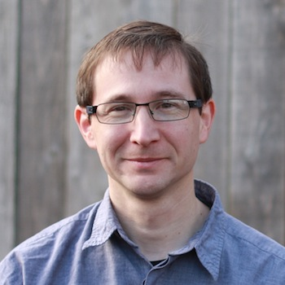

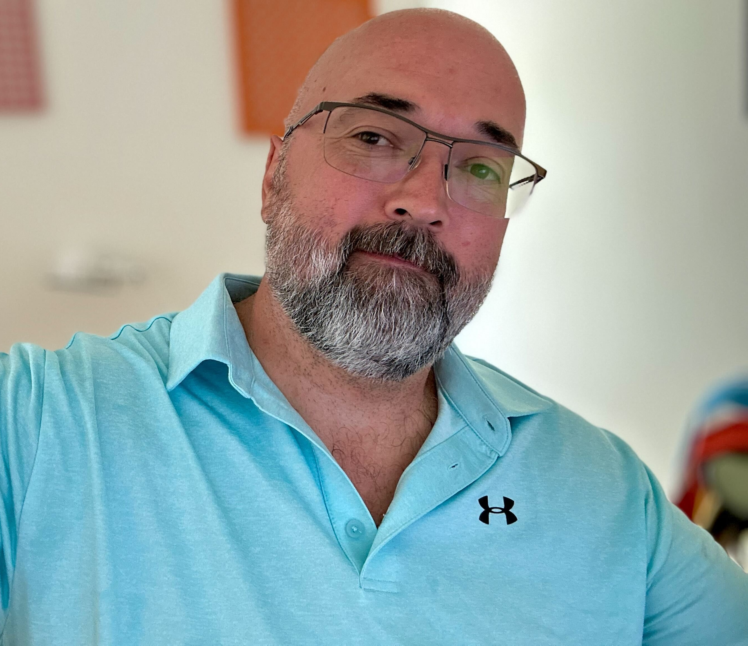



RouteViews Team Members
Hans Kuhn
Nina Bargisen
Owen Conway
Philip Smith
Philip Paeps
Anton Berezin

Slide 4
What is RouteViews
A tool that allows Internet network operators to look at the BGP table from different backbones and locations around the world to troubleshoot and to assess:
  Reachability, hijacks, bugs, peer visibility, mass withdrawals, RPKI status,…
Operators who find it a valuable tool also peer to contribute to the value
RouteViews operates collectors strategically positioned at IXPs around the world.
  It also hosts a few multi-hop collectors at UO for those operators who are not present at IXPs.

Slide 5
What is RouteViews
Many free and commercial tools used by network engineers every day include data from RouteViews
  CAIDA ASRANK
  CAIDA BGP Reader
  HE BGP Tools
  Kentik Market Intelligence
  Kentik BGP monitoring
  Catchpoint
  BGPMon
  And many more

Slide 6
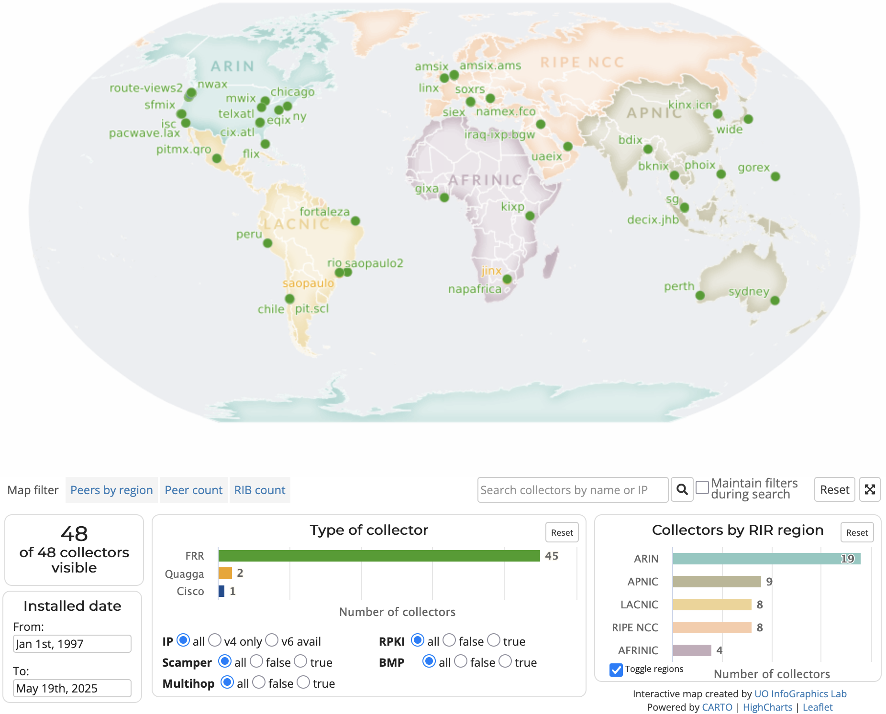
RouteViews Collector Map
https://www.routeviews.org/routeviews/map/

Slide 7
Routeviews news
What’s happening at RouteViews

Slide 8
RouteViews News
Collectors:
  All software collectors use FRR¹ (version 10.5.1 where possible)
  One Cisco ASR1004 (as a tribute to the original!)
  Moving collectors from metal to VMs (easier deployment & management)
Location update:
  Most recent additions include Jakarta (IIX Jakarta), Puerto Rico (CRIX) and Lagos (IXPN), DE-CIX Frankfurt (soon!)
¹FRRouting Project: https://frrouting.org/

Slide 9
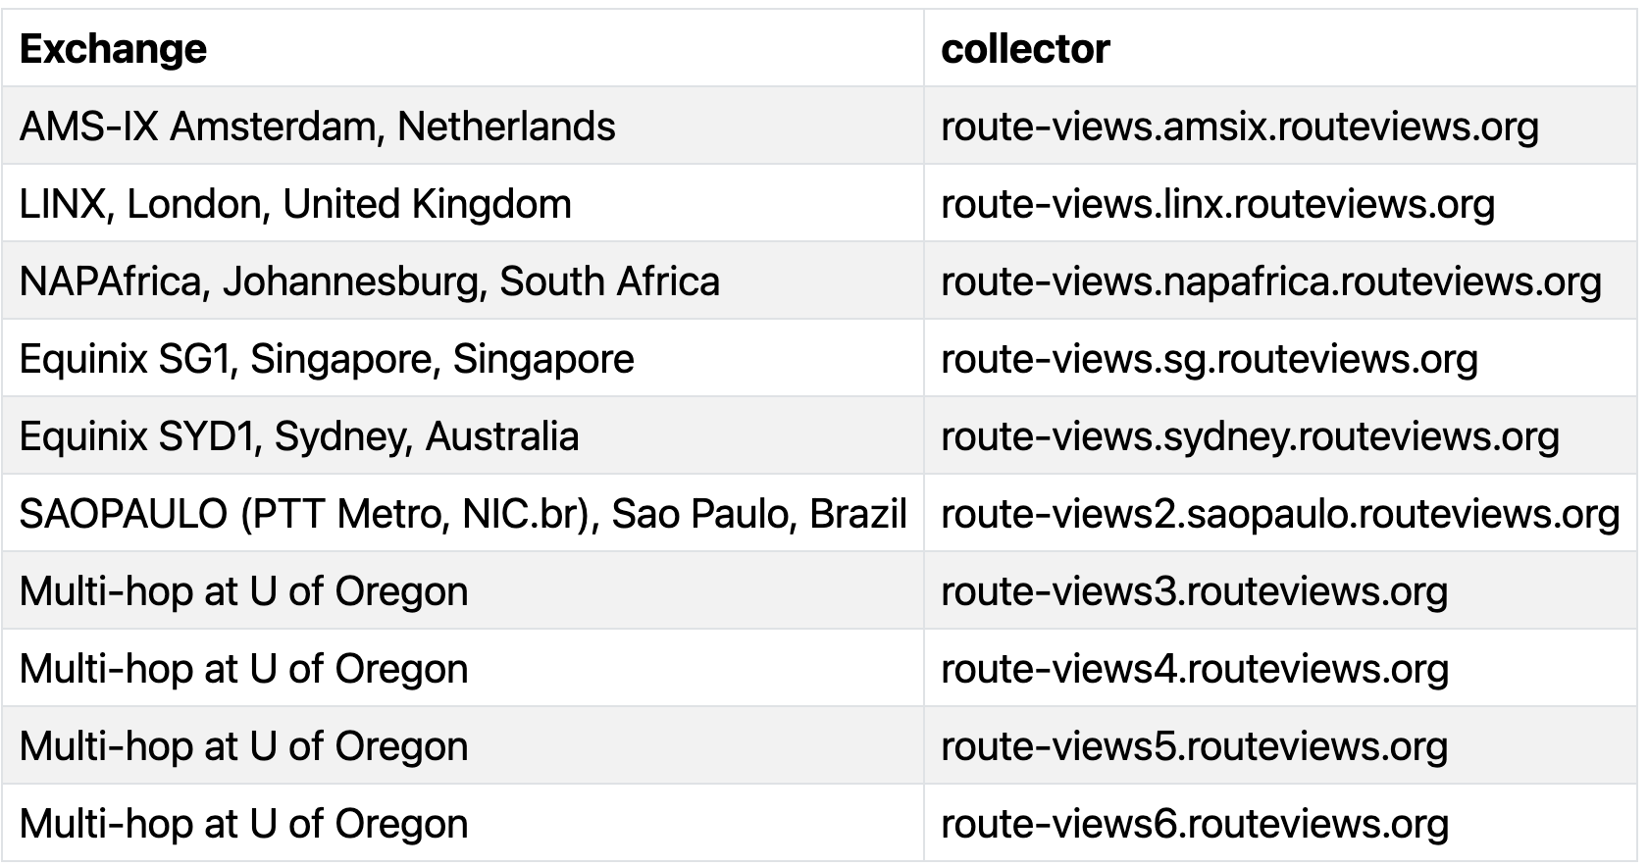
RouteViews Development Projects: API
API allows programmatic access to live RouteViews data
  (our collectors currently allow telnet access, which 1000s of automated scripts hammer daily)
Two access levels:
  Unauthenticated for casual (infrequent queries)
  Authenticated access (using verified PeeringDB users) for more serious research
API currently supports ten collectors
  More will be added as resources become available
Please consult the docs on how to use the API
  https://api.routeviews.org/docs/

Slide 10
RouteViews Development Projects: LG
telnet access is unsustainable
  Gives open access to the collector command line interface to run “show” commands
Looking Glass will soon become the default access for each collector
  Permits the most commonly used BGP diagnostic commands
  telnet remains available on route-views.routeviews.org (the Cisco ASR1004) for legacy access
Looking Glass can be found on https://lg.routeviews.org/lg/
  telnet access will be removed after due notice to the community

Slide 11
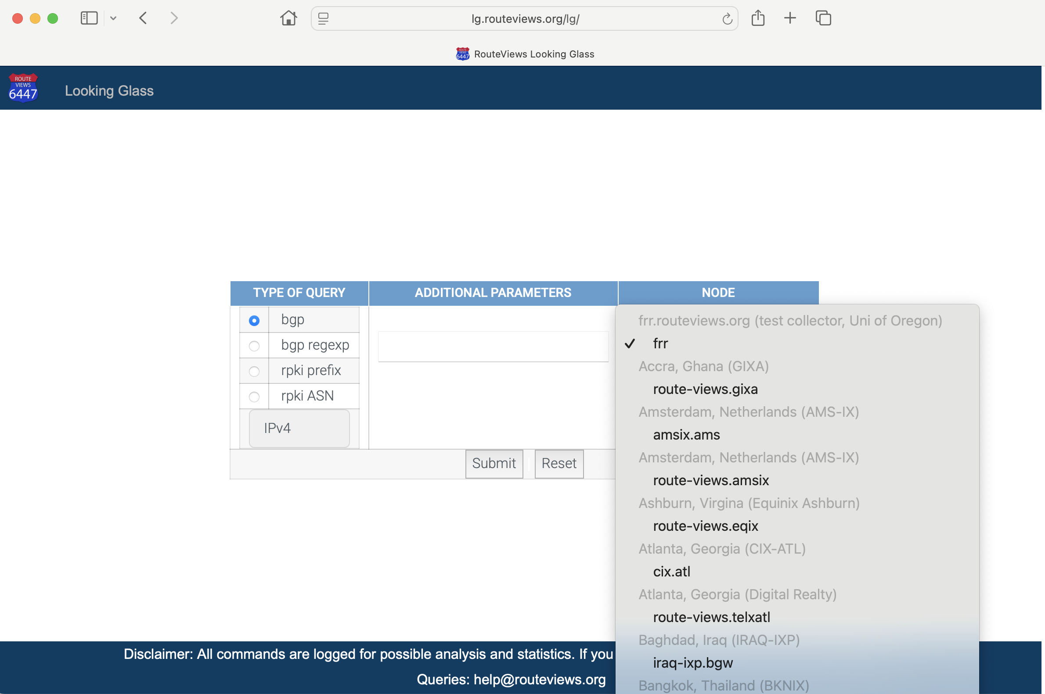

Slide 12
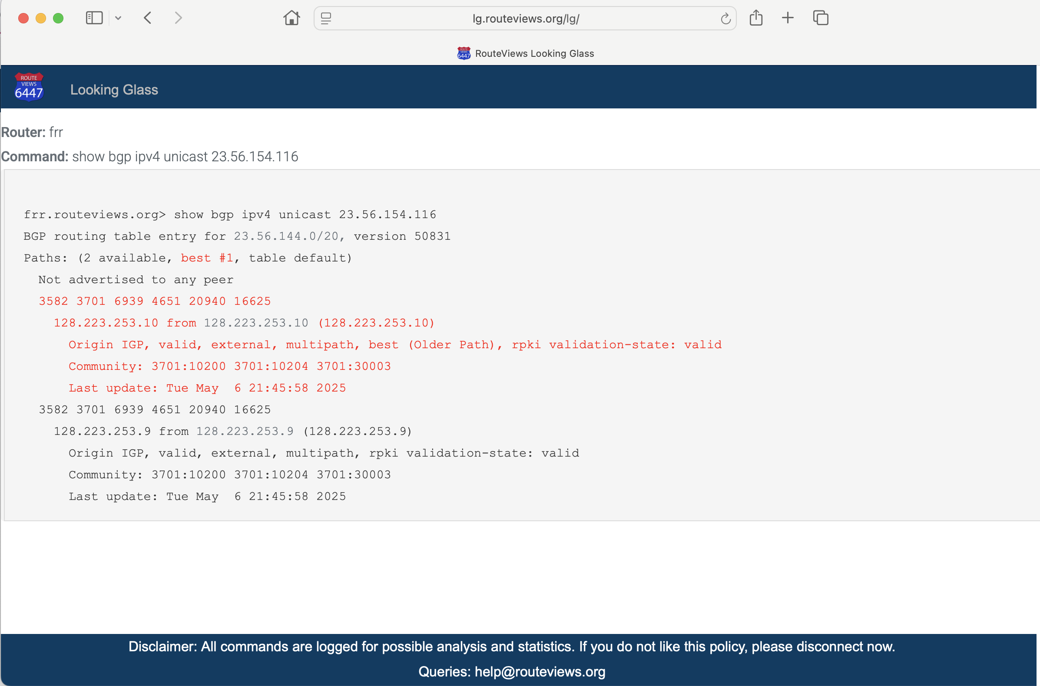

Slide 13
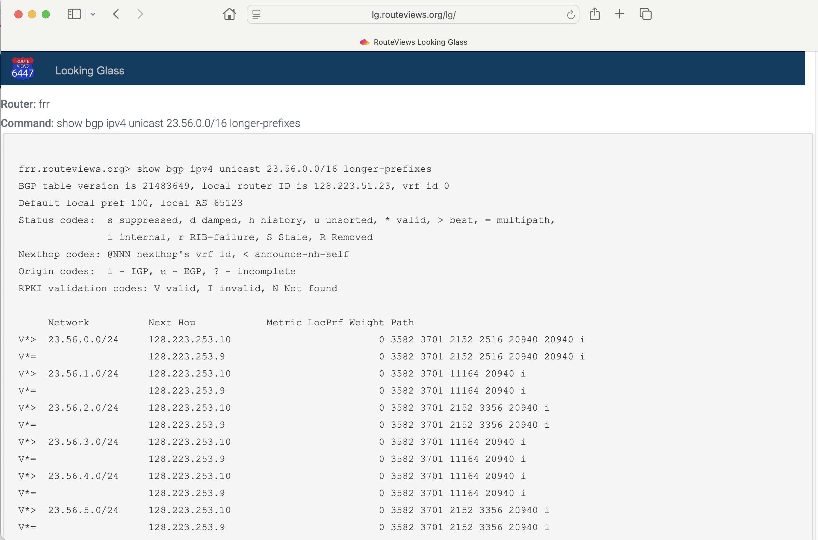

Slide 14
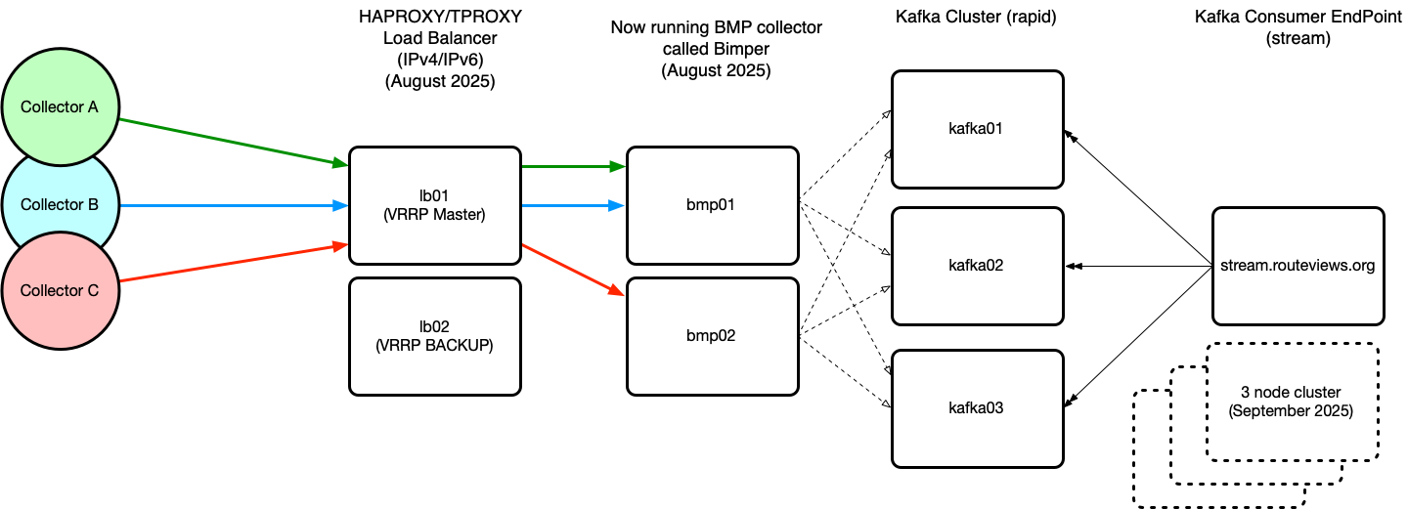
RouteViews Development Projects: BMP
Live feed from collectors for BGP data consumers
Challenge is to make this scale and provide the infrastructure resources to support
stream being replaced by kafka cluster for better resilience

Slide 15
RouteViews Development Projects: Bimper
Bimper is a specialised high-performance BGP Monitoring Protocol (BMP) message processor that receives BGP routing data from network routers and forwards it to Kafka for downstream analysis and storage. It provides real-time monitoring of BGP routing events with Prometheus metrics integration for operational visibility.
The system includes bimperctl, a control utility for managing and monitoring bimper instances, allowing administrators to interact with the service and view connection status information, and manage router connections
Bimper replaces OpenBMP and Bimper messages are compatible with OpenBMP’s raw bmp

Slide 16
RouteViews Behind the Scenes Projects
Upgrading archive infrastructure and storage
  RouteViews stores BGP data from 1997 – around 50 TBytes (compressed)
Tooling
  Automation tools for managing the whole infrastructure and deploying new peers
Collector OS (from CentOS to Ubuntu)
  CentOS end-of-life – half the collectors still running CentOS
FRR performance
  Tuning Linux TCP parameters to improve BGP peer performance
    https://fasterdata.es.net/host-tuning/linux/
  “Badly behaving peers” (aka slow and/or noisy peers)

Slide 17
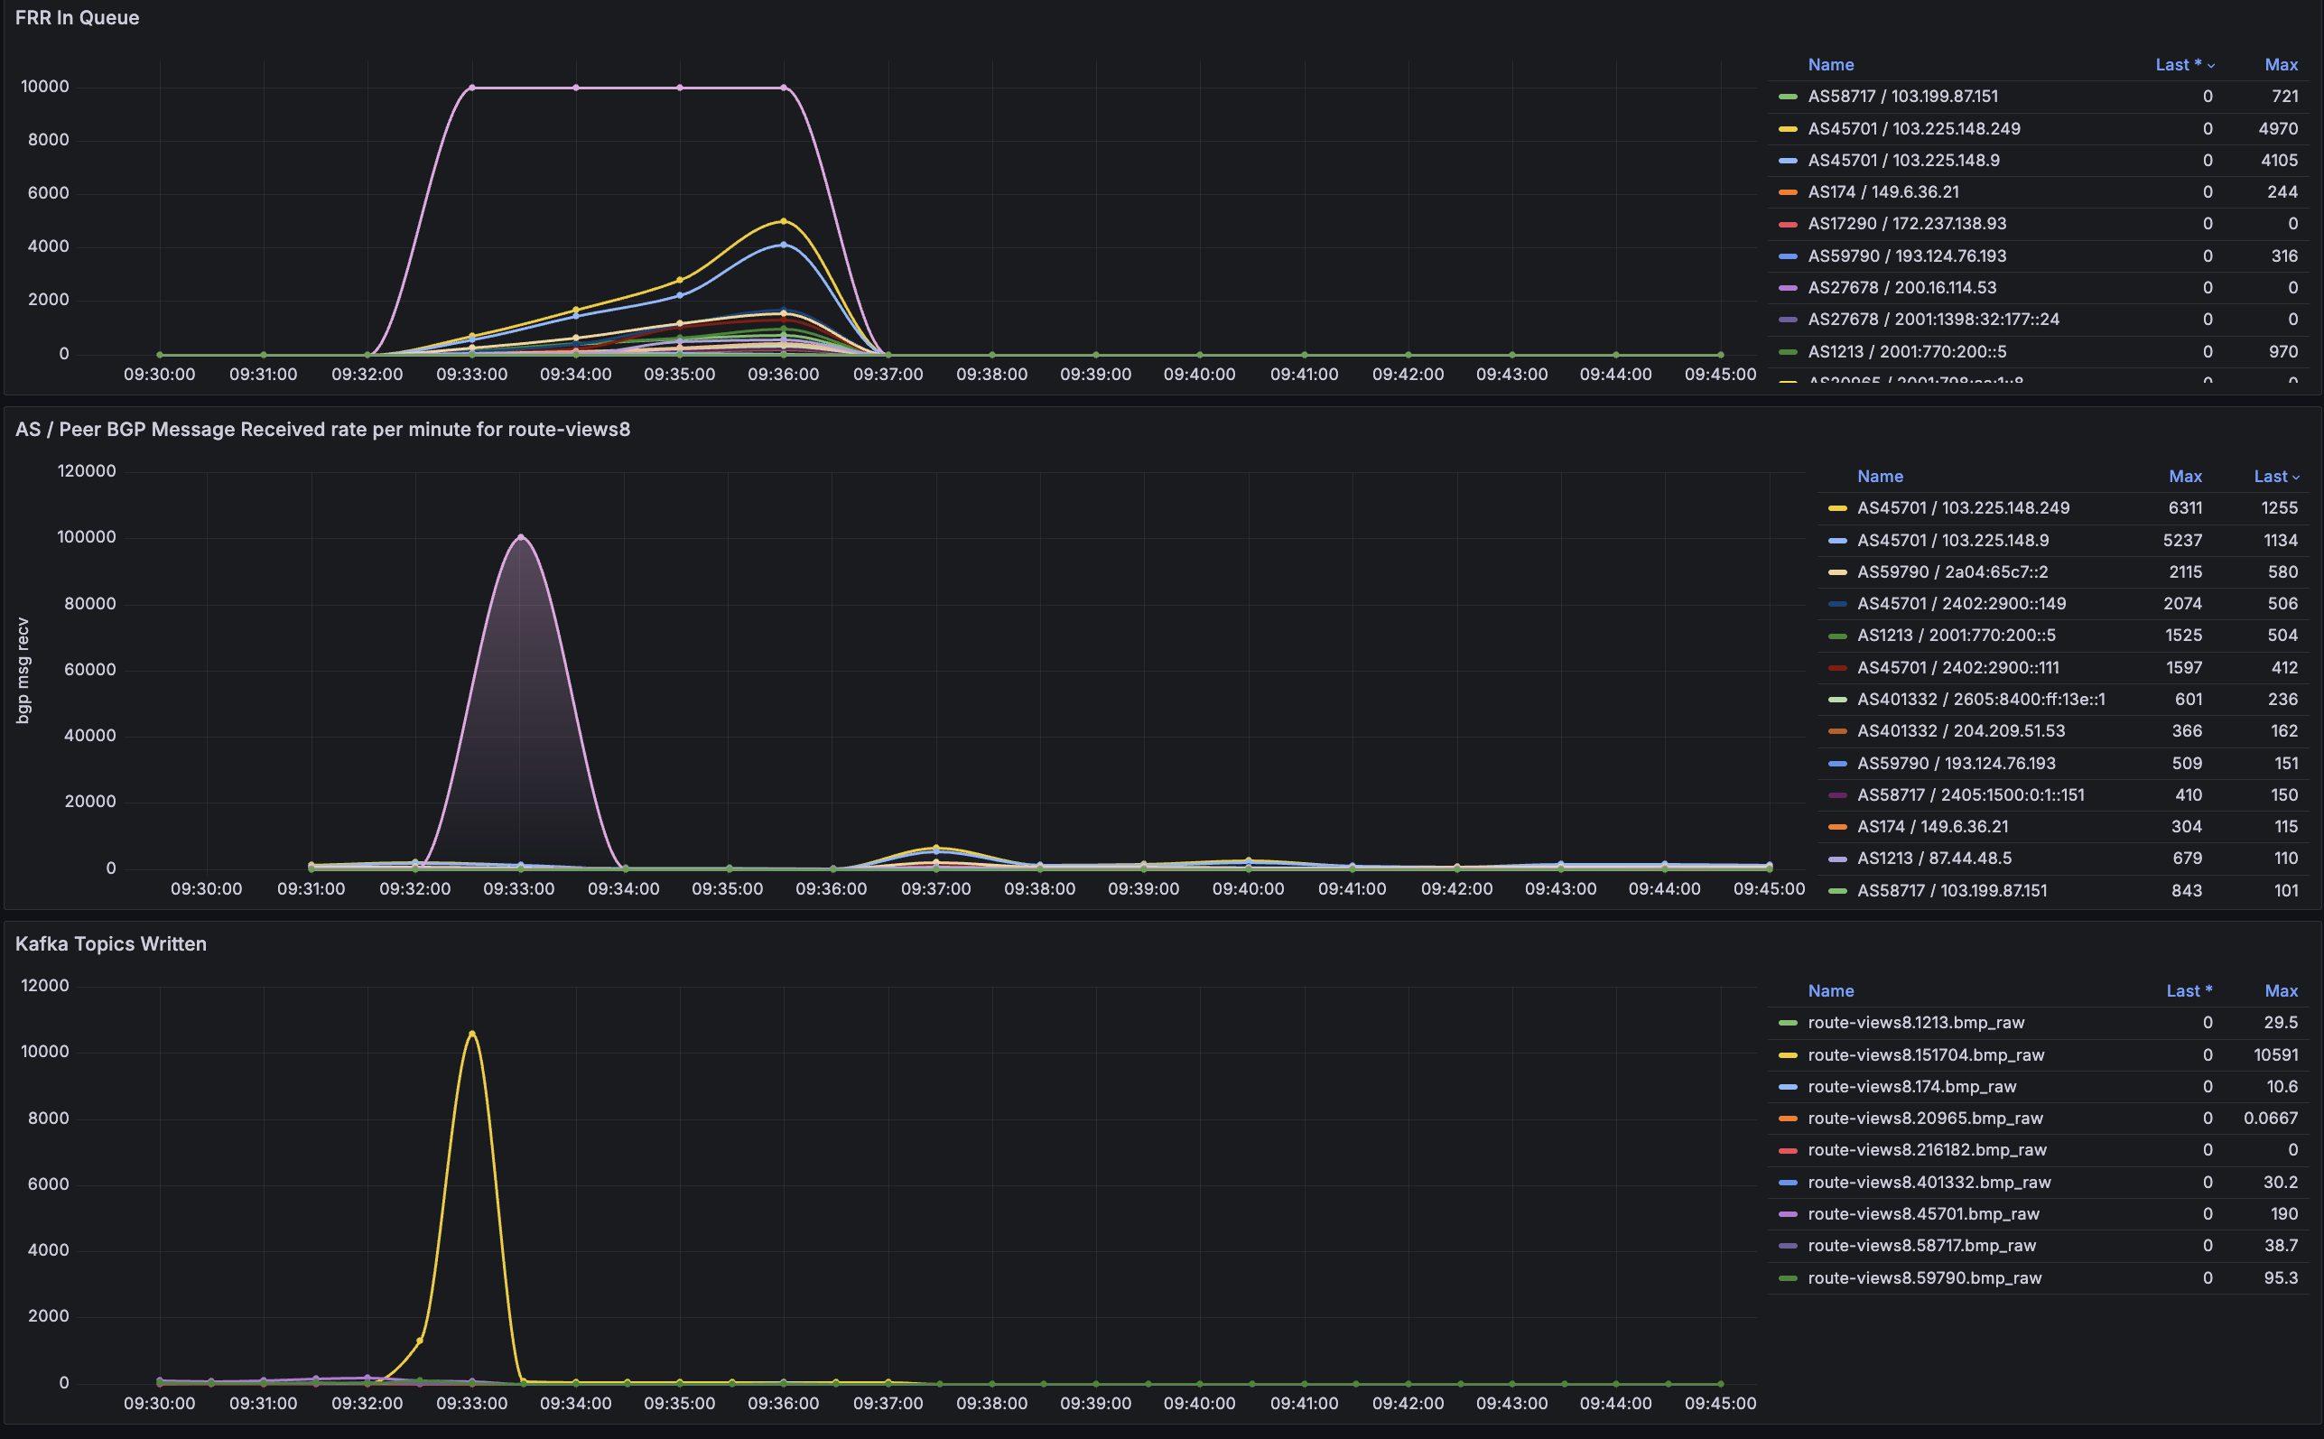
Slow and noisy peers
Bimper enables us to monitor bgp and bmp more closely
Much time was spent chasing stalled bgp and bmp sessions
upgrade to FRR 10.5.1 greatly improve queing and processing of updates and means the live stream platform is much more stable now

Slide 18
RouteViews Future Planning
Collectors & hosts in new locations outside North America
  Large IXPs with dense interconnection
  Unique or specialist environments (e.g. R&E exchanges)
Scalable and diverse archiving
RouteViews Peering Portal
Improved community support
  Running this infrastructure costs money!
  We hugely appreciate our generous supporters
    https://www.routeviews.org/routeviews/index.php/supporters/
Your recommendations are welcome! 🙏

Slide 19
Using routeviews
For network operators & researchers

Slide 20
Using RouteViews
Network Operators use the live data to analyse how their routes appear on the Global Routing System
Researchers use the 27-year-old data archive to study trends, route hijacks, and changes such as:
  Origin change
  Next-hop change
  New prefix / more specifics
  New neighbours
  Operator ASN appearing in a new transit path
  Bogons

Slide 21
Consumers of RouteViews data
If you use RouteViews data for your products or services:
Please acknowledge the source!
  Your product or service likely would not work without our data!
Please do NOT send your customers of your products or services to us for technical support:
  We simply collect what is seen in the global routing table
  We cannot fix mistakes made by network operators
  We cannot fix bugs in BGP implementations
  We cannot remove BGP announcements we receive
  We cannot change what is seen in the global routing table

Slide 22
ReFERENCING routeviews
For Researchers

Slide 23
We have a DOI
10.7264/1y7v-2d90
https://doi.datacite.org/dois/10.7264%2F1y7v-2d90
Please feel free to use this in your papers if you use our data

Slide 24
ACCESSING routeviews DATA
For Researchers

Slide 25
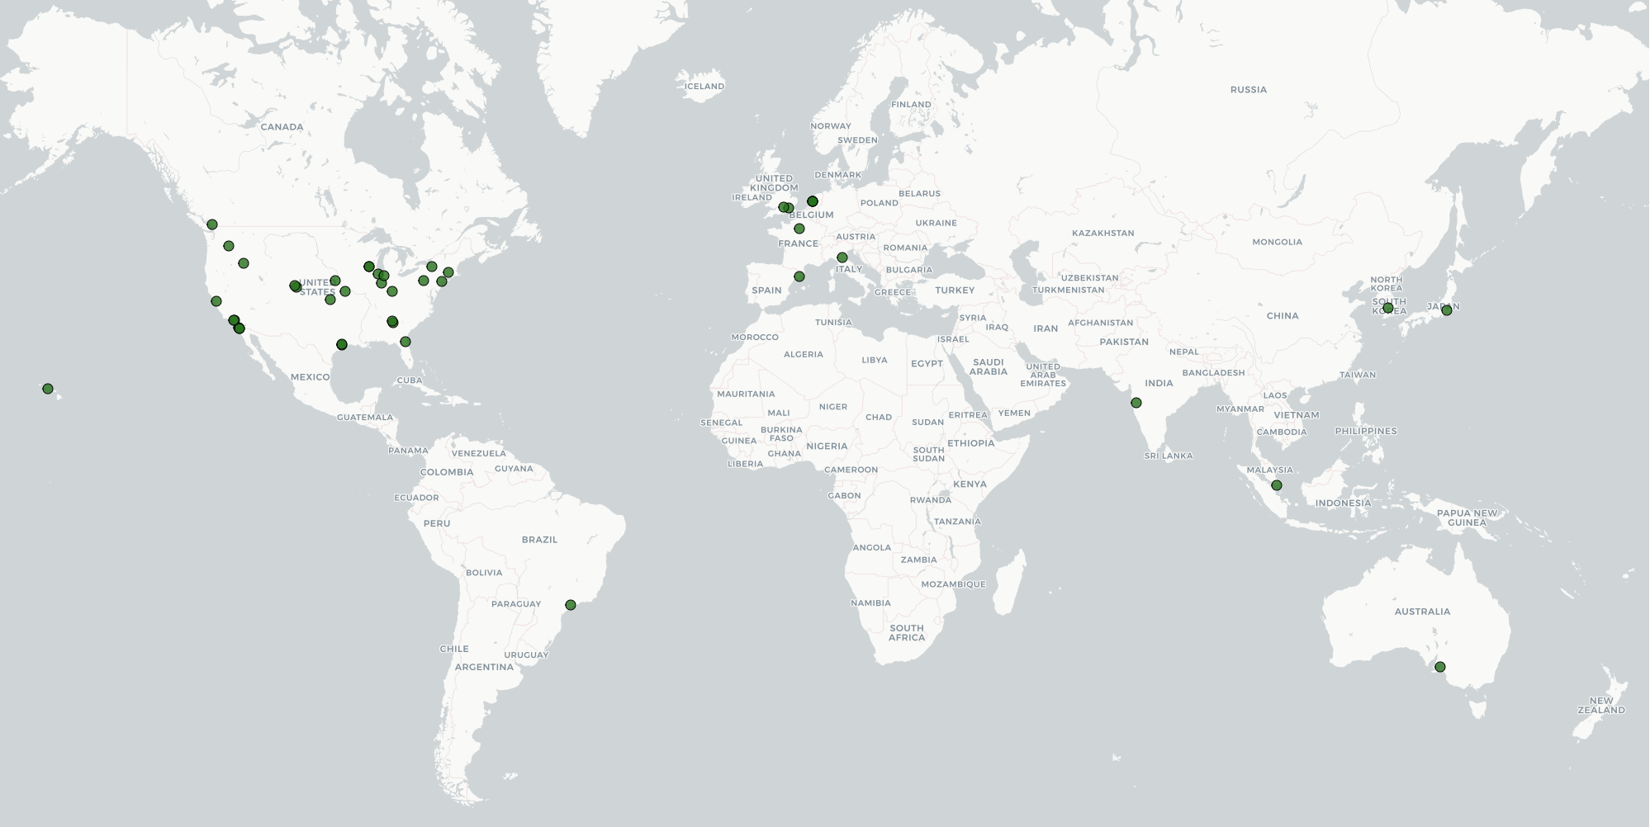
OSDF Cache Locations serving /routeviews

Slide 26
Using Pelican to access to OSDF caches
https://docs.pelicanplatform.org/getting-started
https://docs.pelicanplatform.org/getting-started/accessing-data

Slide 27
PUBLIC ROUTEVIEWS DashbOARDS
For anyone still awake

Slide 28
We want to start trialling public Dashboards
We have a couple available to anyone interested at
https://graphs.routeviews.org/grafana/
(login: rviews/rviews)
Please feel free to look around. Dashboard suggestions can be made to anyone here from RouteViews. Please email help@routeviews.org also.
We’ll be adding more over time. We need to also add documentation

Slide 29
NOISY PEER ANALYSIS
For anyone who needs to sleep

Slide 30
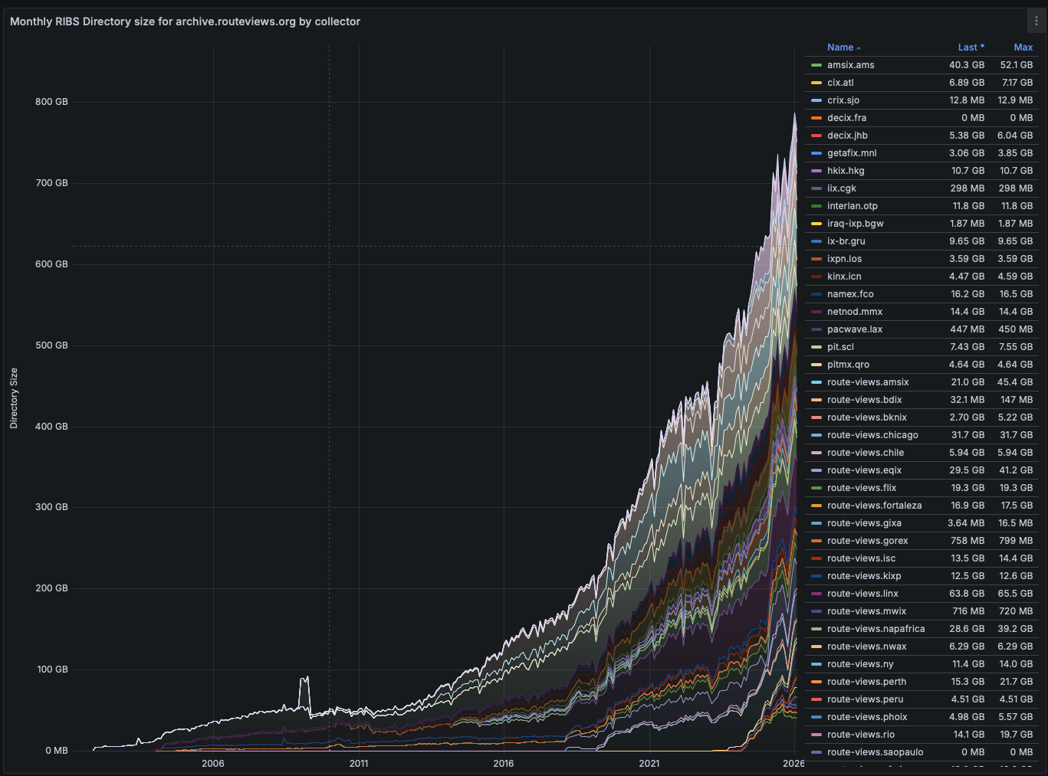
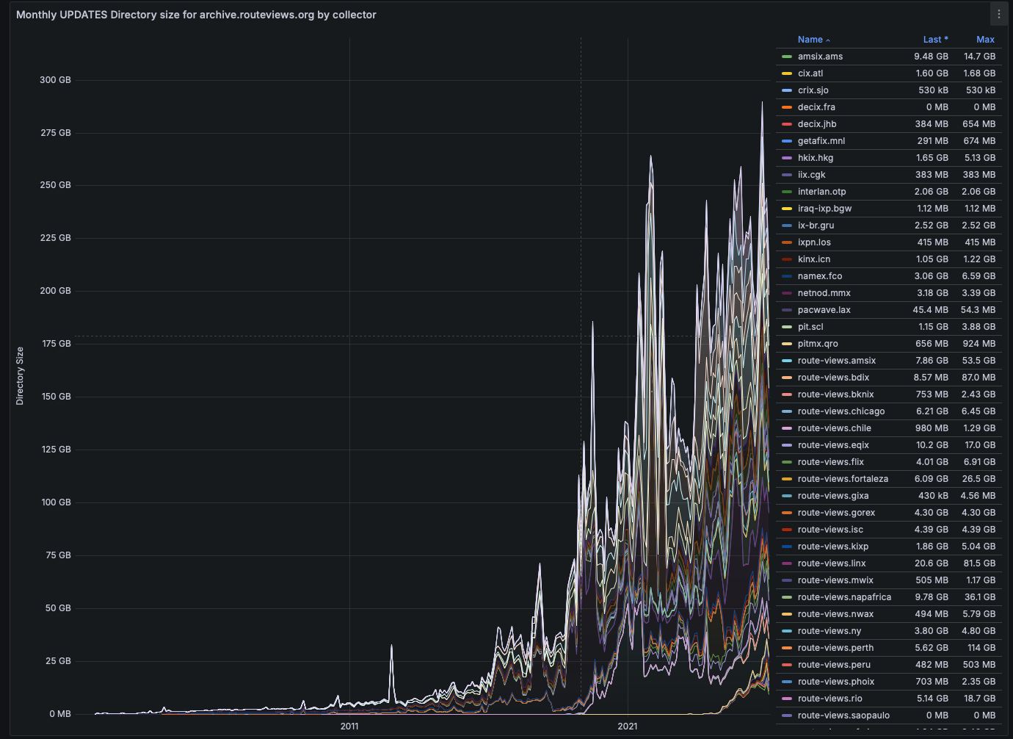
Noisy Peer Identification
We’ve been slowly getting better at Noisy Peer Identification, which helps reduce the noise in our archive

Slide 31
Noisy Peer Identification
We’ve built a relatively simple system which is currently called ‘Stampede’
Utilizes our live streaming service (Kafka RAW BMP)
Does minute by minute analysis of 40 of our collectors
Finds Noisiest (per minute):
  Collectors
  Peers
  Prefixes (Announcements / Withdrawals)
  Single ASN in any ASPATH
  ASPATH ngrams
  Communities

Slide 32
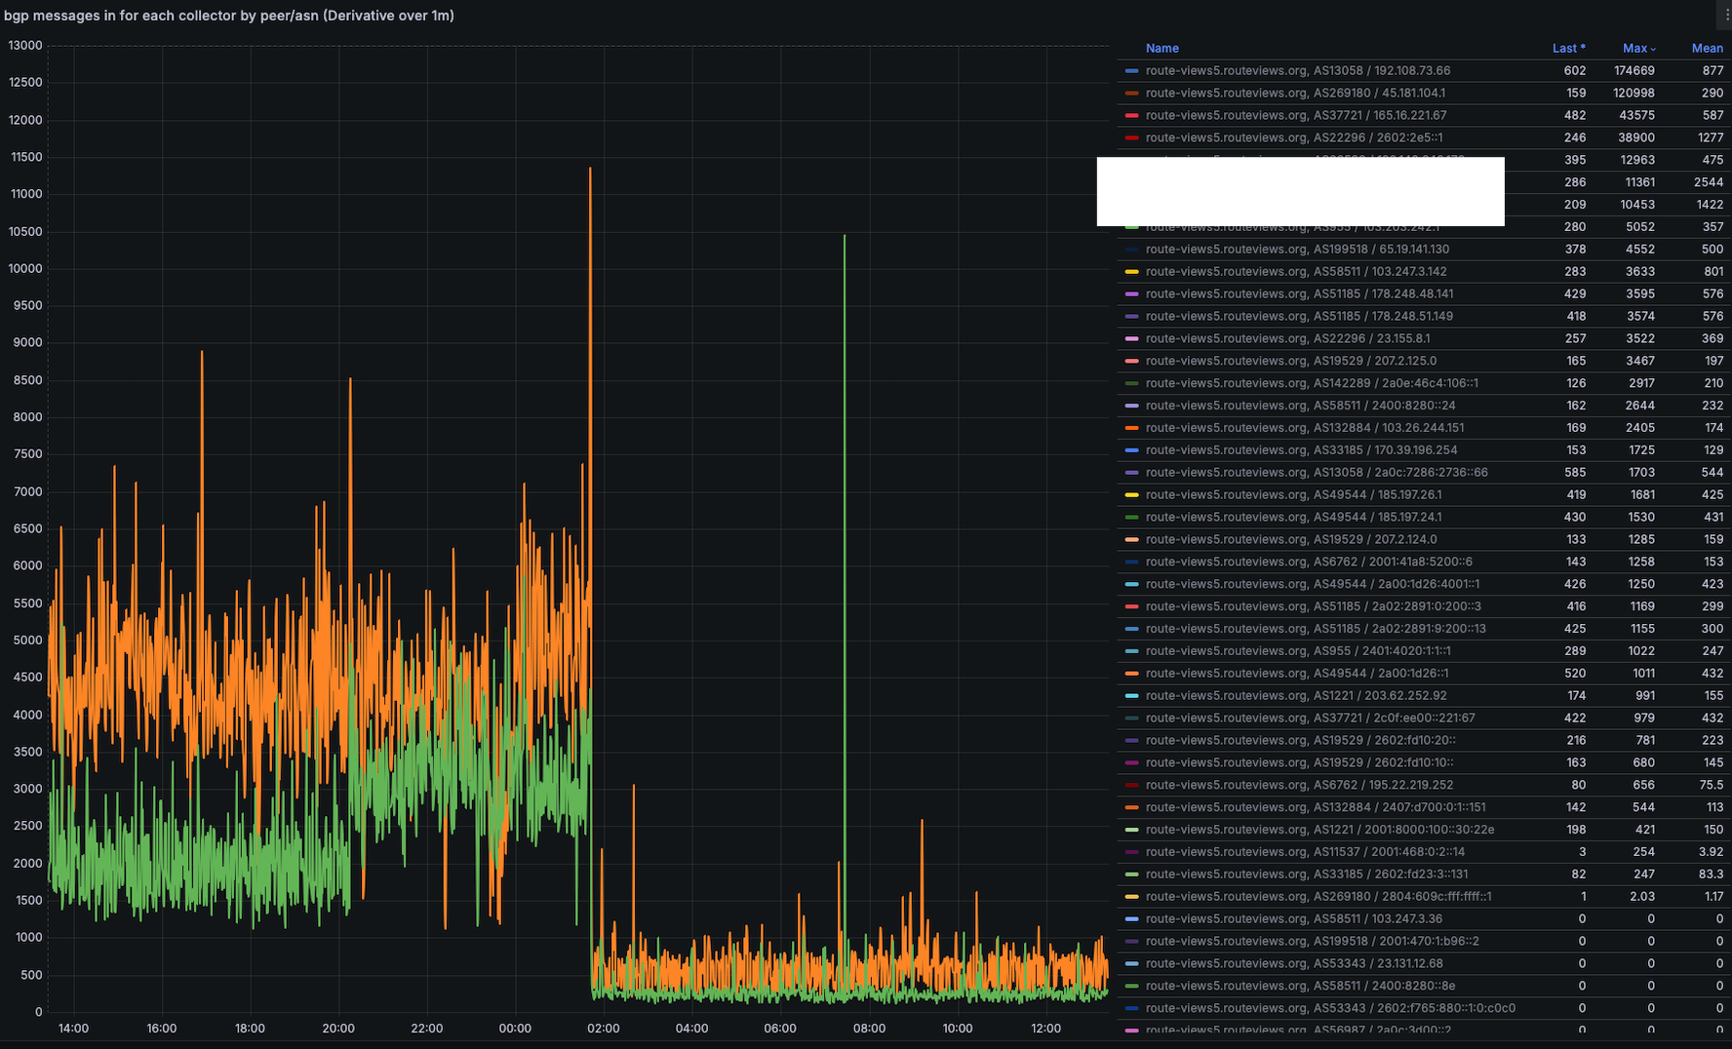
Noisy Peer Identification
This and our existing monitoring helps us find noisy peers and work with them to understand what is happening and in some cases we’ve seen real reductions

Slide 33
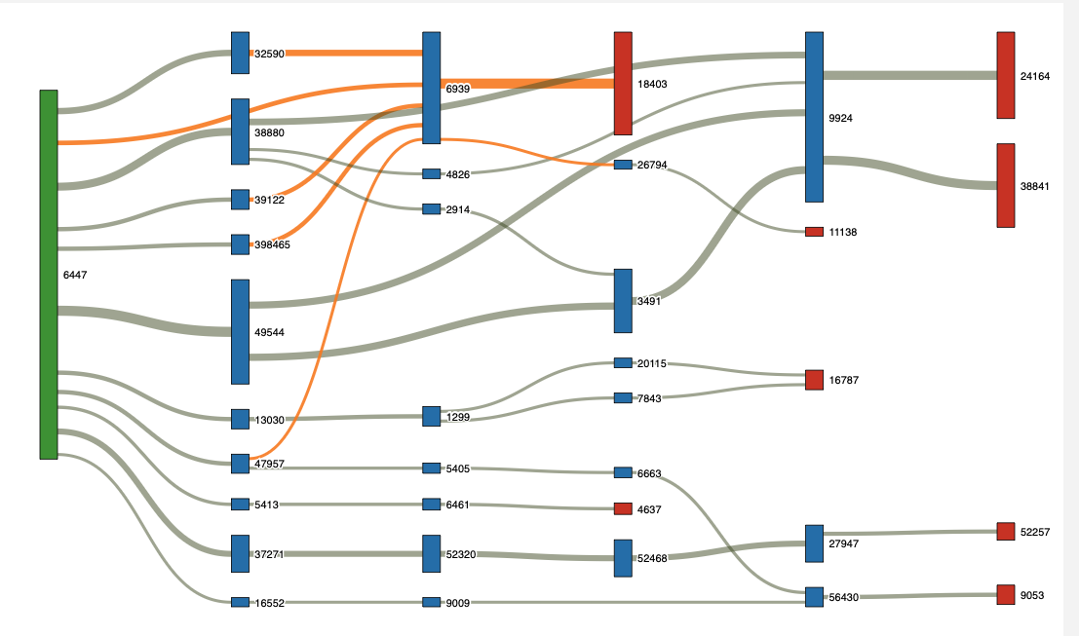
Noisy Peer Identification
We’ve also started using the minute by minute data for some Sankey Visualization to identify noise that originates downstream of us in order to assist peers in tracking down potential noise

Slide 34

Thank you!

